Slide 1
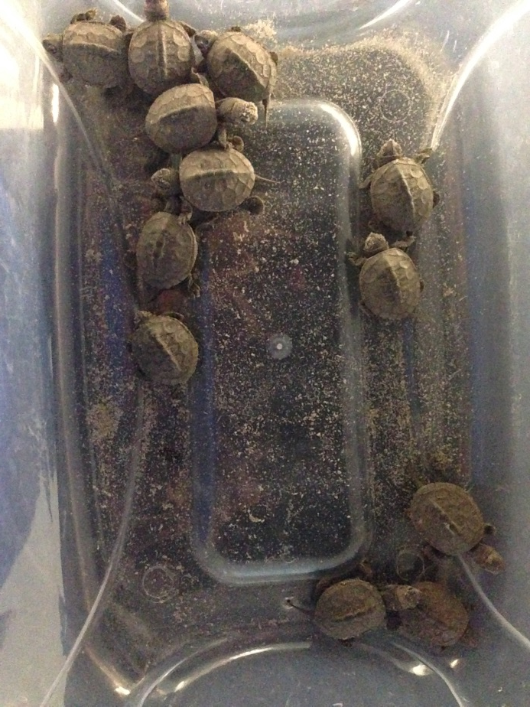
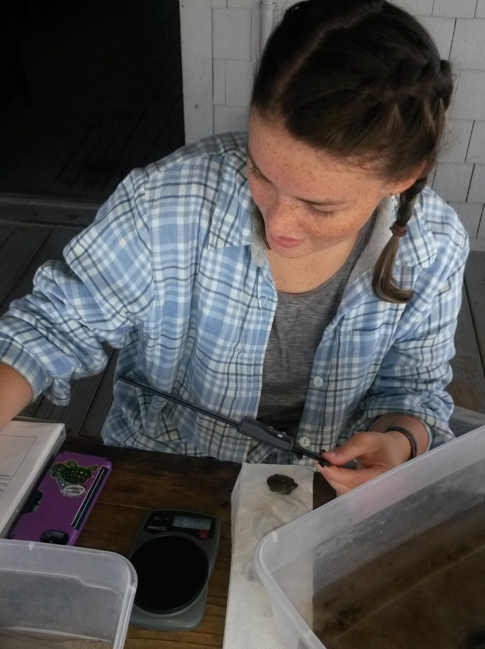
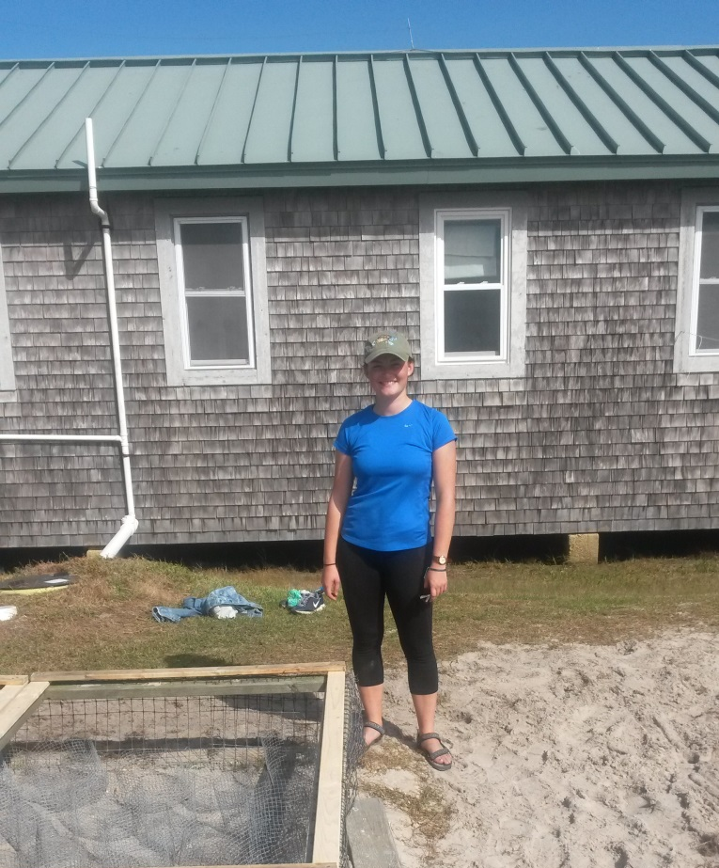
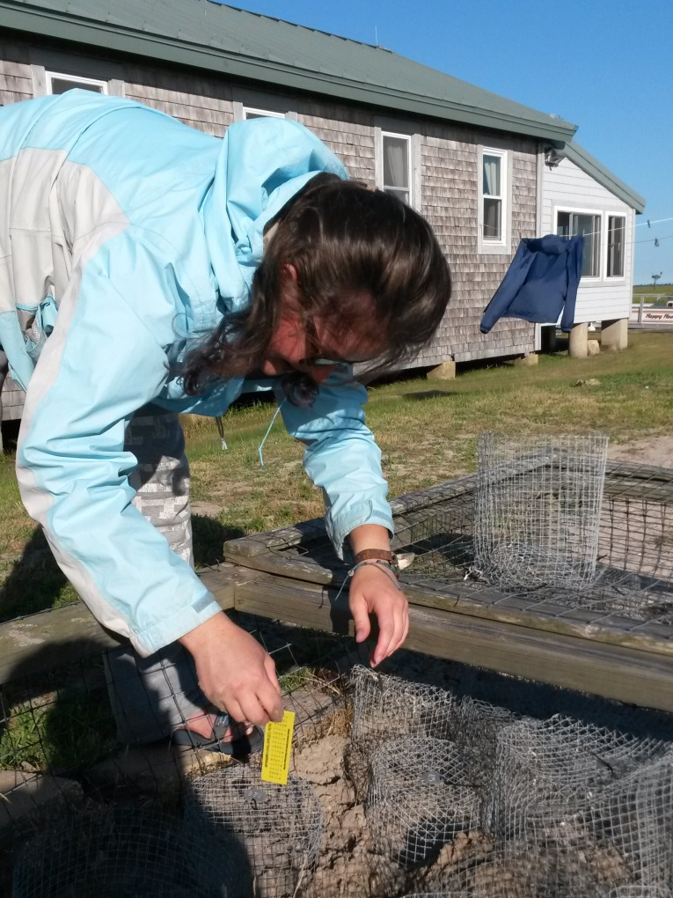
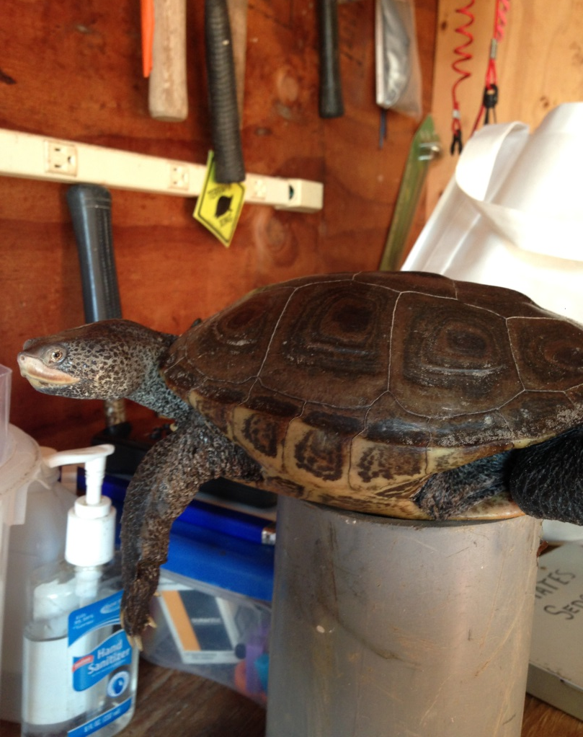
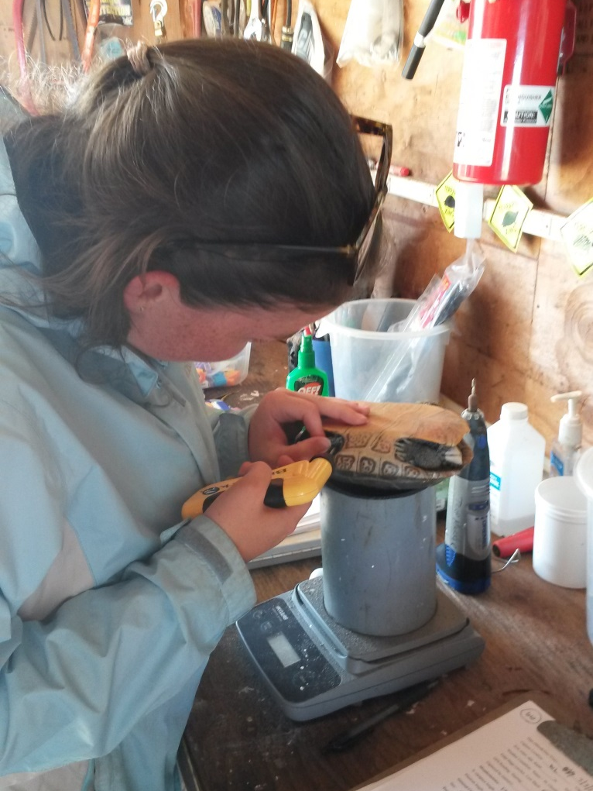
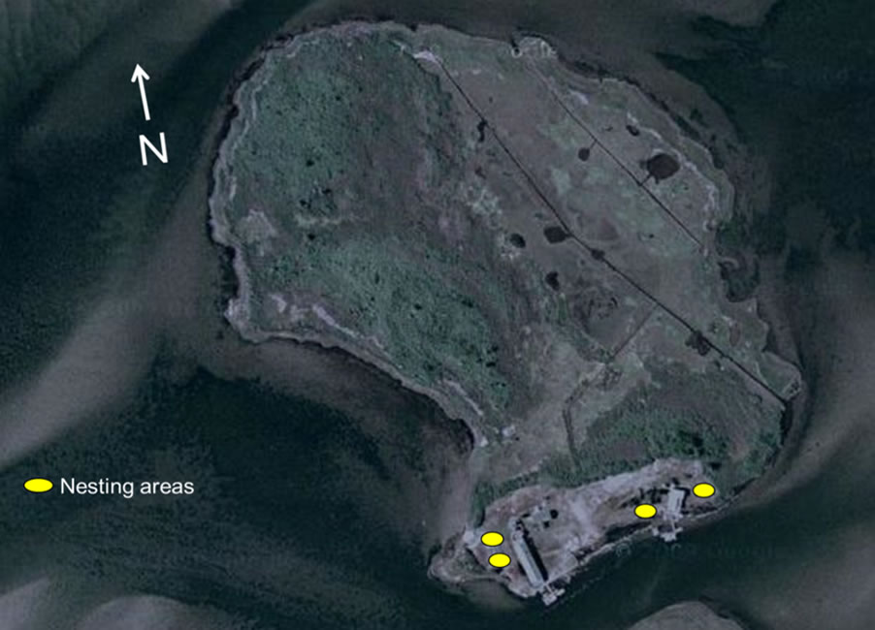
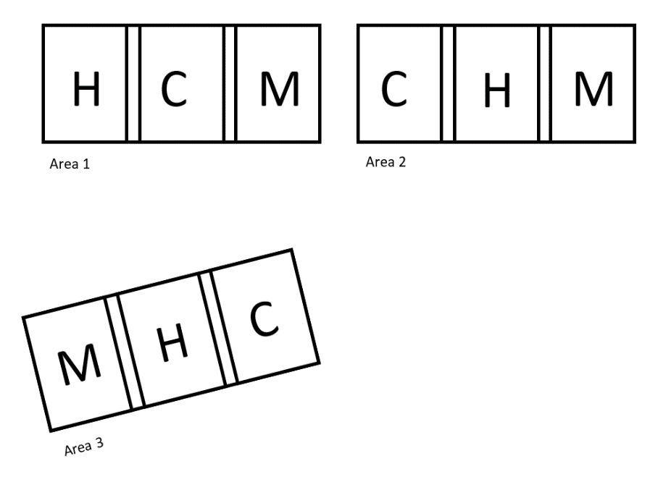
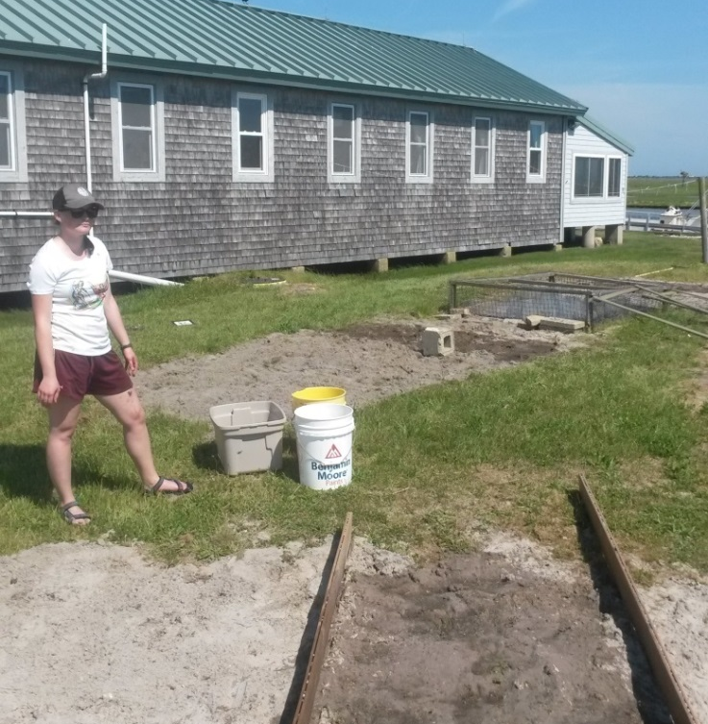
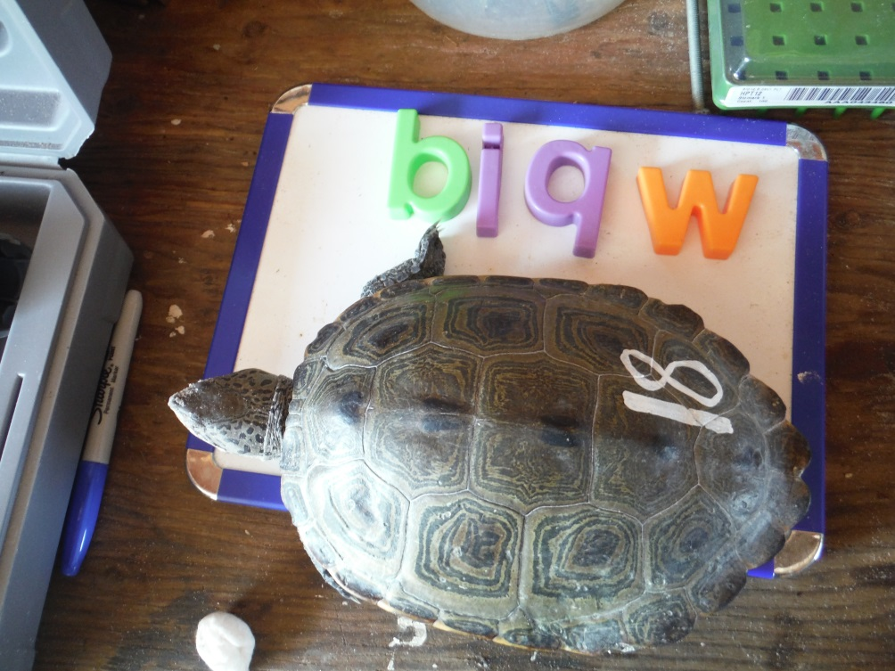
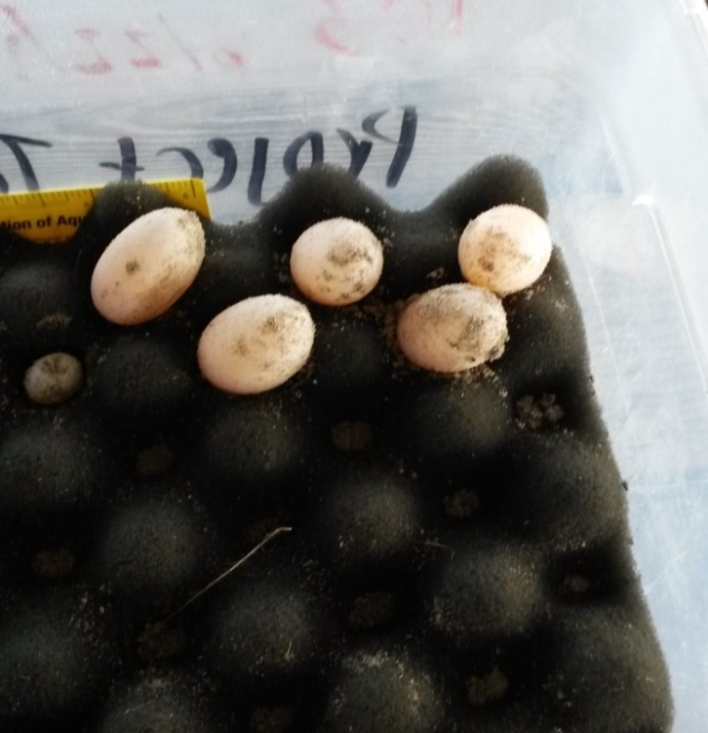
Reproductive output trends and effect of soil conductivity on nest site selection of Malaclemys terrapin in Barnegat Bay, NJ
Sidney Anderson^{1,2} and John Wnek¹
¹Project Terrapin, MATES, Manahawkin, NJ
²College of the Atlantic, Bar Harbor, ME
Abstract
Objective
Discussion
Nesting diamondback terrapins (Malaclemys terrapin) access estuary beach areas from early May to mid-July. With sea level rise estimates, available nest sites will be inundated with sea water. If they nest early enough, some females return to lay a second nest late in the season. During the 2017 season, Sedge Island in Barnegat Bay was used as a study site to evaluate ecological characteristics of the northern diamondback terrapin, such as nest site selection and reproductive output. To test if soil conductivity had an effect on nest site selection, three plots were separated into three sections each treated with either bay water (with an average conductance of 3444 μs), a bay and rain water mix (with an average conductance of 2485 μs), or not treated and considered a control. Nesting female terrapins were measured and clutches were analyzed for egg mass (g), length (mm), and width (mm). Nests from females that laid twice were compared and analyzed for trends. Data from 2015 and 2016 were used when analyzing the effects of soil conductivity on nest site selection, and reproductive output was correlated with female body size. Our results indicated that conductivity did not affect nest site selection, nor did female body size impact reproductive output.
To analyze reproductive output trends and determine the effect of soil conductivity on nest site selection of nesting female Northern diamondback terrapins on North Sedge Island.
Conductance
There is no statistical significance in nest site choice over the three years (Figure 1)
36% nested in control plots
35% nested in medium plots
28% nested in high plots
Sea-level rise may be detrimental to D. terrapin nests because eggs exposed to high conductivity soil or flooded by salt water will desiccate (Pike, Roznik, and Bell, 2015)
Reproductive Output
Plastron length did not significantly relate to mean egg mass
Each female that laid two nests lost weight between nests (Figure 2)
Nest mass was variable
Weight loss was variable, ranging from 6 g to 39 g
Mean egg mass did not significantly relate to mean hatchling mass
Methods
Field Protocol
Three plots on N. Sedge Island were further subdivided into three sections
Each section was treated with either bay water (average conductance of 3444 μs), bay-fresh water mix (average conductance of 2485 μs), or not treated
The treatment was performed at the beginning of the season and following each precipitation event
Chosen nest location was recorded and marked with a GPS waypoint
Females were captured, measured (cm), weighed (g), and marked prior to nesting and weighed following each nesting event
Carapace length, width, and height, and plastron length were recorded upon initial capture
Egg length, width, and mass was recorded after each event
Statistical analysis
An ANOVA test was performed to determined significance for three year site selection data (2015, 2016, 2017, P ≤ 0.05)
Regression test to determine strength of data
T-tests were used to compare weights following nesting events (P ≤ 0.05)
Hypothesis
It is hypothesized that females will choose soil with a lower conductivity and that female body size will have a positive correlation with mean egg mass.
Figure 1: Compound bar graph showing 3 years of nest site selection data. Though slightly more chose control, it was not statistically significant.
a
b
c
Processing hatchlings: Hatchlings from Sedge Island (Figure a), measuring and weighing hatchlings (Figure b), end-of-season nest site and hatchery maintenance (Figure c).
Introduction
Conclusion
Northern Diamondback Terrapin (Malaclemys terrapin terrapin)
a brackish water turtle with a life span of 25-40 years (DEEP, 2015), (CWF)
Females choose sandy areas for nesting from May to July
Site fidelity – females tend to return to the same nesting site each year (Feinberg and Burke, 2003)
Construction of barriers, like bulkheads, reduces available nesting sites (Winters 2013)
If a female nests early in the season, she may lay a second nest later
Predicted sea-level rise will inundate nest areas with salt water
Incubation in soil too salty results in failed eggs (Wnek et al., 2013)
Egg mass range (EMR) gives an indication of female health and energetic investment in egg development (Roosenberg and Dennis, 2006)
Variable EMR from nest to nest may indicate different energetic or resource investment in eggs
Results
Conductance
The high plot conductance ranged from 322 µs to 5060 µs
The medium plot conductance ranged from 1568 µs to 3879 µs
The control plot conductance ranged from 118 µs to 610 µs
ANOVA, P > 0.05
Reproductive Output
Mean egg mass ranged from 4.6 g to 9.5 g
Median egg mass ranged from 4.7 g to 9.9 g
The difference between first and second nest mass ranged from 3.3 g to 25.7 g
Soil conductivity did not affect nest site selection
Female body size does not impact reproductive output
Females lose mass between nesting events
Figure 2: Female mass after each nesting event. There is a positive trend showing that each female lost weight between nesting events; although, the weight loss was not consistent among females.
d
e
f
Field work on Sedge Island: Placing eggs in the hatchery (Figure d), weighing a nesting female (Figure e), and PIT-tagging a new capture (Figure f).
Acknowledgements
I would like to thank my advisor, Dr. John Wnek, the staff at Sedge Island, and the internship committee at College of the Atlantic for their guidance, assistance with transportation to and from the island, and support throughout the summer.
A
B
Figure 3 a and b: Temperature trend data from nests in 2016 (a) and 2017(b). The dashed line marks 29.5°C, the pivotal temperature for embryo gender development in terrapins. Nests that do not frequently reach 29.5°C have a lower chance of producing female hatchlings.
Figures A and B:Aerial view of N. Sedge Island (A), yellow marks indicate nesting areas. 2016 plot treatments (Gundermann, 2017) which 2017 plot treatments were based on.
References
Gundermann, K. The effect of soil conductivity on nest site selection in diamondback terrapins. 2016.
New Jersey Endangered and Threatened Species Field Guide. Conserve Wildlife Foundation of New Jersey. 2017.
Northern Diamondback Terrapin. Department of Energy and Environmental Protection. Sept. 30, 2015.
Pike, D.A., Roznick, E. A., Bell, I. Nest inundation from sea-level rise threatens sea turtle population viability. R. Soc. Open sci. 2: 150127.
Roosenberg, W.M., Dennis, T. Egg Component Comparisons within and among Clutches of the Diamondback Terrapin, Malaclemys terrapin. Copeia , vol. 2005, num. 2, 2005.
C
D
E
Field work on Sedge Island: Preparing and initial treatment of plots (Figure C), documentation of returning nesting female (Figure D), and a small nest during processing before placement in the hatchery (Figure E).
Figure 4: Scatter plot showing incubation period of each nest. The data trends toward a positive linear relationship and incubation time.
*Nest dug 5cm deeper than other nest laid same date, effecting incubation time.

