Slide 1
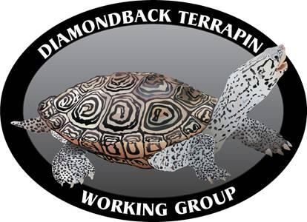
DEDICATED TO DIAMONDBACK TERRAPIN RESEARCH, CONSERVATION, MANAGEMENT AND EDUCATION

Slide 2
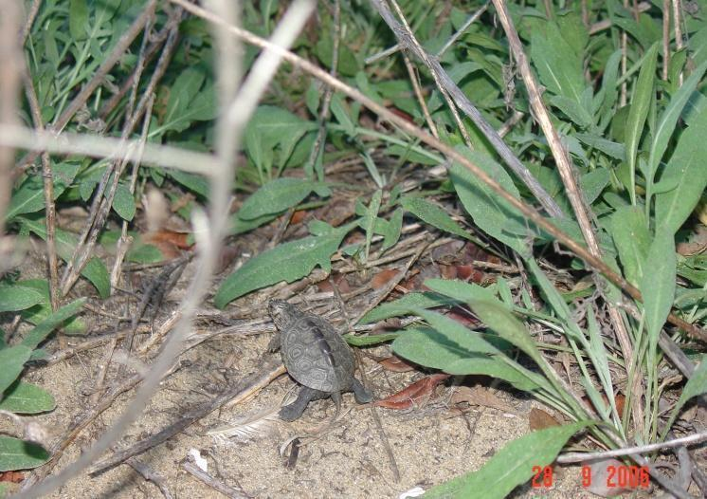
Diamondback Terrapin
Malaclemys terrapin
Notes:
Named for diamond shaped patterns on carapace
Terrapins are mostly noted for their signature smile or mustache like appearance
Malaclemys terrapin name from Greek and Native American meaning soft bodied turtle
Only turtle that tolerates fresh water, salt water and intermediates. Other turtles live in strictly freshwater or marine and tortoises live only on land.

Slide 3
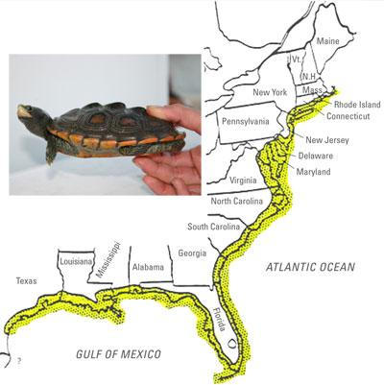
Diamondback Terrapin Distribution
Terrapins inhabit coastal waters from Massachusetts to Texas
Habitats: salt marshes & mangrove swamps
Notes:
Terrapins primary habitats are salt marsh through north and south regions & mangrove swamps in the Florida keys, more about habitats later.

Slide 4
Species Variation

Slide 5
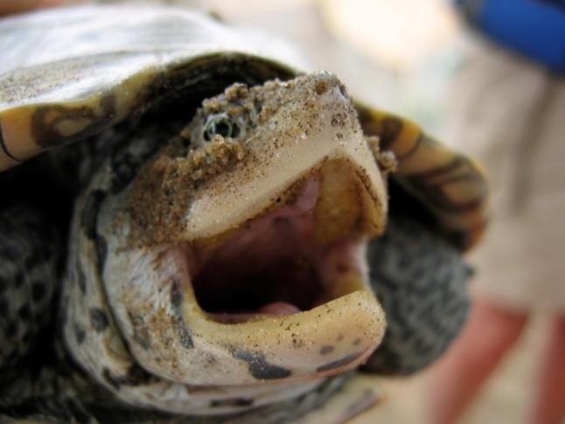
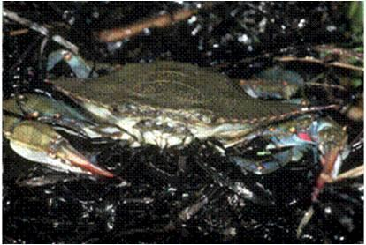
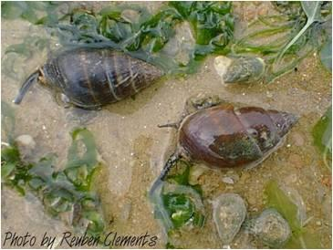
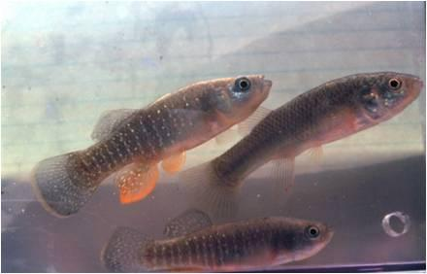
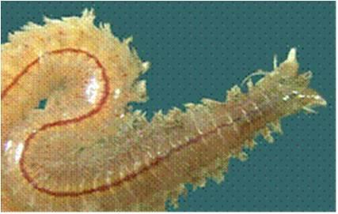
Estuarine Life History
Found in brackish water (mix of fresh and salt)
Sharp bony beak with no teeth for a diet that includes: snails, fish, mussels, crabs, worms, algae and other plant material
Notes:
Only North American terrapin that strictly lives in brackish water. Brackish water is where salt enters freshwater and mixes.
They do not have teeth so food is crushed with the terrapins strong jaw.

Slide 6
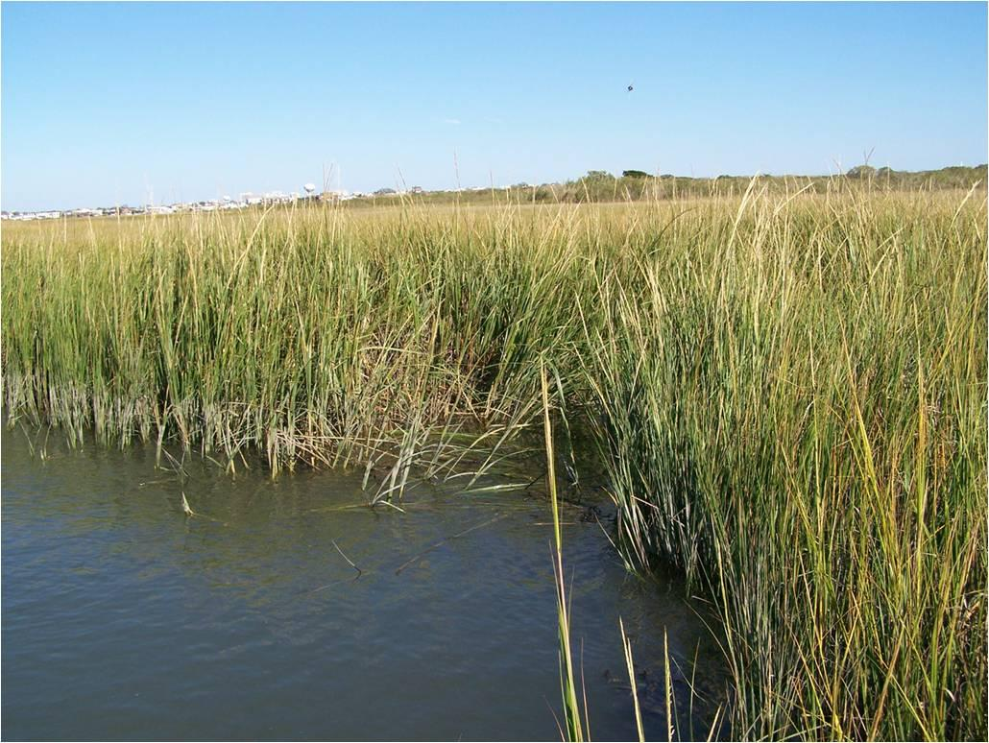
Habitat: Salt Marsh
Most terrapins live in salt marshes
Notes:
A salt marsh is predominantly covered with cordgrass, Spartina alterniflora.
This plant species plays an important part of a terrapins food cycle. Once the plant dies, microscopic organisms consume the grass to detritus. Then crabs, mussels, and other invertebrates consume the detritus that in turn later become food for terrapins.
This makes terrapins top consumers in this ecosystem. However, without the existence of salt marshes and cordgrass, the ecosystem and food cycle will no longer corporate.

Slide 7
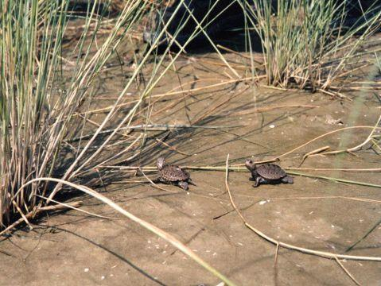
Habitat: Salt Marsh
Hatchlings moving in a salt marsh
Notes:
These two hatchlings are moving in the saltmarsh. Notice the patches of cordgrass

Slide 8
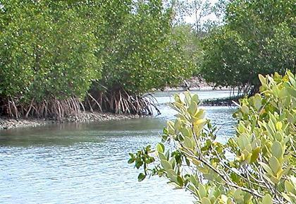
Habitat: Mangrove
Terrapins can also be found in mangrove swamps
Notes:
A mangrove swamp is a subtropical and tropical environment that is mostly dominated by Mangrove trees and other halophytic trees and shrubs.
Most mangrove swamps are found in the southern tip of Florida, but can also be seen through Louisiana and Texas.

Slide 9
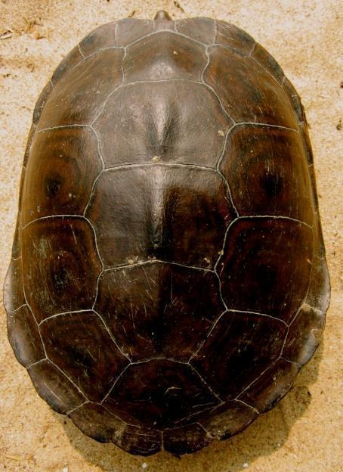
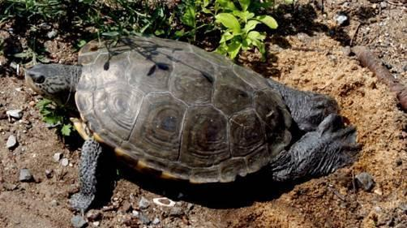
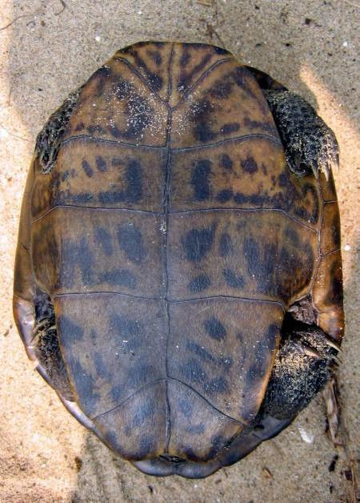
Morphology & Physiology
Adapted for water and land:
  Shells streamlined for swimming
  Webbed feet for swimming and nest digging
  Nails for digging into sand or mud
Carapace
Plastron
Feet and Nails
Notes:
All terrapins have hingeless shells, therefore they can not retract into their shell like other turtles.
The carapace and plastron serve as a protective armor and structure like an external skeleton
The carapace is made up of scutes, or plates around the terrapins shell. Each scute grows outward in direction and can sometimes tell the age of the terrapin. By counting the rings in each scute, you can estimate how old a terrapin is. This is very similar to counting tree rings.

Slide 10
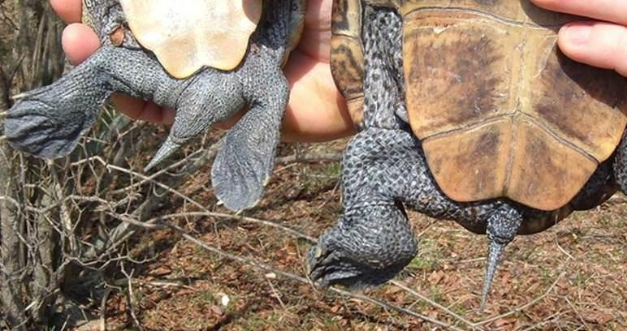
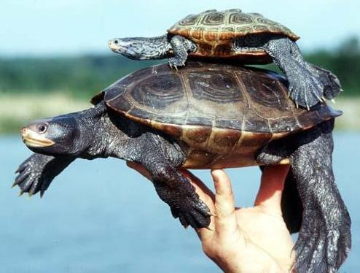
Sexual Dimorphism
MALES
Average length: 6 inches
(15 cm)
Reach sexual maturity at
3 - 7 years old
FEMALES
Average length: 9 inches (23 cm)
Reach sexual maturity at 7 - 11
years old
Notes:
Male and female terrapins show sexual dimorphism. Sexual Dimorphism is when one sex (male or female) is extremely different looking for the other sex.
For terrapins, females are much larger, having larger heads and flat plastron. Males are smaller in size and have convex plastrons which fits with the females flat plastron during copulation.
yellowfin.dnr.sc.gov/.../Malaclemysterrapin.html

Slide 11
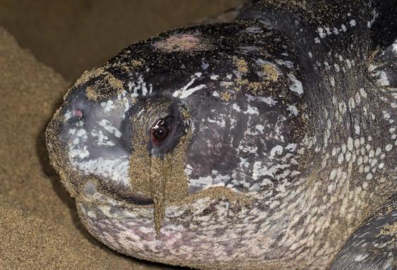
Adaptations to Saline Environments
Terrapins "Osmoregulate": regulate % salt in their bodies
Salt glands in the corner of eyes to secrete salt "tears" (lachrymal gland)
Example of salt being extruded through a salt gland in a nesting sea turtle
Notes:
Terrapins are the only freshwater turtle that can tolerate fluctuating salinity for long periods. P. 26 Diamonds
Terrapins have the ability to drink freshwater or rainfall off the surface of the water.
Link for picture http://www.arkive.org/species/GES/reptiles/Dermochelys_coriacea/more_still_images.html

Slide 12
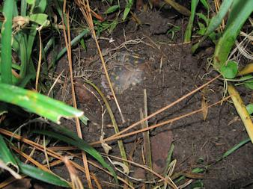
Brumation
Winter period of reduced activity
Notes:
Hibernation or Brumate( winter months) and Aestivation (summer months for dry heat) are two ways of conserving energy. Fat storage is needed before this process begins.
At lower temperatures, terrapins enter a state of Torpor – a low metabolic rate, an inactive state of being.
1. Terrapins must fast to eliminate bacteria growth in their body
2. They must find an overwintering location usually in creeks or borrowed under mud
3. Must maintain a dormant state
Have a low metabolic rate in order to conserve energy
Terrapins are freeze tolerant. They are capable of converting some of their body’s water to ice and remain frozen for throughout the cold months. It is still uncertain how terrapins can accomplish this.
Picture http://turtle_tails.tripod.com/raisingbabyturtles/rbt11_10.JPG

Slide 13
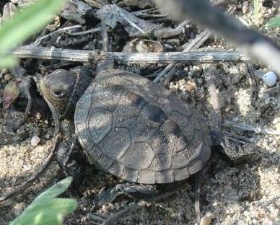
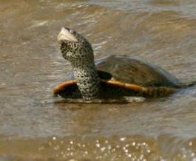
Terrapin Life Cycle: Adult
Adult
Hatchling
Summer
Females lay eggs
on land and return
to water
Fall
Adults burrow in the mud
Fall
hatchlings
emerge
Find
wintering
location on
land or water
Spring
Mating occurs
In the water
Overwinters
Hatchlings emerge in
spring and enter water
Notes:
Adult Terrapin Life Cycle
In the fall adult terrapins prepare for the colder temperatures of winter by burrowing in the mud.
Once it is warm enough, terrapins are active in the water, in spring they will mate in the water.
During the summer, females search for an area to nest on land, then they return to the water.

Slide 14
Terrapin Life Cycle: Hatchling
Adult
Hatchling
Summer
Females lay eggs
on land and return
to water
Fall
Adults burrow in the mud
Find
wintering
location on
land or water
Fall
hatchlings
emerge
Spring
Mating occurs
In the water
Overwinters
hatchlings emerge in spring and enter the water
Notes:
Hatchling Terrapin Life Cycle:
Hatchlings that emerge in the fall either overwinter on land or in the water
In the spring overwintering turtles emerge and then enter the water

Slide 15
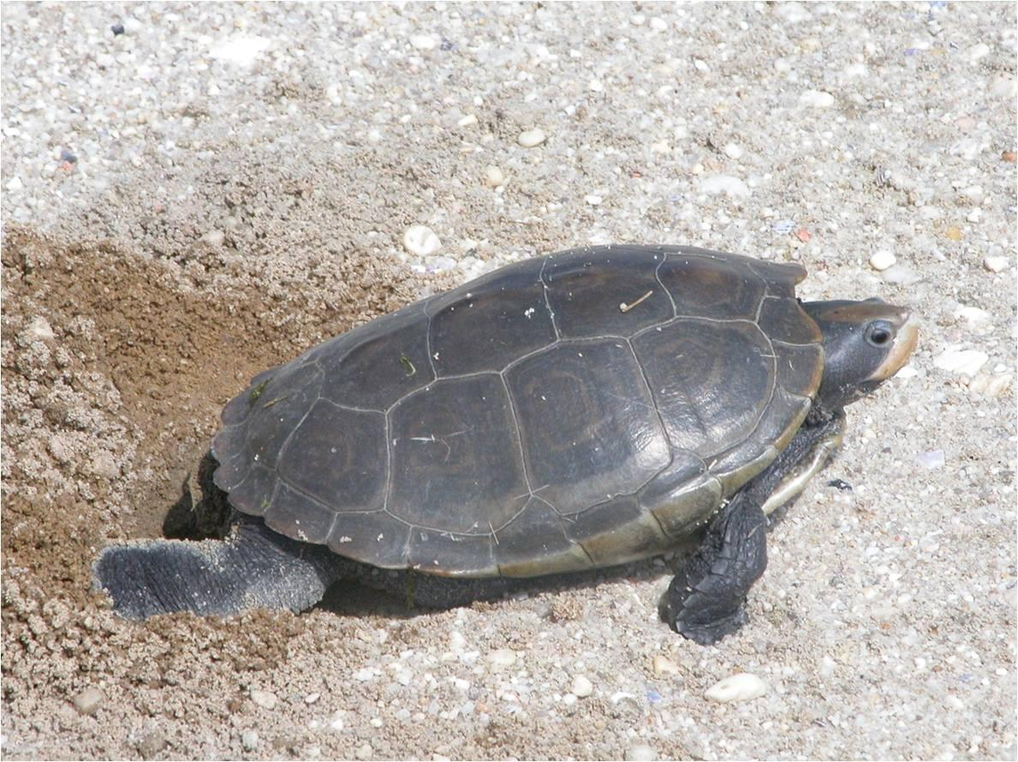
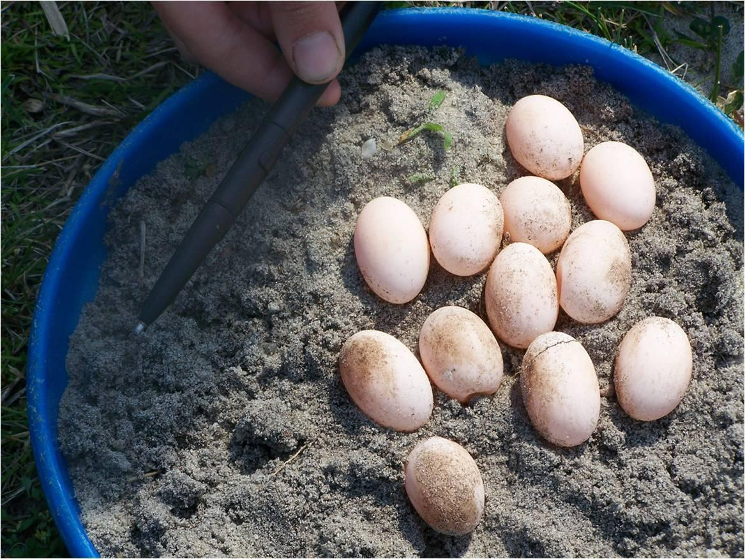
Reproduction
Females can store sperm for years
2 - 22 eggs per clutch (location dependent)
Up to 3 clutches per season
Notes:
The number off eggs a terrapin can lay in one single event is called a Clutch. Several clutches are possible per female in one nesting season with a 14 – 17 grace period of fertilization. Two or three clutches is common per nesting season.
http://www.nrdc.org/water/conservation/hbyear/hbjun.asp
Females can store sperm for the advantage of producing more than one clutch in one season with out multiple mating.
Terrapins are very particular about their nesting location. Several attempts on land can be made before a female will lay a clutch of eggs p 80- 100 etc…
Females can choose sandy or unrooted substrate when choosing a nest but other terrain could also be possible; dirt, rocks, or shells.
Females dig their nose into the sand before they lay their eggs to make sure they picked a good nesting location
http://www.wetlandsinstitute.org/education/teacher/Turtle_Talk.pdf

Slide 16
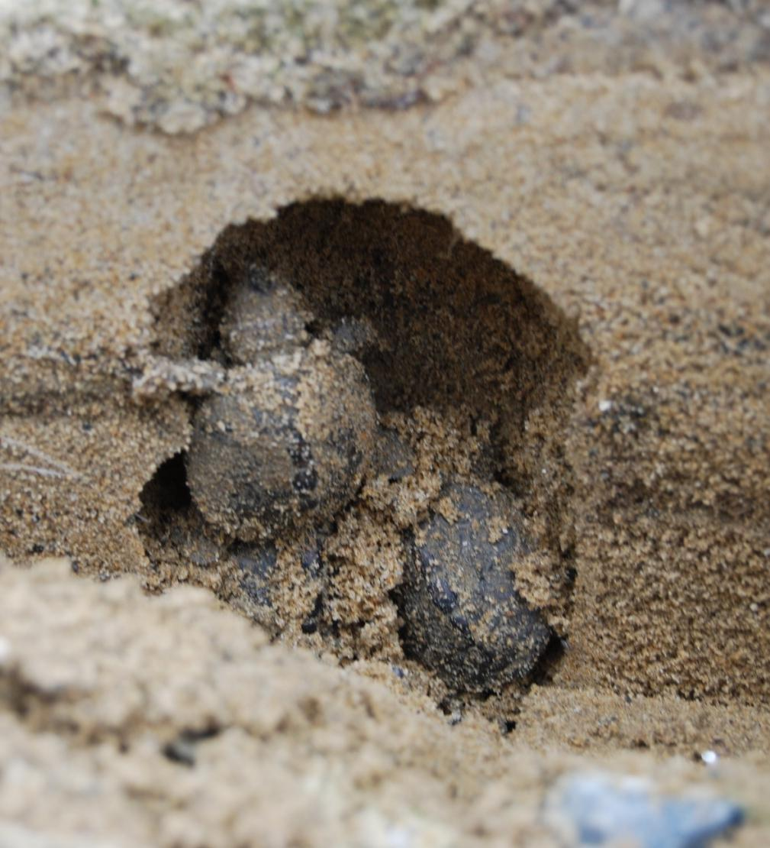
Nesting
Nesting
Season April – August (location dependent)
Nest flask-shaped and 5 - 11 inches deep
Usually around 30 minutes to complete nesting

Slide 17
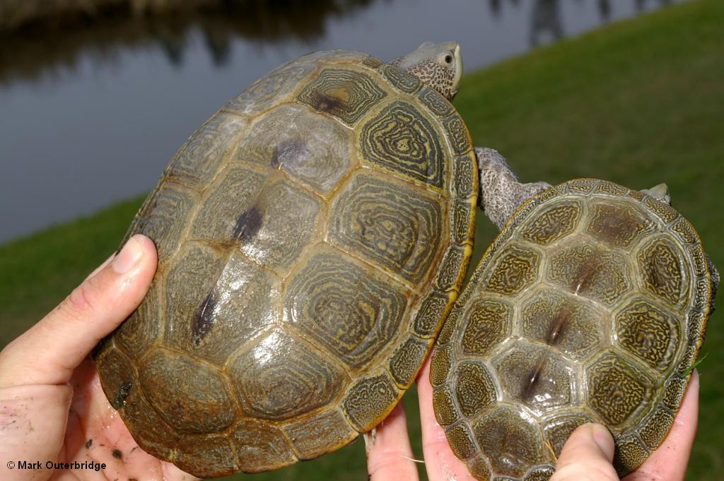
Incubation
Temperature-Dependent Sex Determination (TSD)
Warmer temps: 90ºF, 32ºC produce females
Cooler temps: 82ºF, 28ºC produce males
Average incubation period: 60 - 90 days
Notes:
Temperature-Dependent Sex Determination (TSD) is a different strategy than mammalian genetics. Terrapins do not have the typical X and Y chromosomes. The incubation temperature of the nest determines the sex ration of hatchlings. At warmer temperatures, females are produced whereas at cooler temperatures males are produces.
There are several factors that influence nest temperature. Some include the weather temperatures (if it is a hot and dry summer vs. a cool and wet summer), ground temperature, nest depth, humidity, or nest substrate.

Slide 18
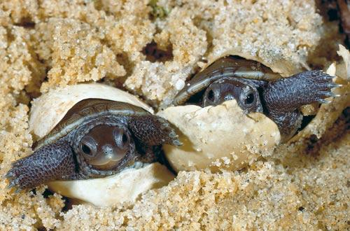
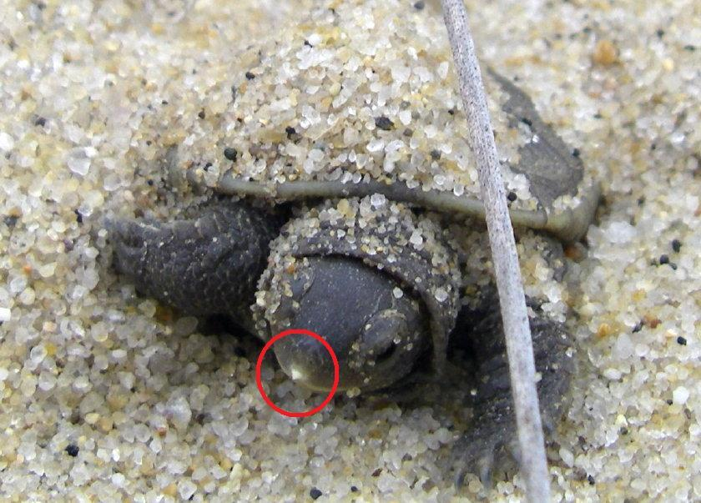
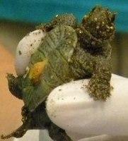
Hatchlings
Emerge in fall and spring
Egg tooth used to break out of shell
Able to live off reserves for 2+ weeks
Notes:
It is impossible to determine the difference between a male and female hatchling. Because of their size and lack of unspecific features that are seen in the adults, all living hatchlings can not be sexed.
Egg yolk sacs serve as a the hatchlings food source providing important nutrients for the first two weeks of a hatchling life. This sac is located on the hatchlings plastron.
The egg tooth is made up of Keratin, a fibrous material just like your fingernails, that will eventually fall off

Slide 19
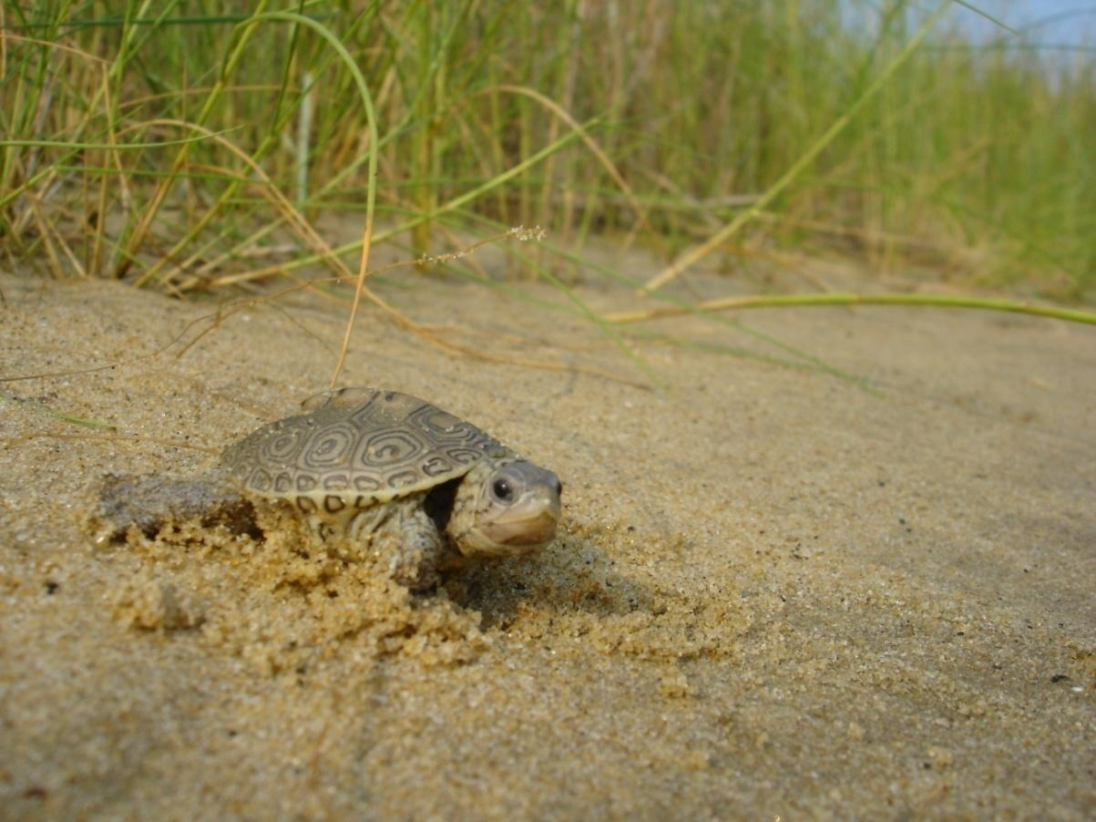
The “Missing Years"
After emergence, hatchlings spend time in salt marsh habitats and become difficult to observe
Notes:
Once hatchling enter the water, it is very unlikely they will come out until they have reached sexual maturity

Slide 20
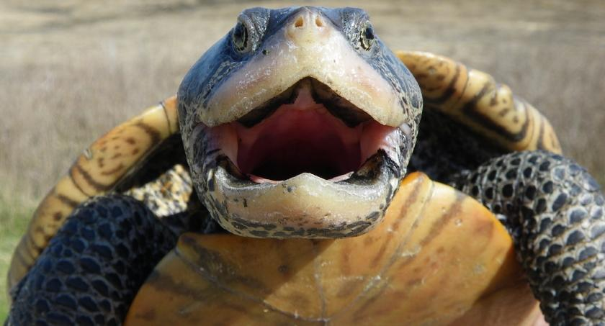
Conservation Efforts
Currently, there is no federal protection for the Diamondback Terrapin, however, each state has its own protection

Slide 21
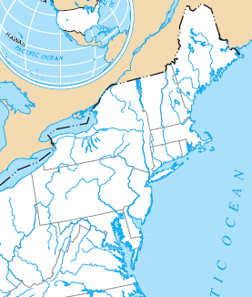
Legal Status Per Region
Northeastern Region:
MA: Threatened
RI: Endangered
CT: State regulated
NY: State regulated
Mid-Atlantic Region:
NJ: Species of Concern
DE: Species of Concern
MD: State regulated
VA: Species of Concern
Notes:
Currently there is no federal designation for the diamondback terrapin. However, it is considered endangered by the state of Rhode Island, threatened in Massachusetts and a species of concern in several other states.
State regulation permits what is allowable for taking. For more information, check with your states Department of Natural Resources

Slide 22
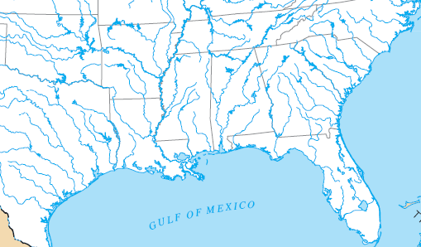
Legal Status Per Region
Southeastern Region:
NC: Special Concern
SC: No listing
GA: Special Concern
Florida Region: No listing
Gulf Coast Region:
AL: Special Concern
MS: Special Concern
LA: Special Concern & Game Animal
TX: No listing
Notes:
South Carolina, Florida and Texas currently carry no listing or designation.
State regulation permits what is allowable for taking. For more information, check with your states Department of Natural Resources

Slide 23
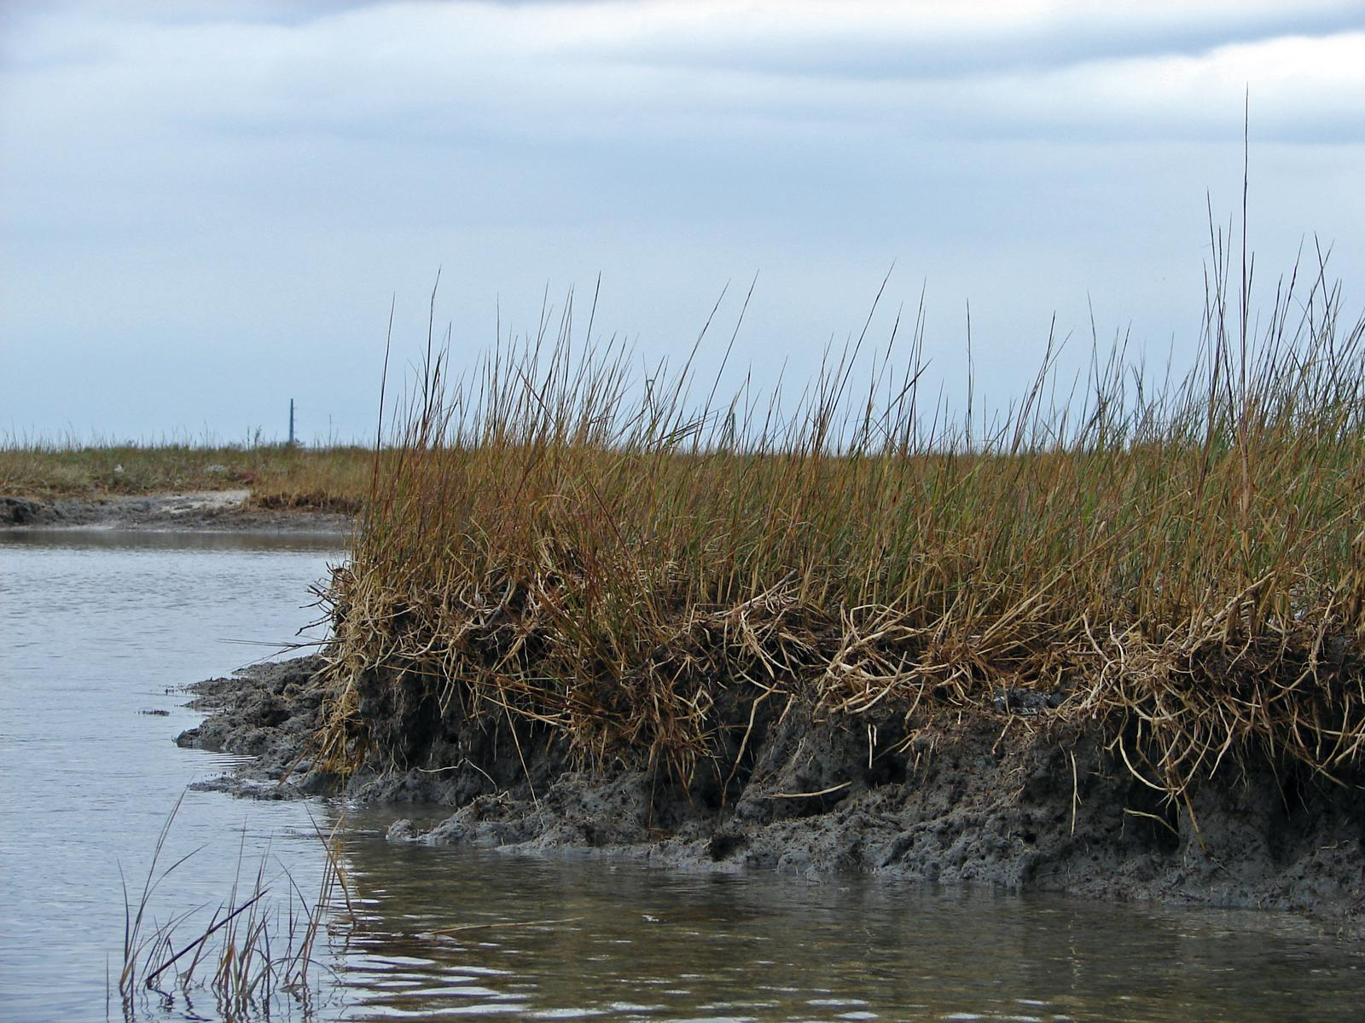
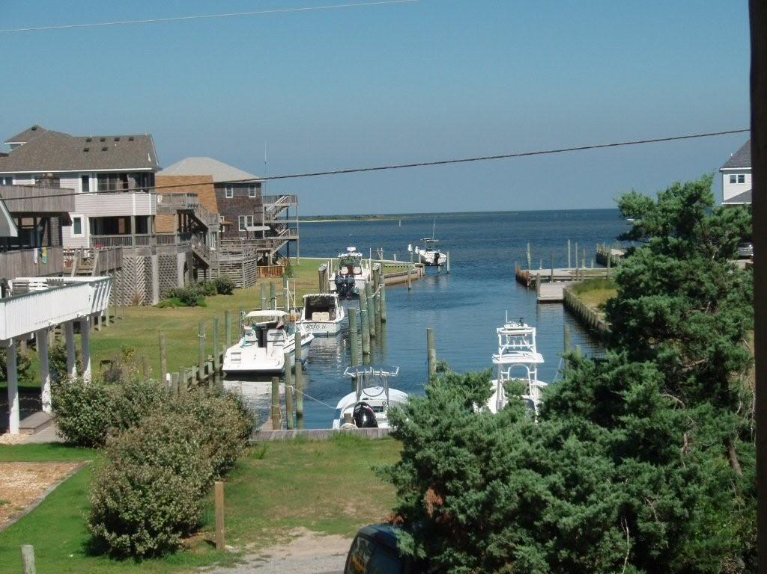
Anthropogenic Threats
Human development around marshes can cause habitat erosion and can eliminate nesting areas.
Notes:
Erosion, development, and bulk heading can reduce, fragment, or eliminate nesting locations.
The loss in salt marsh habitat is the number one threat to terrapins. The loss can be directly related to the decline in terrapin populations. Because salt marshes serve as primary habitat source for terrapins, without their locale, the terrapin population could also diminish.
Another threat to terrapin populations is erosion. If a highly elevated slope is present, females will have a hard time climbing the slope which restricts them from laying their eggs in prime nesting locations. As a result poor habitat selection will be made which does not guarantee the best hatchling success. Females are often forced to lay their eggs in unfamiliar substrate.
Blue crabs and terrapins share a very similar home range
By catch in commercial and recreational Blue claw crab traps are a major threat to terrapins, bait used in crab traps also attract terrapins leading to entrapment
Traps that are abandoned or that become loose from their moorings are considered ghost traps and are responsible for terrapin deaths by drowning
Some states limit the number of traps fishermen use or the depth at which the trap is set.
Also some states require Turtle Excluder Devices, or By-Catch Reduction devices on crab traps. TED’s limit the size of the entrance funnel, crabs can still enter but larger turtles are restricted. Capture of older, larger females is reduced however, smaller males and juveniles are still at risk.
http://intraweb.stockton.edu/ccrp/description.html
http://www.terrapinconservation.org/articles.htm
When a females leaves the water in search of location of a nest, they often cross roads and become victims of car strikes.
http://www.jekyllislandauthority.org/turtlecenter/diamondbackterrapins.htm pictures website
http://nytts.org/proceedings/wood-rdk.htm roadkill pic
http://dnr.wi.gov/org/land/er/herps/turtles/turtle1.htm turtle crossing pic

Slide 24
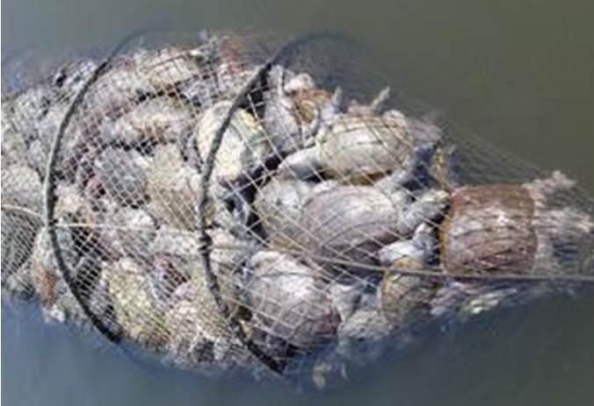
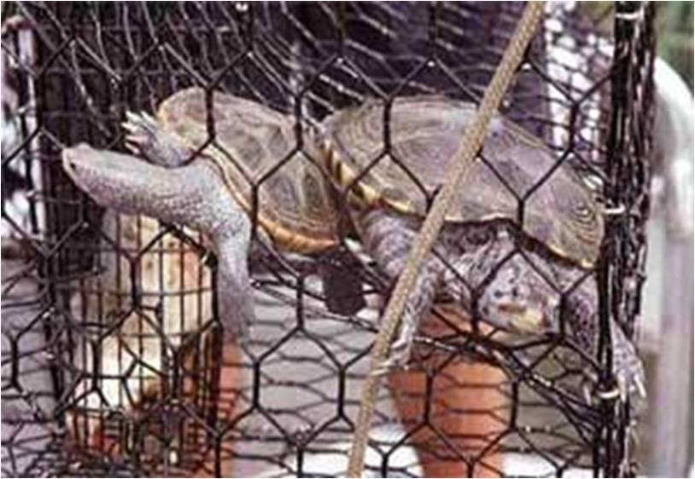
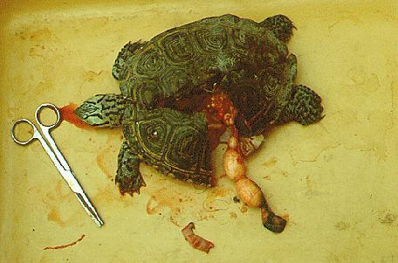
Anthropogenic Threats
Crab traps can cause drowning
Vehicular damage

Slide 25
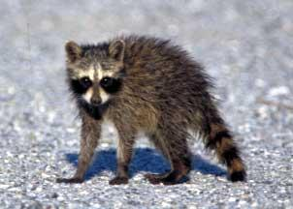
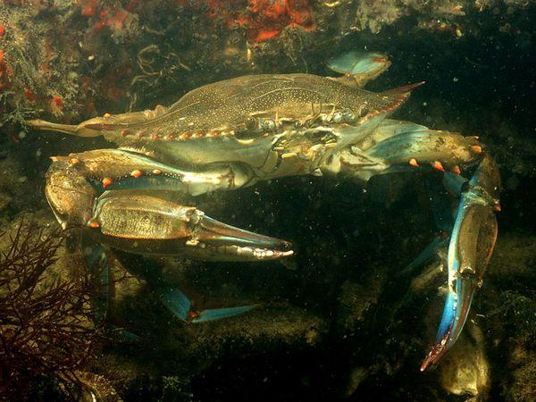
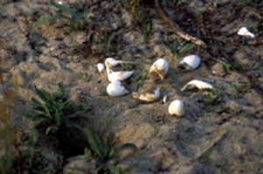
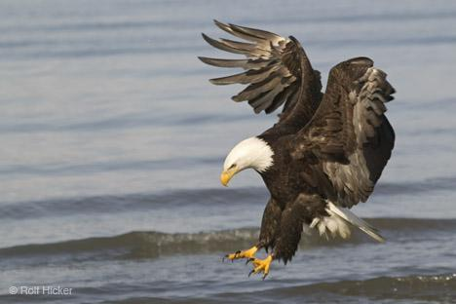
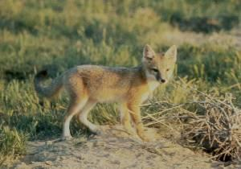
Natural Threats

Slide 26
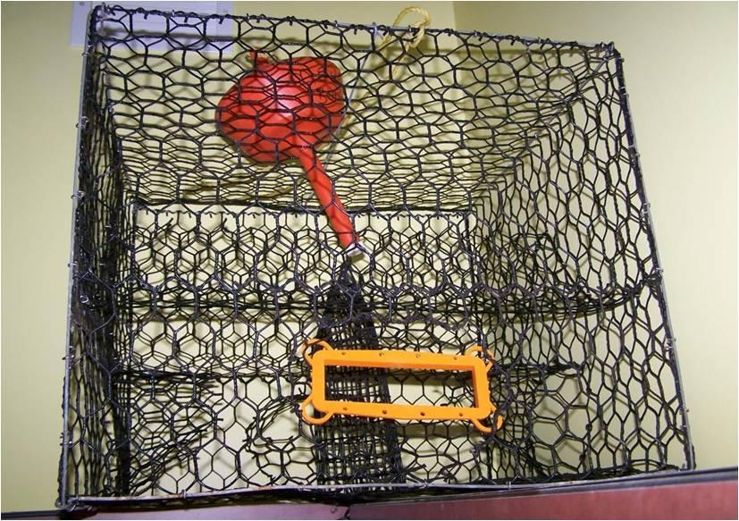
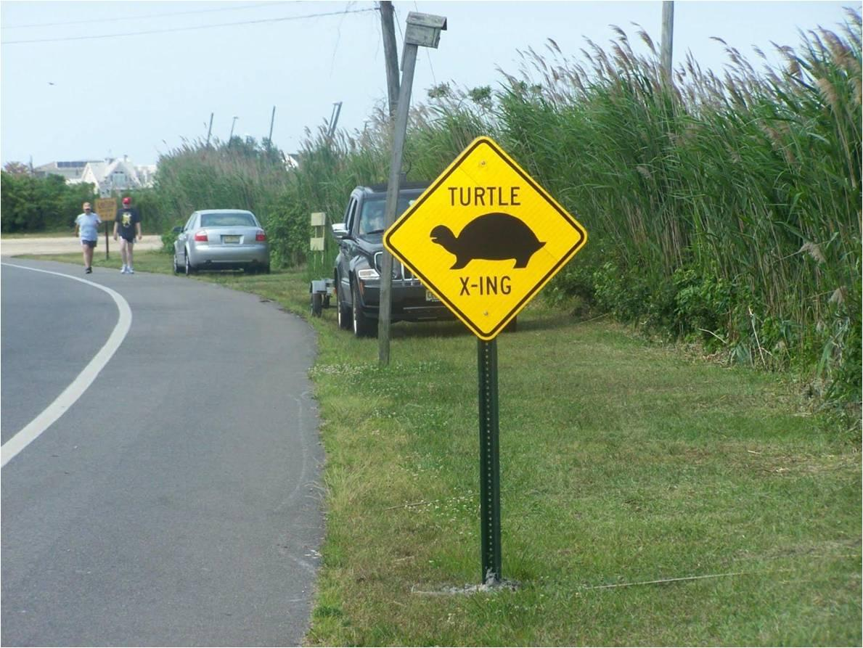
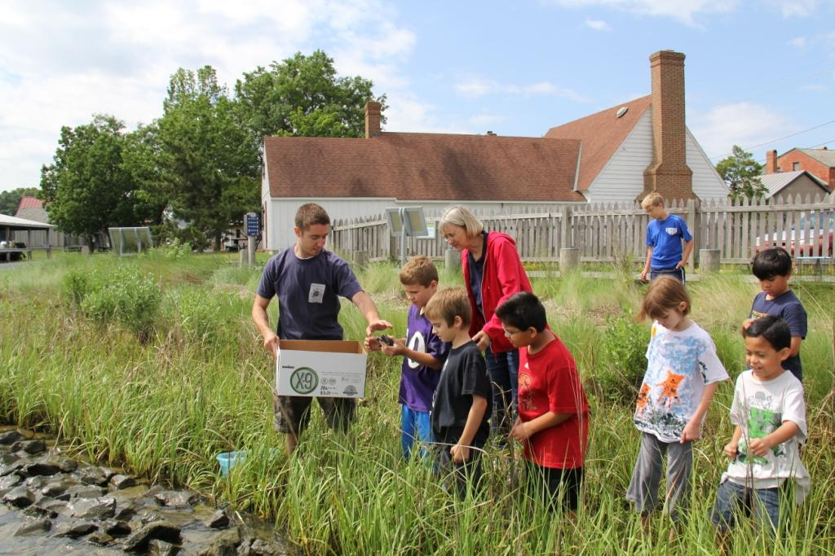
Education is the Key!
Turtle Excluder Devices
Road crossing signs
Terrapin Head Start
Notes:
Conservation is the key element for helping to protect terrapins throughout their range. Habitat management is essential for maintaining a viable population.
Head starting programs eliminates egg predation. Eggs removed from their natural settings, placed in incubators, raised, and then released back into the wild.
Terrapins are used as marketing icons which promotes public awareness of the species.

Slide 27

DTWG Purpose:
The Diamondback Terrapin Working Group has prepared this presentation to provide a brief overview of the natural history and conservation efforts within the range of the species.

Slide 28
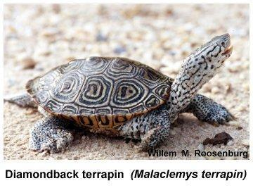
DTWG Objectives:
Advocate and promote scientific surveys/studies; identify causes of changes to populations
Identify threats to populations
Maintain database of populations studied
Provide advice/recommendations for research, management, and conservation
Notes:
Objectives of the Working Group:
1. To advocate and promote sound, scientifically based survey and population studies that can identify demographic trends and identify causal factors contributing to changes in population size, growth and structure.
2. To identify factors that threaten terrapin populations and take the necessary steps to remedy those situations.
3. To maintain a database of the known terrapin populations that are or have been studied with specific attention to changes in population growth rate.
4. To provide advice and recommendations for the research direction and effective management and conservation of terrapins throughout their range.

Slide 29
DTWG Objectives:
Promote and assist with educational programming
Meet every three years for "Workshop on the Ecology, Status and Conservation of Diamondback Terrapins"
Serve as a source of information on Diamondback terrapins and their habitat
Notes:
5. To promote and assist educational programs that focus on terrapin conservation or that use the terrapin as a model organism to promote environmental awareness and stewardship.
6. To meet once every three years as the “Workshop on the Ecology, Status and Conservation of Diamondback Terrapins.” The Diamondback Terrapin Working Group will hold an open meeting during the workshop to conduct general business.
7. To serve as a source of information on terrapins and their associated habitats. One aspect of this will be to maintain a bibliography of all known scientific publications concerning diamondback terrapins

Slide 30
Credits
Chesapeake Terrapin Alliance:
http://www.cterrapin.org/terrapinsinchina.html
Diamondback Terrapin Working Group:
http://www.dtwg.org/
Georgia Sea Turtle Center:
http://www.georgiaseaturtlecenter.org/kids-spot/turtles-tortoises-and-terrapins-oh-my/diamondback-terrapin/
Hofstra University:
http://people.hofstra.edu/Russell_L_Burke/terrapin-nyc.htm
Project Terrapin Blogspot: http://terrapinstationnj.blogspot.com/2009/07/welcome-to-terrapin-station-nj.html
Slides Prepared by Dr. Russ Burke, Dr. John Wnek and Ms. Kim Belfer

Slide 31
Credits
South Carolina Department of Natural Resources:
http://yellowfin.dnr.sc.gov/ACEHerpGuide/Pages/Turtles/Emydidae/Malaclemysterrapin.html
The New York Turtle and Tortoise Society:
http://nytts.org/proceedings/wood-rdk.htm
Western Connecticut State University:
http://people.wcsu.edu/pinout/herpetology/mterrapin/index.html
Wetlands Institute:
http://www.terrapinconservation.org/home.htm
Slides Prepared by Dr. Russ Burke, Dr. John Wnek and Ms. Kim Belfer

Slide 32
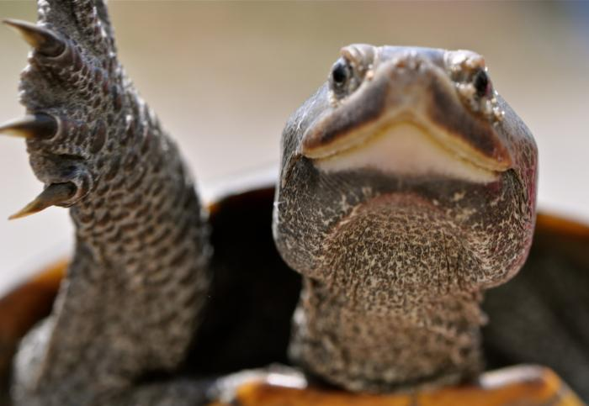
QUESTIONS???
Please visit DTWG.org

