Slide 1
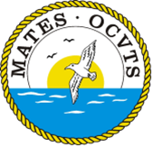
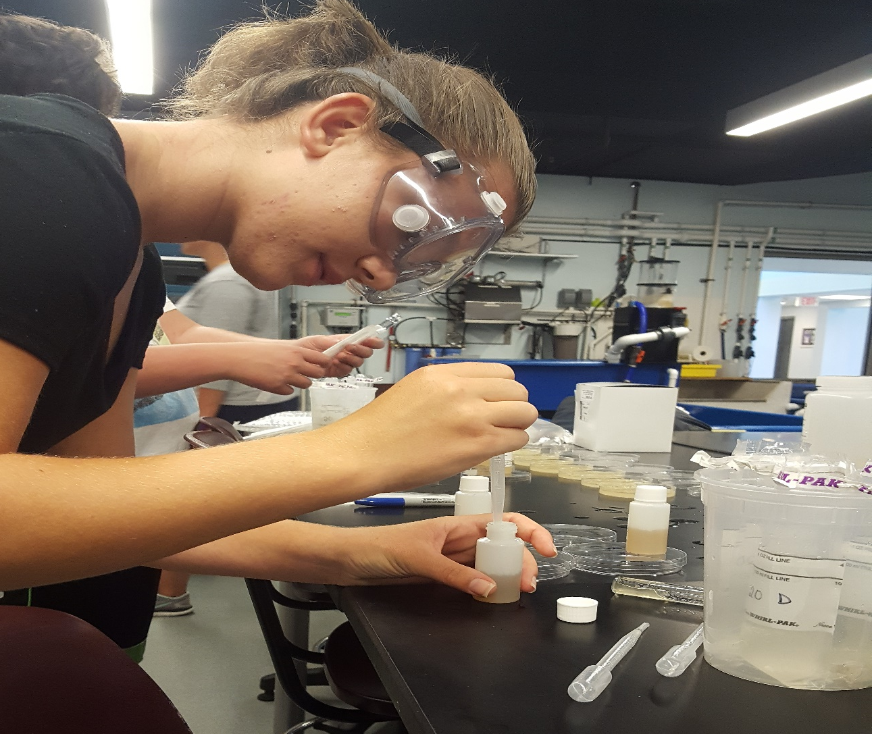
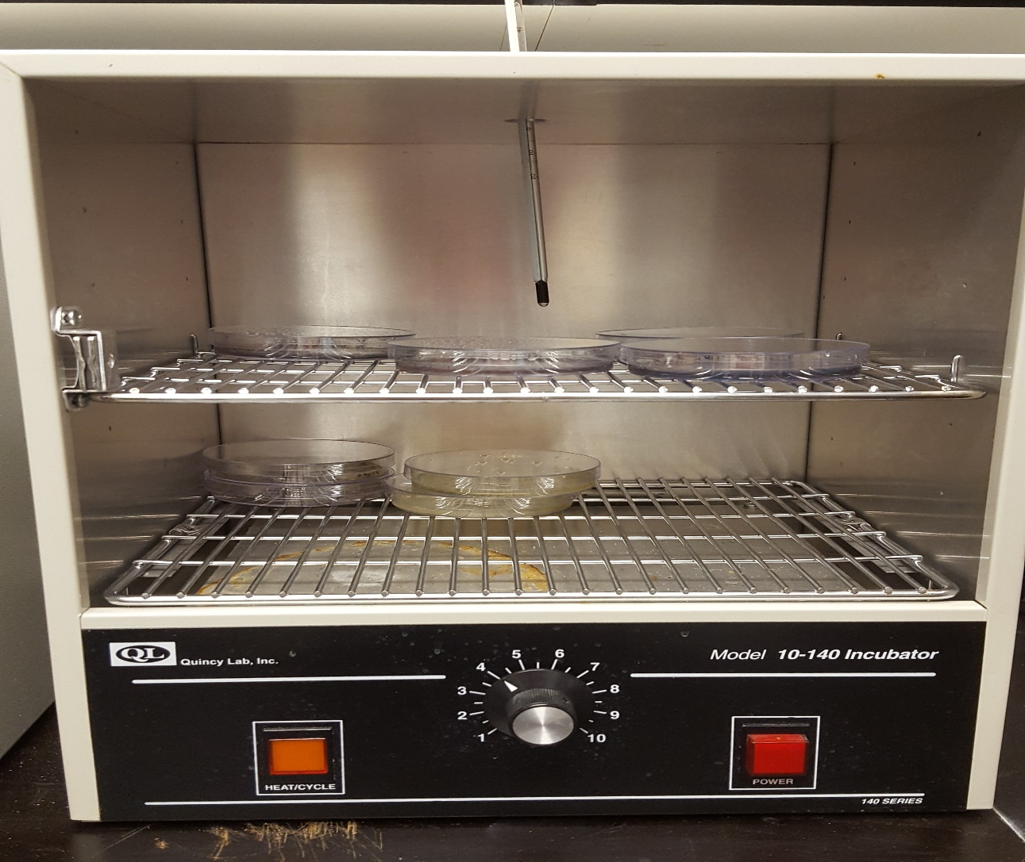
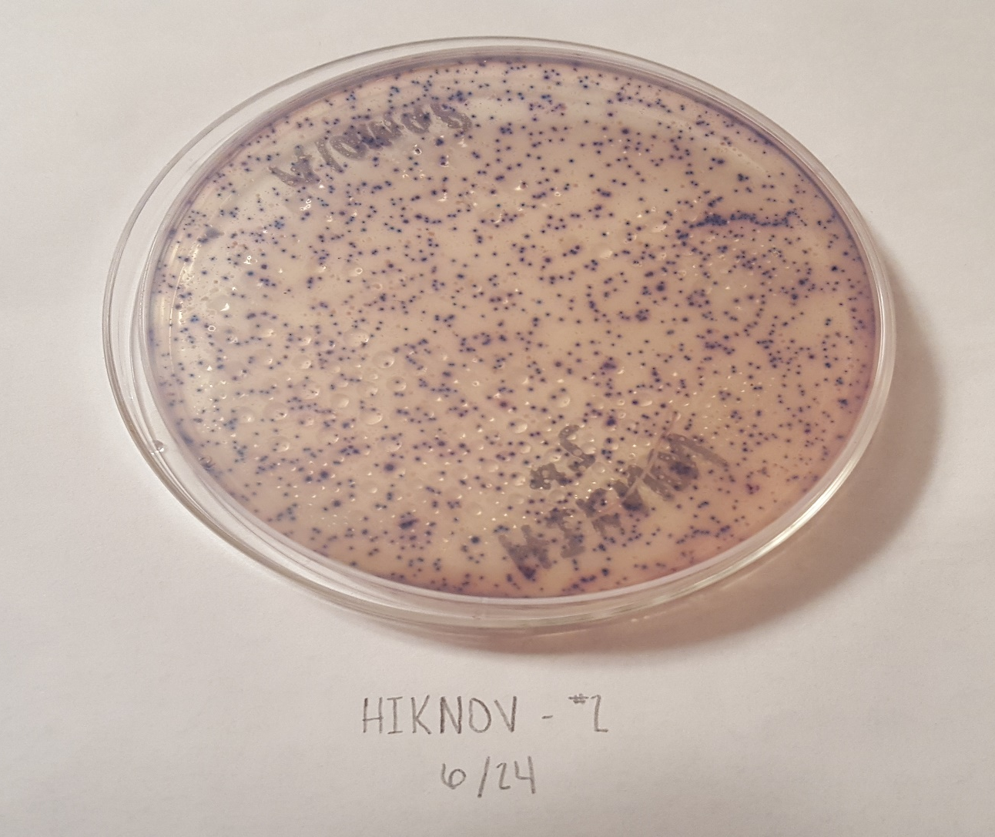
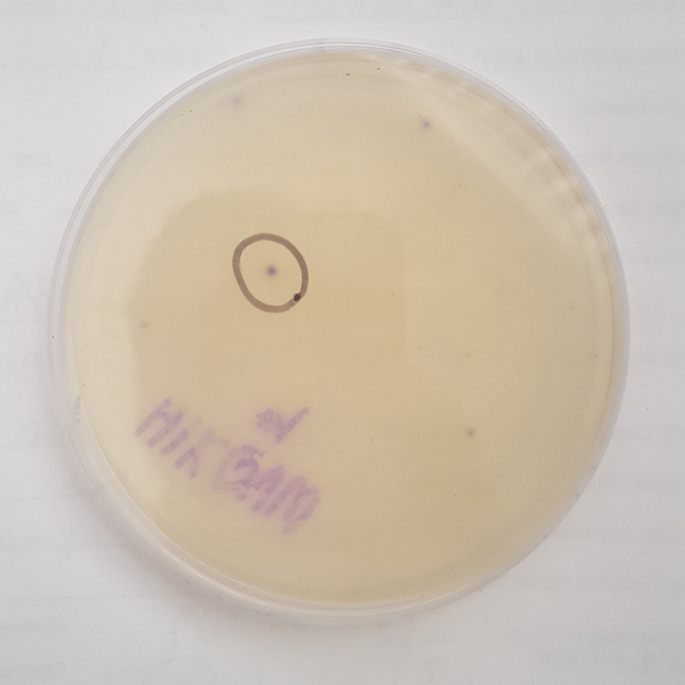
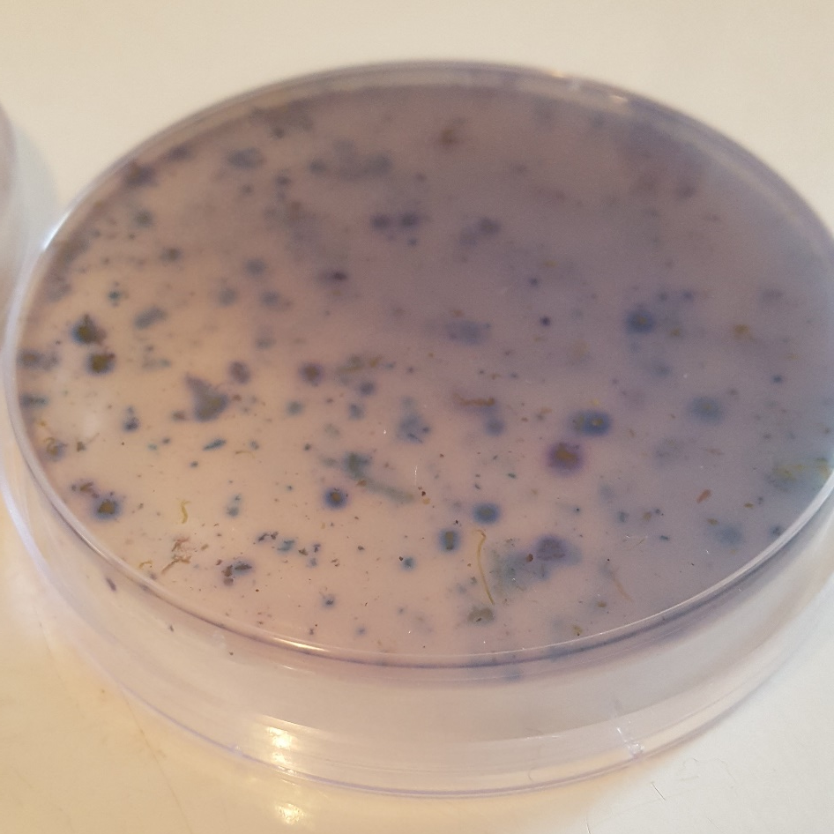
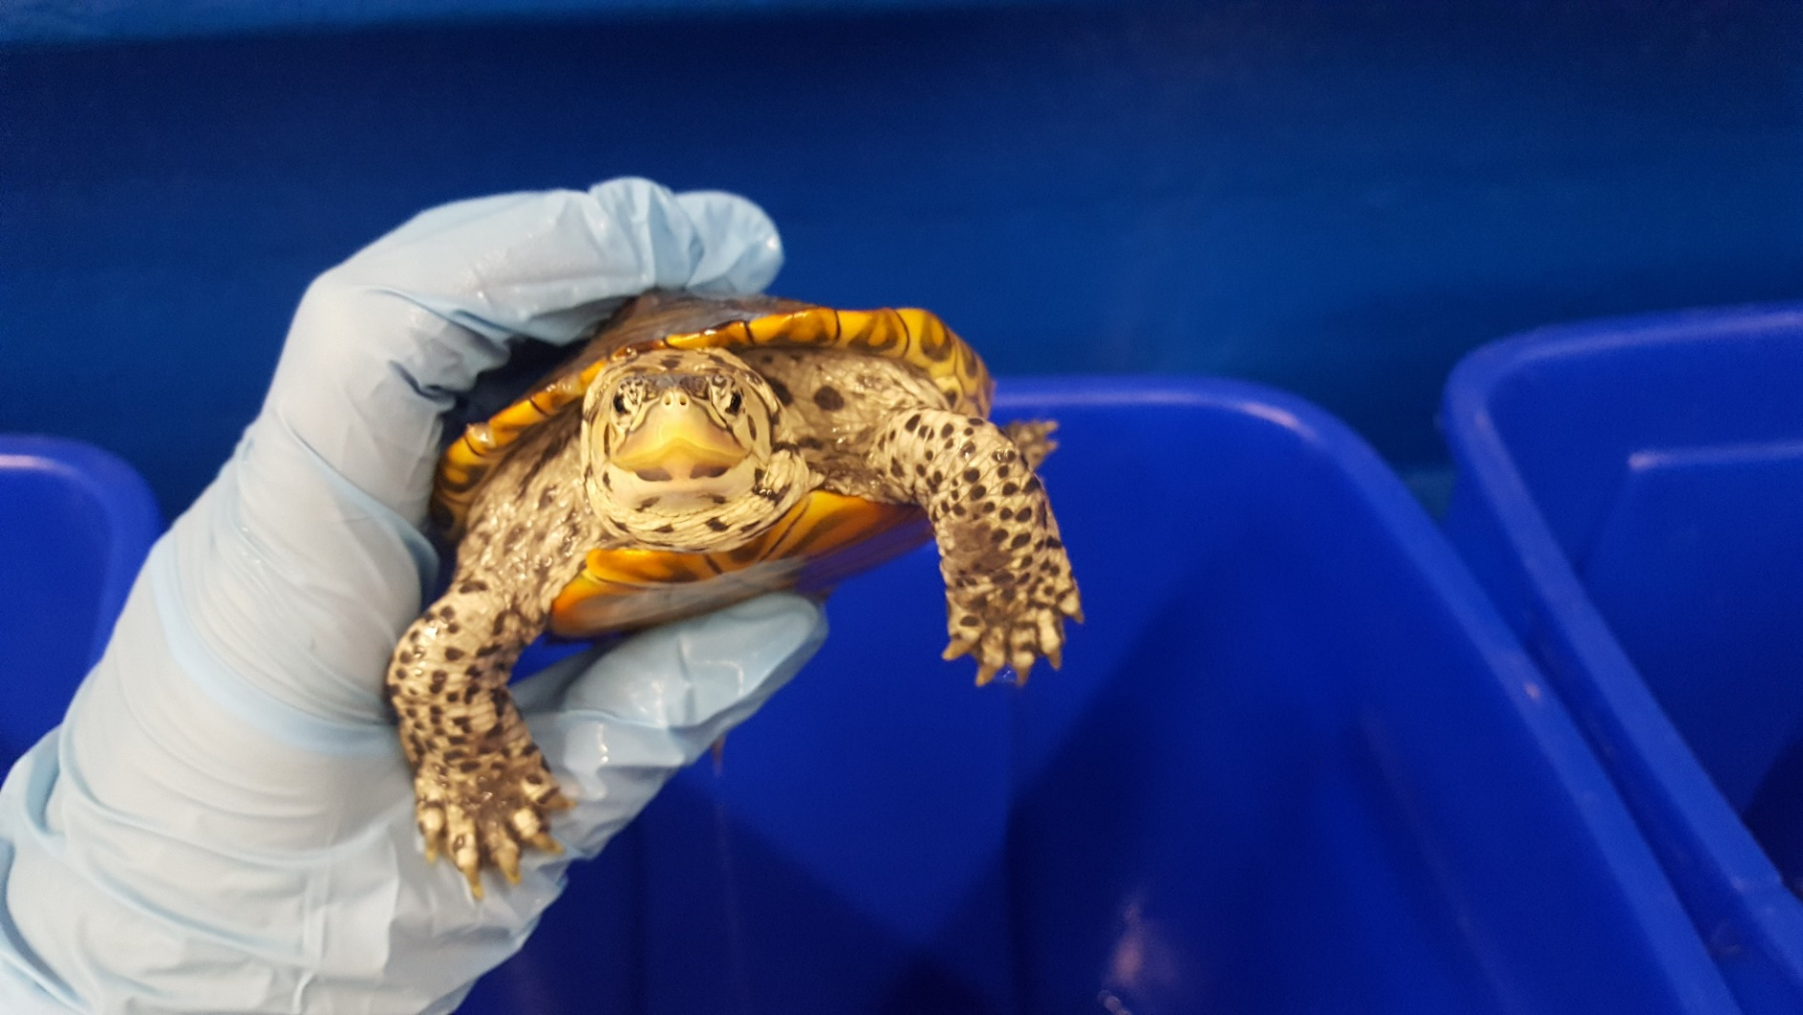
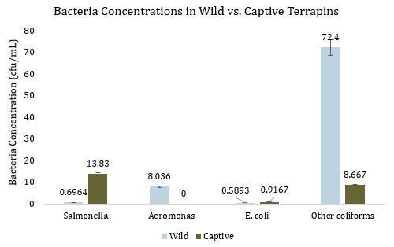
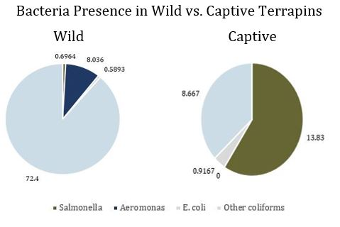
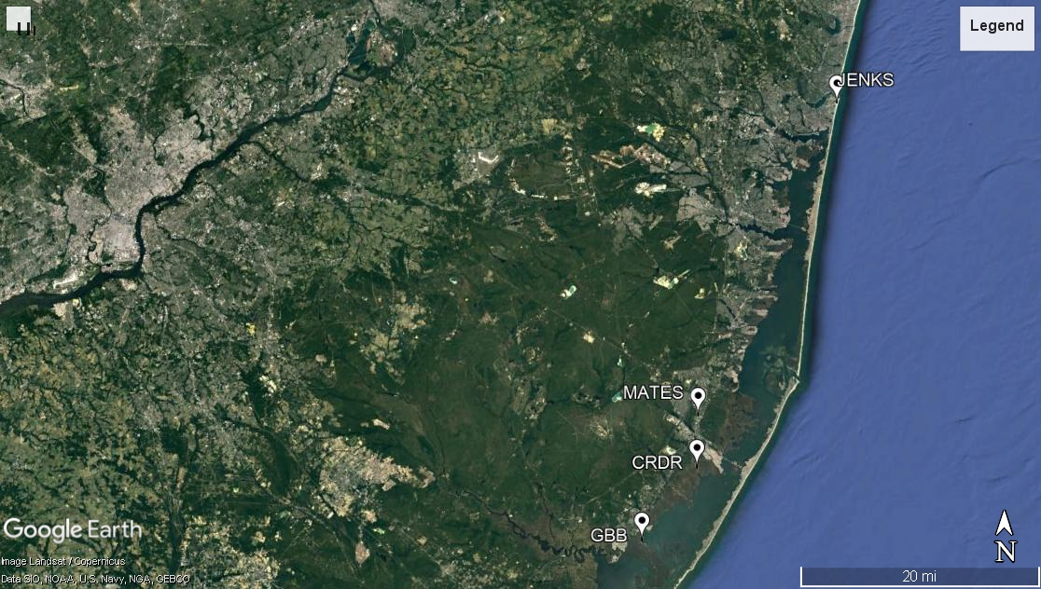
Bacteria Presence in Wild vs. Captive Malaclemys terrapin terrapin
Alaina Perdon Marine Academy of Technology and Environmental Science , Manahawkin, NJ 08050
Abstract
Salmonella and Aeromonas are two genera of gram-negative waterborne pathogens found in abundance in the digestive tracts of reptiles and aquatic species. While the bacteria do not harm their host animal, they can cause a multitude of health problems for humans that come into contact with infected animals, including typhoid fever and dysentery. Salmonella infection, specifically, is often associated with turtles, with over 150 reported infections via contact with turtles reported in the United States in the summer of 2012 alone. This study assesses the risk of infection posed to humans by interacting with turtles, specifically those involved with the care of northern diamondback terrapins (Malaclemys terrapin terrapin), with the intention of determining if there is a greater risk of contracting the disease from wild or captive specimens. The data indicates that Salmonella occurs with significantly higher frequency in captive terrapins, implying that stresses imposed by unnatural living conditions stimulate abnormal bacteria production.
Methodology
Discussion
Stresses on captive reptiles and exotic birds induces a neurophysiological response which increases bacteria production; enteric nervous system releases catecholamine hormones and norepinephrine, stimulating abnormal, hyperactive digestive processes (Everest).
Captive terrapins assessed in this study are held water ranging from 25 to 30°C (McWeeney, personal communications); facilitates Salmonella growth and reproduction, as the optimal temperatures for such bacteria range from 27 to 37°C (Tajkarimi, 2007).
Dietary changes may compromise the chemical integrity of the animals’ stomach acids, allowing Salmonella to grow unhindered (Everest, 2007).
Housing multiple animals in close proximity allows for the rapid spread of bacteria; one terrapin harboring abnormally high amounts of Salmonella can transmit to terrapins in the same enclosure (Leong et. al, n.d.).
Highly resistant strains of bacteria can be transmitted amongst captive animals, rendering mitigation techniques ineffective; Salmonella resistance common in captive-raised red-eared sliders (Pseudemys scripts elegans) (D’Aoust et. al, 1990).
Study Sites
The captive terrapin studied reside in the classrooms the Marine Academy of Technology and Environmental Science (MATES) in Manahawkin, New Jersey, as well as at Jenkinson’s Aquarium in Point Pleasant Beach, New Jersey. All laboratory procedures were carried out in the bacteria lab at MATES. Wild terrapin were captured both by hand and using hoop traps from Cedar Run Dock Road and Great Bay Boulevard, located in Manahawkin and Tuckerton, New Jersey.
Procedure
Blood sampling, rectal swabs, and physical examinations are all popular methods for determining the health of live reptiles (Werner, n.d.). This project focuses on assessments of fecal matter obtained from captive terrapin held at the MATES and Jenkinson’s Aquarium, as well as wild terrapin captured as part of a population assessment project by Project Terrapin. The terrapin studied were of both sexes, and included a wide range of ages. Terrapin were held for 24 hours in distilled water in a Rubbermaid container, in which they “purged” their systems. Tank water was collected in Whirlpack® bags and tested the same day with ECA Check Easygels, following the instructions provided by Micrology Labs.
To ensure bacteria collected was strictly from the digestive systems of the terrapin, each specimen was rinsed thoroughly with tap water, dipped in a 10-15% iodine solution, and rinsed again. Each holding container was thoroughly sterilized after each use, also using an iodine solution.
Statistical Analysis
Data was compiled and analyzed using Microsoft Excel. While data on Salmonella, Aeromonas, E. coli, and other coliform bacteria was collected, specifically Salmonella and Aeromonas levels were analyzed due to their known presence in reptiles. Salmonella and Aeromonas levels in wild versus captive terrapins were compared using two separate Two-Sample Assuming Unequal Variances t-Tests with alphas of 0.05.
Introduction
Bacteria
Salmonella
Gram-negative, rod-shaped bacteria with over 2,300 known serotypes
Invasive, facultative intracellular pathogen that can infect humans, commonly attacking the gastrointestinal system (Chikkaballi, 2011)
Severity of infection varies depending on the specific serotype, ranges from mild salmonellosis to typhoid fever - CDC estimates 1.2 million cases of illness and approximately 450 deaths linked to non-typhoidal Salmonella occur annually in the United States (“Salmonella”)
Infection can occur as a result of exposure to improperly treated water, often water containing raw sewage material, as well as contact with reptiles and amphibians, as the animals are carriers of the bacteria.
In the summer of 2012 alone, roughly 150 people across the United States were reported to have been infected with Salmonella by turtles (Livio, 2012)
Aeromonas
Genus of gram-negative, rod-shaped bacteria that arise “ubiquitously and autochthonously” in aquatic environments (Igbenosa, 2012
Strains such as A. hydrophila can cause a range of infections in humans, ranging from the common secretory and dysenteric infections to rare cases of osteomyelitis and pneumonia (“Aeromonas”)
Though rare, extreme Aeromonas cases have a high fatality rate.
Found harbored in the intestinal tracts of healthy livestock and, albeit rarely, reptiles - suggests that these animals could serve as hosts for the bacteria (Janda, 2010).
Diamondback Terrapins (Malaclemys terrapin terrapin)
Species of brackish water turtle native to Barnegat Bay, face threats including illegal trapping and habitat destruction
Conservation efforts include rehab-and-release programs by organizations such as Project Terrapin
Rate of infectious disease in wild turtles reached a level of concern in 2000 and has been on the rise since, possibly due to h the release of captive-raised or rehabilitated animals (Werner, n.d.)
Salmonella and Aeromonas can be transmitted not only from animals to humans, but also from humans to animals
Increased interaction between humans and terrapin puts both species at a higher risk of infection (“Human Salmonella Infantis”)
Conclusion
The data collected suggests that there is a significantly greater occurrence of Salmonella bacteria in captive terrapin; however, Aeromonas is more commonly found in wild terrapin. Abnormal bacteria production is likely caused by stresses introduced in captive environments, including subjection to living conditions that differ greatly from wild habitats.
Figure 2: Fecal samples were pipetted into ECA Check Easygel solution, then transferred into petri dishes in the bacteria lab at MATES in Manahawkin, New Jersey on June 24, 2017.
Figure 3: ECA Check gels incubating in the bacteria lab at MATES in Manahawkin, New Jersey on June 24, 2017
Figure 4: The ECA Check results of a fecal sample taken from a terrapin found on Cedar Run Dock Road in Manahawkin, New Jersey on June 24, 2017, containing 254 cfu/mL of other coliform bacteria
Results
Definite Salmonella colonies were found in only seven of the 28 wild terrapins tested, with concentrations ranging from 1 to 7.5 cfu/mL; however, definite Salmonella colonies were found in all six of the captive specimens, with concentrations ranging from 1 to 54 cfu/mL. Aeromonas was found in 16 of 28 wild terrapins, and concentrations ranged from 0.5 to 73 cfu/mL. E. coli and other coliforms were also found in wild terrapins: eight E. coli occurrences ranging from 0.5 to 3.5 cfu/mL and 27 occurrences of other coliforms ranging from 1 to 909 cfu/mL. Exclusively Salmonella was found in captive terrapins, with the exception of the specimen from Jenkinson’s Aquarium in which 5.5 cfu/mL of E. coli were found and 52 cfu/mL of other coliforms.
The t-Test comparing Salmonella occurrences in wild versus captive terrapins yielded a one-tailed p-value of 0.0882, therefore there is significant variance between the two parameters; while the same test comparing Aeromonas occurrences yielded a p-value of 0.0096, therefore there is little variance between the parameters.
Figures 7a & 7b: ECA Check results for wild terrapin HIKQVW (left) captured on Cedar Run Dock Road in Manahawkin, New Jersey on June 27, 2017, in which 1 cfu/mL of E. coli and 4 cfu/mL of other coliforms were found, versus ECA Check results for captive terrapin “Ted” of Jenkinson’s Aquarium in Point Pleasant Beach, New Jersey sampled on March 14, 2018, in which 10 cfu/mL of E. coli, 43 cfu/mL of Salmonella, and 78 cfu/mL of other coliforms were found.
Figure 8: An adult male terrapin captured on Cedar Run Dock Road in Manahawkin, New Jersey on June 24, 2017.
Acknowledgements
Thank you to my school and research advisors for providing a fully-equipped bacteriological laboratory and specimens to study, as well as to the many field interns for assisting in the capture of wild terrapin, and my peers for providing insight on the proper handling of specimens and access to the animals held at the school. Thank you to the many local organizations and committees for allowing access to both wild and captive terrapins. Finally, thank you to my dear friends for providing transportation, trapping assistance, and moral support when needed.
Figure 5: Bacteria concentrations found in wild and captive terrapin (n = 34) found throughout Ocean County, New Jersey from June 2017 to March 2018. Other coliforms were found in the highest concentration (72.4 cfu/mL) in wild caught terrapins, while Salmonella was found in the highest concentration (13.83 cfu/mL) in captive terrapins. There was significant variance in the presence of Salmonella in wild vs. captive terrapin (P = 0.0882), but little variance in Aeromonas presence (P = 0.0096).
Figure 6: Bacteria concentrations found in wild and captive terrapin (n = 34) found throughout Ocean County, New Jersey from June 2017 to March 2018. Salmonella was found in the highest concentration in captive terrapin, ranging from 1 to 54 cfu/mL; while undetectable amounts of Aeromonas were found. In wild terrapins, other coliforms were found in the highest concentration, ranging from 0.5 to 909 cfu/mL; while E. coli was found in concentrations ranging from <1 to 3.5 cfu/mL
Figure 1: Jenkinson’s Aquarium, MATS, Cedar Run Dock Road, and Great Bay Boulevard, the four
locations studied from June 2017 to March 2018 in Ocean County, New Jersey.
Inset: The approximate location of the study sites in Ocean County, New Jersey

