Slide 1
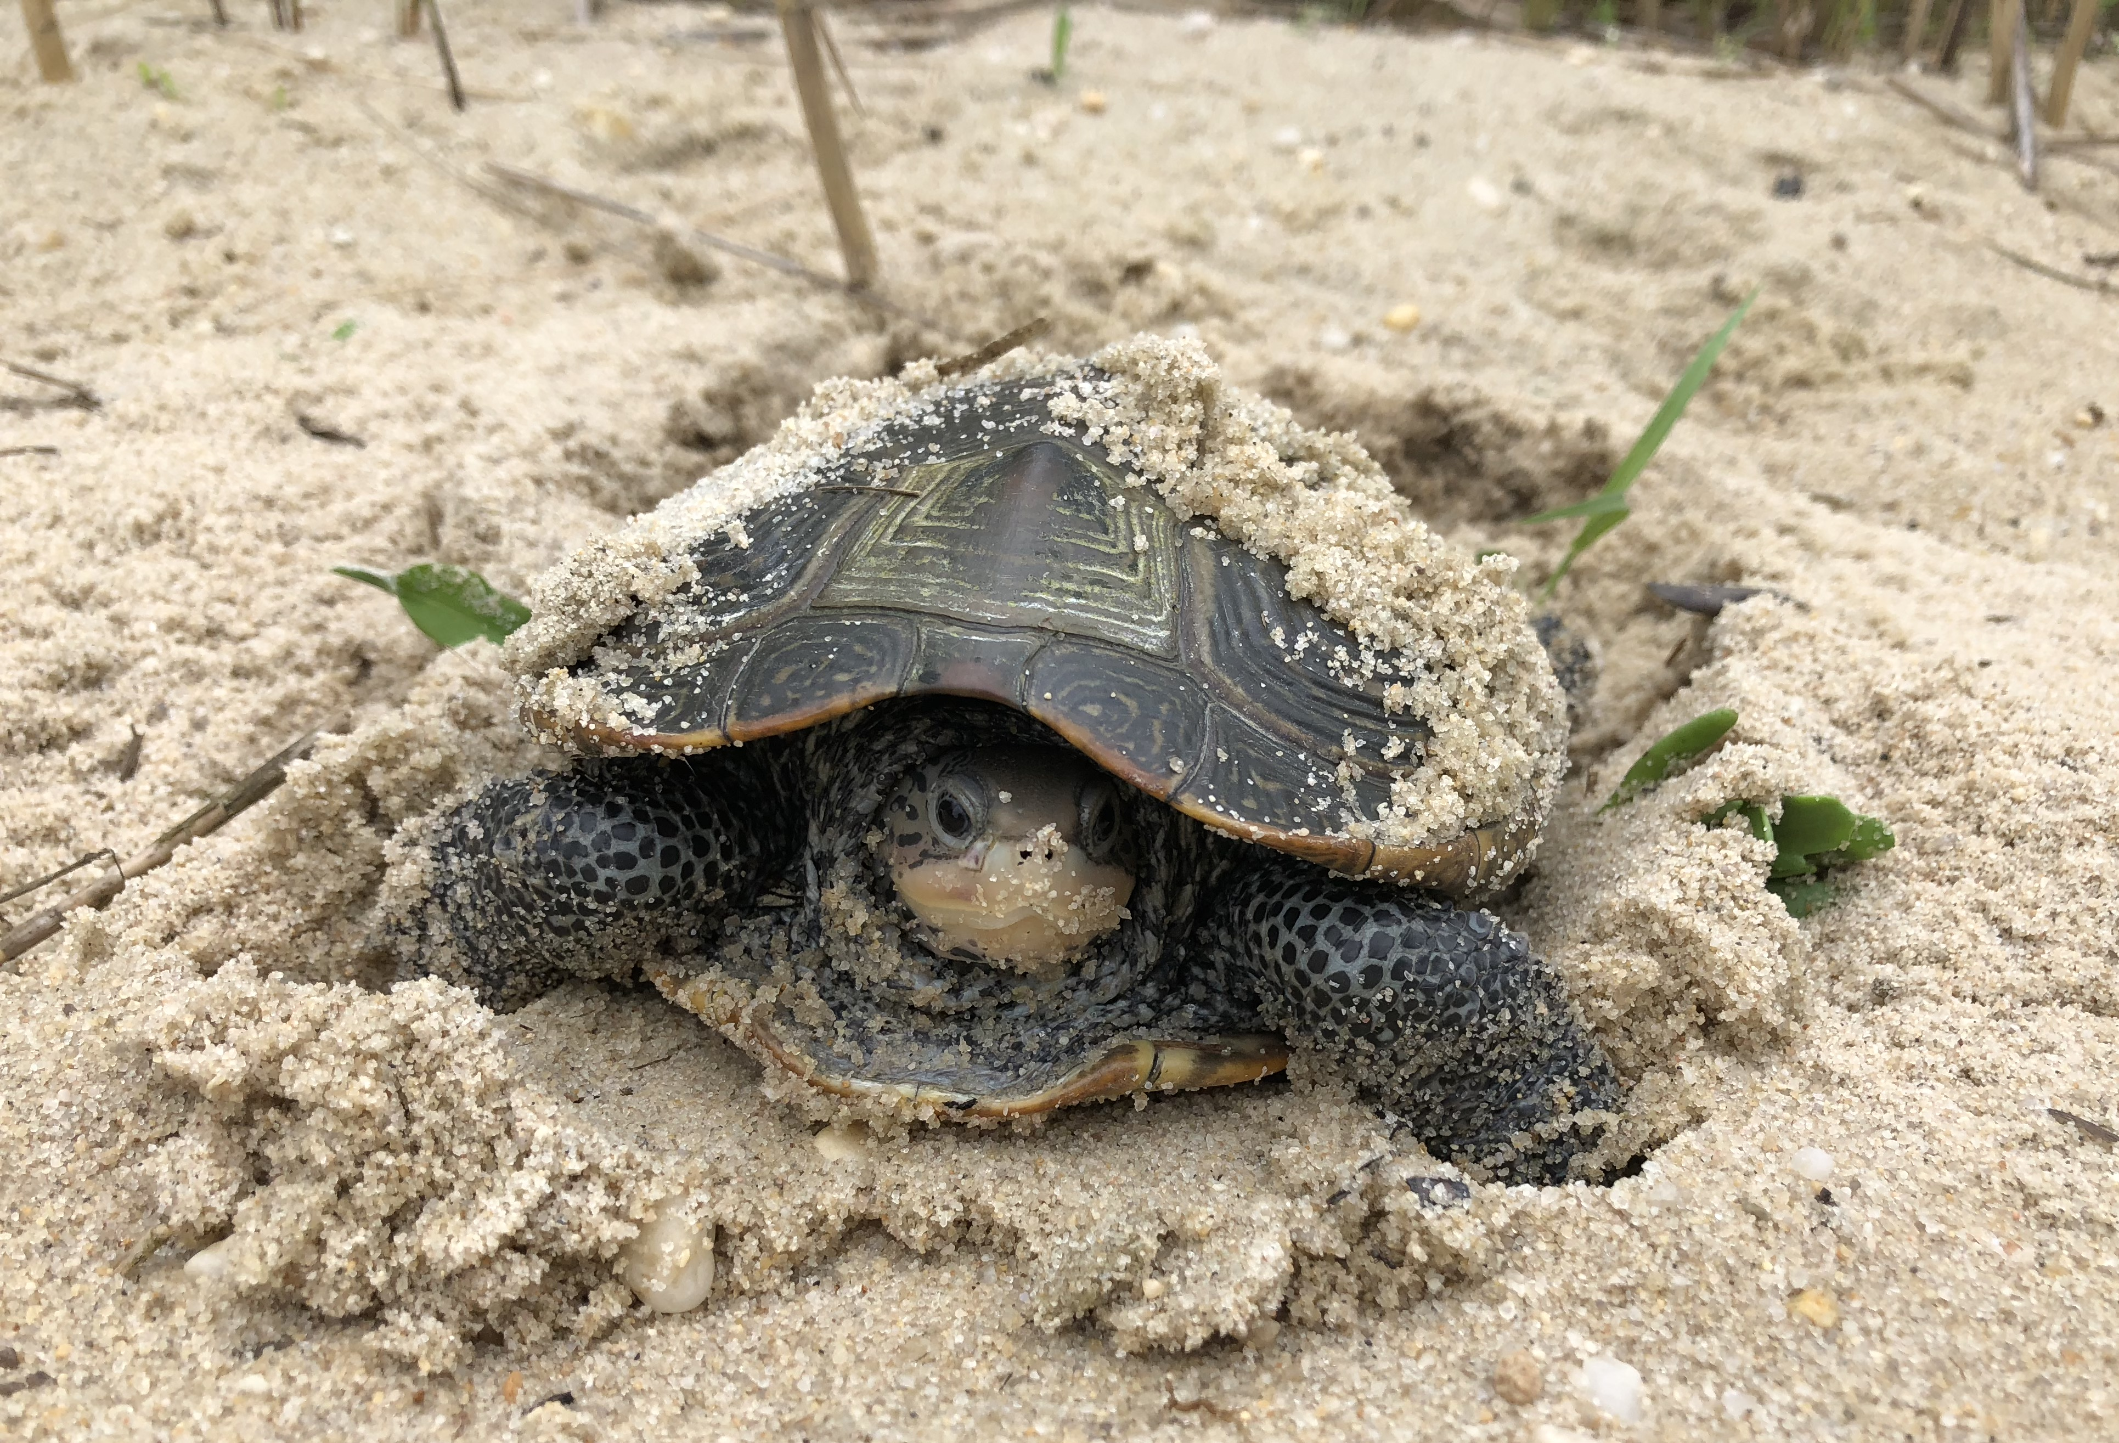
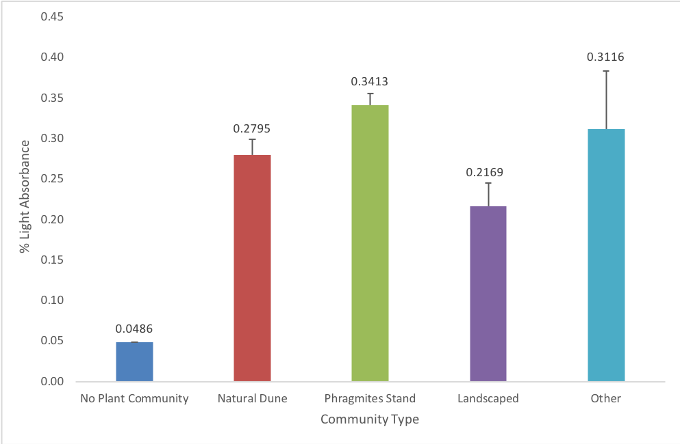
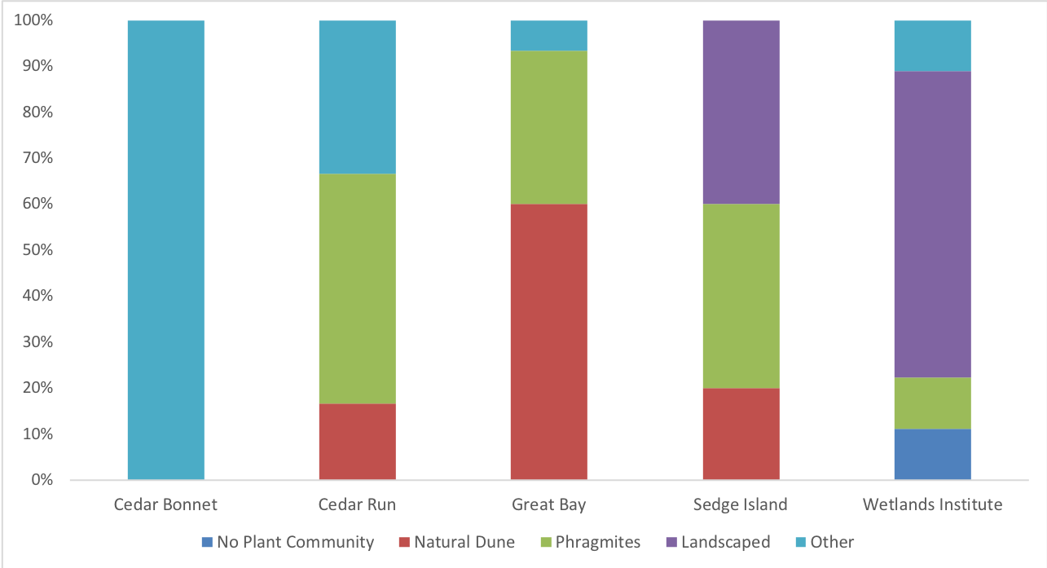
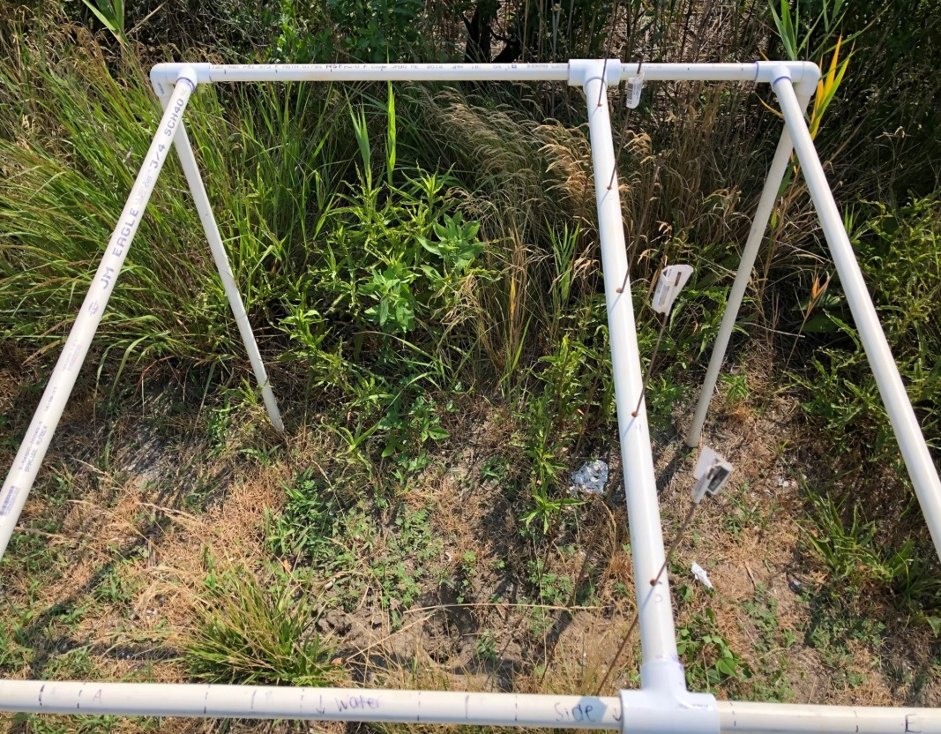
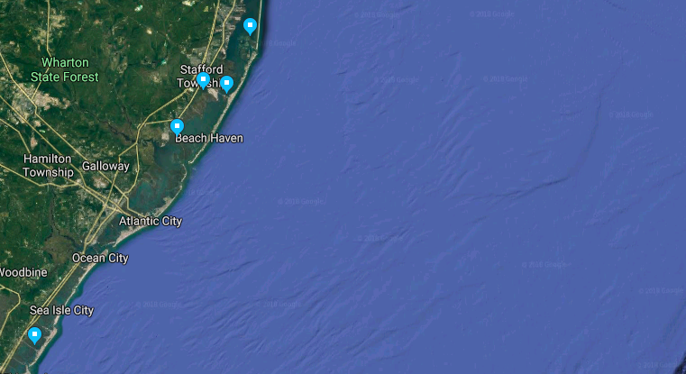
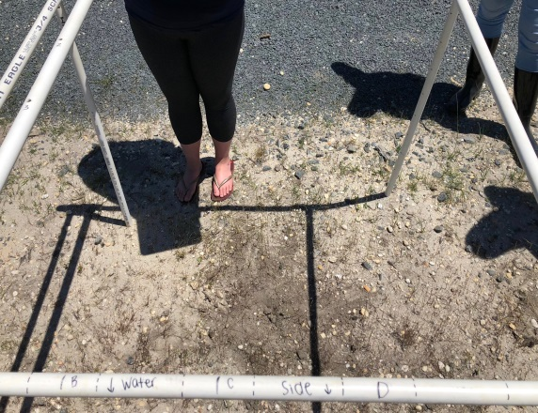
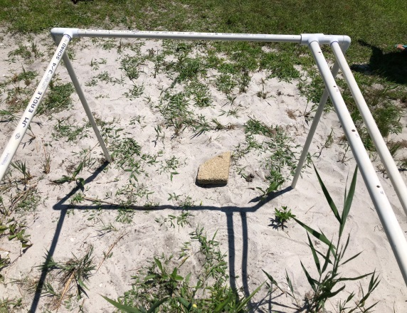
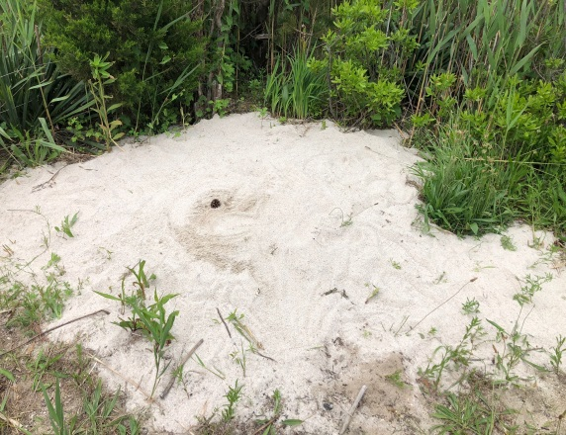
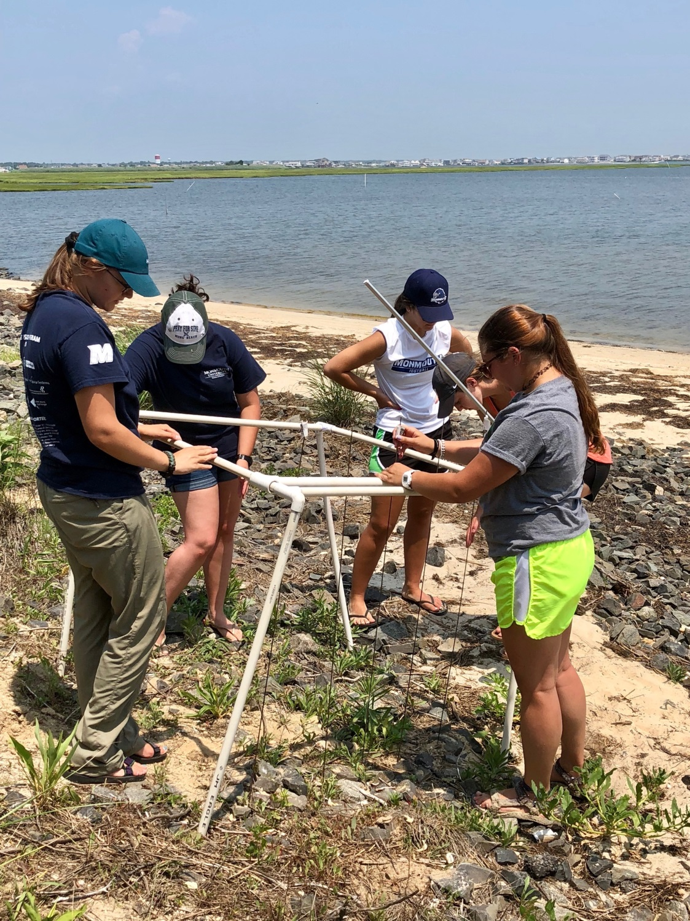
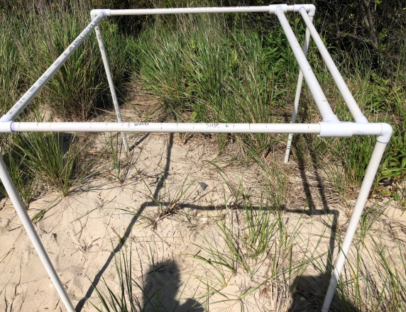
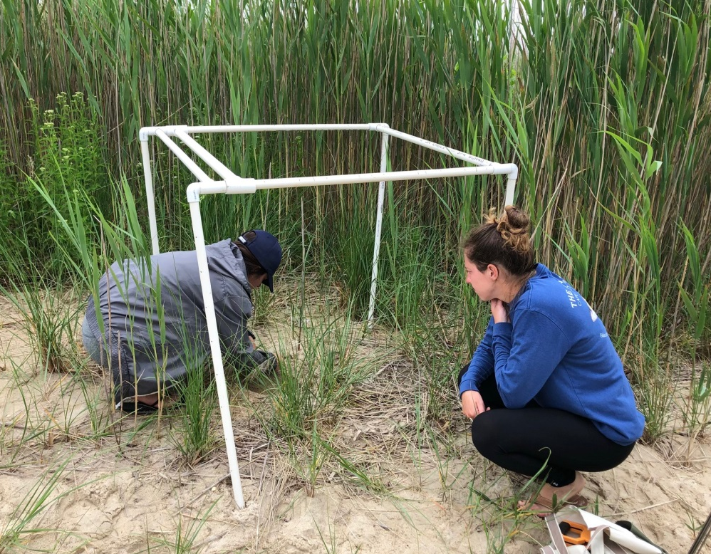
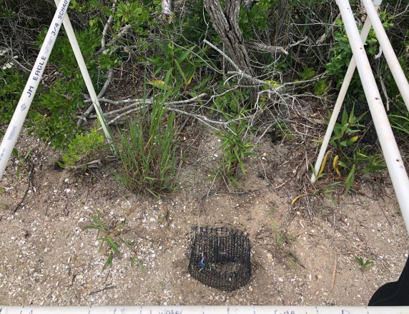
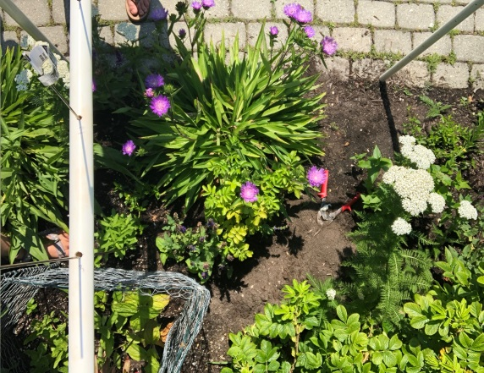
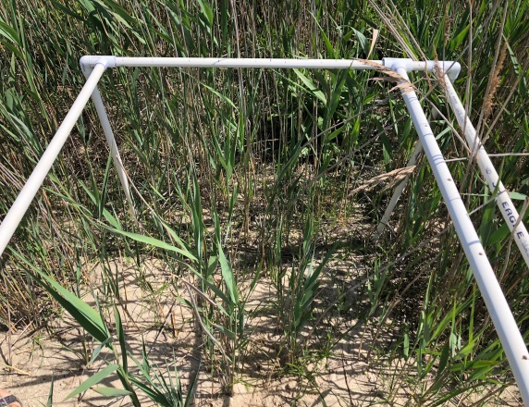
Plant Community Impacts on Northern Diamondback Terrapin Nest Site Selection and Success
Taylor Donovan, Kelly Hanna, Lois Walton, Christiana Popo, and Maria Riley
Pedram Daneshgar, Department of Biology
Background
The northern diamondback terrapin (Malaclemys terrapin terrapin) is a turtle native to brackish coastal marshes along the Atlantic Coast, ranging from Cape Cod, Massachusetts to Cape Hatteras, North Carolina. M. terrapin terrapin have high site fidelity, meaning individuals return to nest in the same locations year after year. Females lay clutches of about 8 to 12 eggs from May to mid-July, most often during high tide in order to avoid tidal inundation. Nest success is dependent upon several environmental factors. One such factor is nearby plant community, as the shade created by aboveground vegetation may affect nest incubation temperature and dictate hatchling gender. In addition, the presence of some coastal plants, such as American beach grass (Ammophila breviligulata), is known to disturb M. terrapin terrapin nests as their roots often penetrate the eggs for water and nutrients. Predation by mammals and birds is another predominant environmental factor impacting nest success.
Therefore, nest site selection may be influenced by invasive vegetation or other natural disturbances. A particular invasive species believed to affect M. terrapin terrapin nesting is Phragmites australis, a tall perennial grass that has rapidly spread throughout disturbed marshes and wetland areas in New Jersey. P. australis spreads primarily through its aggressive rhizome root systems, which pose a threat to M. terrapin terrapin nests as the eggs lie in nests about 4 to 8 inches below ground—the same depths as P. australis root systems. Whether or not suboptimal nesting conditions are enough to deter gravid females from returning to their respective nest sites year after year is unknown. This project aimed to answer that among several other questions regarding M. terrapin terrapin nest site selection.
Abstract
Northern diamondback terrapins (Malaclemys terrapin terrapin), a unique species found within estuarine systems of the Atlantic coast, have been listed as species of concern in New Jersey due to evidence of decline. While several factors, both natural and anthropogenic, are to blame for these declines, nest site degradation and loss may be the most detrimental to the success of future populations because of the strong nest site fidelity exhibited by terrapins. Disturbances, land alteration and the invasion of problematic species such as Phragmites australis seem to be driving nest site degradation, but their definitive impacts on nest site selection and success have yet to be explored.
In this study, we investigated the plant communities associated with newly laid terrapin nests along the New Jersey coast to determine the impacts of disturbance, land alteration and plant invasions on nests. It was hypothesized that site alterations and plant invasions have made sites less suitable for nesting and for the success of future populations. At each nesting site, the plant community was surveyed and the habitat was described in regards to disturbance and invasions. To determine the impacts of the plant community on nest temperature, iButtons were installed in each nest within 24 hours of the nest establishment. Preliminary results suggest that terrapins do not select sites based on the plant communities and the site fidelity rules selection. The final impacts of site selection on the nests will be assessed upon hatching when temperature and plant biomass data and percent of eggs hatched are analyzed this fall.
Preliminary Results
Table 1. Average diversity of plots within vs. plots outside 5 meters of the nearest P. australis stalk. Plots 5+ m away had significantly greater (p = 0.00) diversity.
Table 2. List of plant species and characteristics found in plots throughout the five sites. Subscripts indicate at what sites the vegetation was found. 1: Cedar Bonnet 2: Cedar Run Dock Rd. 3: Great Bay Blvd. 4: Sedge Island 5: The Wetlands Institute.
P. australis | Diversity
Within 5 meters | 0.7802 ± 0.1063
Outside 5 meters | 1.2667 ± 0.1534
Scientific Name | Common Name | Perennial (P) Annual (A) | Native (N) Exotic (E) | Flower Time | Functional Group
Achillea millefolium _{2,5} | Common Yarrow | P | N | April-Sept | Herb
Ajuga reptans ₅ | Carpet Bugle | P | E | May-June | Herb
Ambrosia artemisiifolia ₃ | Common Ragweed | A | N | Aug-Oct | Herb
Ammophila breviligulata ₃ | Beach Grass | P | N | May-Sept | Grass
Aralia nudicaulis ₅ | Wild Sasparilla | P | E | May-June | Shrub
Asclepias syriaca ₅ | Milkweed | P | N | June-Aug | Herb
Cakile edentula _{2,3} | Sea Rocket | A | N | July-Sept | Taproot
Carex kobomugi _{3,4} | Asiatic Sand Sedge | P | E | June-Aug | Grass
Carex pensylvanica ₁ | Sedge Grass | P | N | N/A | Grass
Ceanothus americanus ₅ | New Jersey Tea | P | N | Mar-Apr | Shrub
Centaurea Americana ₅ | American Basket Flower | A | N | May-Aug | Herb
Centaurea stoebe _{2,3} | Spotted Knapweed | P | E | May-June | Herb
Convolvulus arvensis _{2,3,4} | Field Bindweed | P | E | July | Vine
Digitaria sanguinalis _{3,4,5} | Crab grass | A | E | Late May | Grass
Eupatorium perfoliatum ₅ | Common Bone Set | P | N | July-Sept | Herb
Euphorbia maculate ₃ | Spotted Spurge | P | N | May-Oct | Herb
Euphorbia polygonifolia ₃ | Seaside Sand Mat | A | N | July-Oct | Herb
Eurybia divaricate ₅ | Small Aster | P | N | Aug-Sept | Herb
Festuca arundinacea ₅ | Fescue | P | E | May-June | Grass
Fragaria vesca ₅ | Strawberry | P | N | May-Aug | Herb
Hedera helix ₃ | Common Ivy | P | E | Sept-Oct | Vine
Hypericum perforatum _{2,3} | Common St. John's Wort | P | E | June | Herb
Iva frutescens _{2,4,5} | Marsh Elder | P | N | Aug-Nov | Shrub
Juniperus virginiana ₅ | Red Cedar | P | N | May-June | Shrub
Liatris spicata ₅ | Blazing Star | P | N | July-Aug | Herb
Ligustrum obtusifolium ₅ | Border Privet | P | E | June | Shrub
Lolium multiflorum _{2,3,4,5} | Ryegrass | A | E | Apr-Sept | Grass
Lysimachia quadrifolia ₅ | Whorled Loose Strife | P | N | July-Aug | Herb
Lysimachia terrestris ₅ | Swamp Candle | P | E | June-July | Herb
Medicago lupulina _{2,4,5} | Clover | P | E | Apr-Aug | Legume
Mentha arvensis ₅ | Corn Mint | P | E | July-Aug | Herb
Monarda punctate ₅ | Spotted Beebalm | P | N | June-July | Herb
Myrica pensylvanica ₅ | Bayberry | P | N | May | Shrub
Oxalis triangularis ₅ | Red Oxalice | P | E | Late winter | Herb
Panicum virgatum ₅ | Switchgrass | P | N | July-Feb | Grass
Phragmites australis _{3,4,5} | Phragmites | P | E | July-Sept | Grass
Plantago major ₅ | Plaintain | P | E | June-Oct | Herb
Poa annua _{2,3,4} | Annual Blue Grass | P | E | May-June | Herb
Portulaca oleracea _{2,3,4} | Purslane | A | N | May-Oct | Herb
Rosa rugosa ₅ | Beach Rose | P | E | May-July | Shrub
Sedum kamtschaticum ₅ | Stone Crop | P | E | June-Aug | Herb
Solidago sempervirens _{2,3,4,5} | Goldenrod | P | N | Aug-Oct | Herb
Spartina alterniflora _{3,5} | Smooth Cordgrass | P | N | July-Sept | Grass
Spartina patens ₃ | Salt Hay | P | N | June-Oct | Grass
Taraxacum officinale ₃ | Dandelion | P | E | Multiple | Herb
Toxicodendron radicans ₅ | Poison Ivy | P | N | May-July | Shrub
Figure 5. Total percent light absorbance by community type. Although not statistically significant, it is observed that P. australis absorbs the most light.
Hypothesis
Disturbances to M. terrapin terrapin nesting locations, including site alteration and plant invasions, will overall create less suitable nesting habitat and may also decrease chances of success for future populations.
Figure 6. Total percent of each plant community assigned to nests for each study site.
Objectives:
Determine if established vegetation influences M. terrapin terrapin nest site selection
Identify changes in root biomass of surrounding vegetation from start to end of nest presence
Experimental Design
No established trend between nest site selection and type of plant community
Human interference did not seem to attract or deter nesting
Light absorption was the greatest within P. australis plant community type
Plot diversity was significantly greater (p = 0.00) in plots more than 5 meters away from P. australis
Initial Data Collection
Nests were identified through visual surveys
Each nest was carefully dug up and eggs were counted
A Thermocron i-Button was placed in selected nests, measuring temperature every 45 minutes during the nesting period
GPS coordinates were recorded using a Trimble GeoExplorer 2008 Series device
1m² quadrat was used to assess vegetation
5 pins were dropped every 20cm along X and Y axis’
Every point of contact was recorded for each species
Light absorption was measured for each plot using a ceptometer
Distance from water and distance to nearest P. australis stalk were measured
Each nest was characterized by its soil type, plant community type, and level of human interference
Site Selection
Study sites were chosen based on known presence of M. terrapin terrapin from previous nesting seasons
M. terrapin terrapin dig nests with their hind legs and are therefore limited by soil type
Discussion
Plant community does not dictate nest site selection
P. australis may reduce available photosynthetic light, therefore reducing nest incubation temperature
P. australis negatively impacts floral diversity immediately surrounding the nests, which leaves the area open for other invasives
Successful P. australis establishment now leads to less suitable nesting habitat later
Gravid females may be unable to dig their nest cavities to an optimal depth
Females may have difficulty maneuvering a robust P. australis habitat
It is expected that grasses will have greater below ground biomass, therefore taking away large quantities of nutrients from nearby nests
Disturbed habitats could inhibit hatchlings from traveling to the water post-hatch if no unobstructed path exists
Figure 2. Aerial view of the quadrat used to assess nest vegetation using pin drops.
Cedar Bonnet
Sedge Island
Cedar Run Dock Rd
Future Directions
Sites will be revisited 60 days after initial data recording
I-Buttons will be removed and temperature data will be analyzed
Soil samples will be collected to characterize site by particle size
Vegetation will be assessed again to examine changes in plant community
Light absorption will be measured again using the ceptometer
Root samples will be collected to assess post-hatch root biomass
Nests will be observed for egg desiccation or penetration by surrounding roots
Statistical software SPSS will be used to run statistical analysis on collected data
Wetlands Institute
Great Bay Blvd
Figure 5. A Thermocron i-Button placed inside a nest found at The Wetlands Institute.
Figure 1. Study sites used to collect M. terrapin terrapin nesting data. From North to South: Sedge Island, Island Beach State Park; Cedar Bonnet Island, Manahawkin; Cedar Run Dock Road, West Creek; Great Bay Boulevard, Little Egg Harbor; The Wetlands Institute, Stone Harbor.
Figure 3. Lab members (from left to right) Lois, Maria, Christiana, Kelly, and Taylor counting pin drops for a vegetation survey at Great Bay Blvd.
Figure 4. Plot vegetation being assessed by lab members Christiana (left) and Kelly (right) at Great Bay Boulevard.
Acknowledgements
This research was supported by the Monmouth University School of Science Summer Research Program, the Urban Coast Institute, and Project Terrapin. Special thanks to Dr. John Wnek of Project Terrapin, Ben Wurst of the Conserve Wildlife Foundation, Leslee Ganss and Raymond Fisk of West Creek, NJ, and Lisa Ferguson and Brian Williamson of the Wetlands Institute.

