Slide 1

What is a Diamondback Terrapin?
A. Bird
B. Snake
C. Turtle
D. Lizard

Slide 2
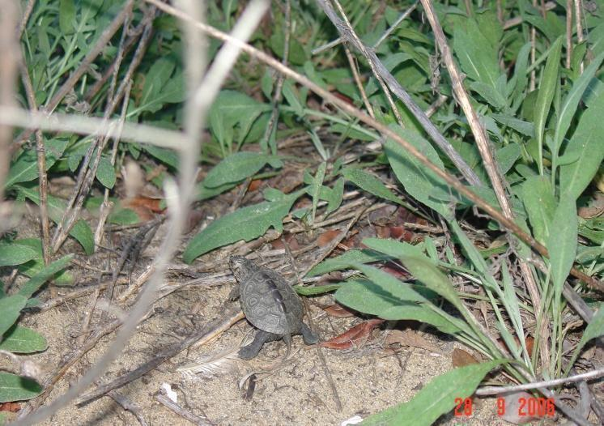
Diamondback Terrapin
Malaclemys terrapin
Notes:
Named for diamond shaped patterns on carapace
Terrapins are mostly noted for their signature smile or mustache like appearance
Malaclemys terrapin name from Greek and Native American meaning soft bodied turtle
Only turtle that tolerates fresh water, salt water and intermediates. Other turtles live in strictly freshwater or marine and tortoises live only on land.

Slide 3
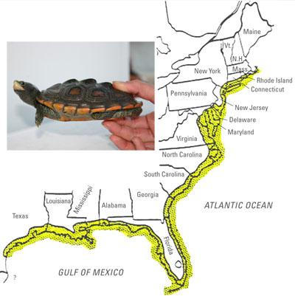
Where do we live?
Coastal waters from Massachusetts to Texas!
Habitats: salt marshes & mangrove swamps
Notes:
Terrapins primary habitats are salt marsh through north and south regions & mangrove swamps in the Florida keys, more about habitats later.

Slide 4
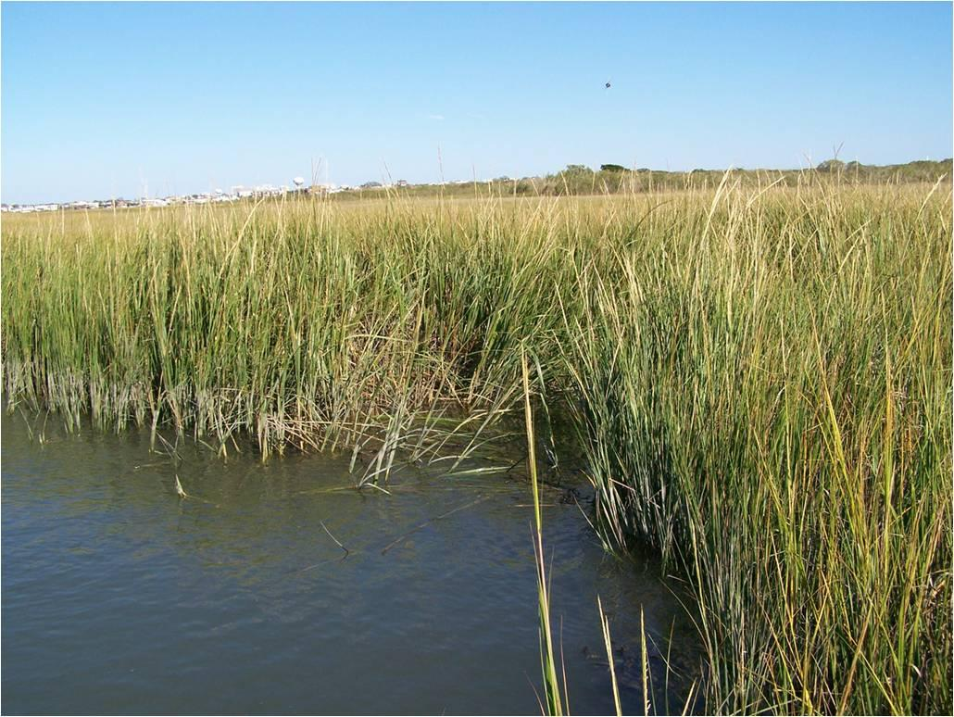
Habitat: Salt Marsh
Notes:
A salt marsh is predominantly covered with cordgrass, Spartina alterniflora.
This plant species plays an important part of a terrapins food cycle. Once the plant dies, microscopic organisms consume the grass to detritus. Then crabs, mussels, and other invertebrates consume the detritus that in turn later become food for terrapins.
This makes terrapins top consumers in this ecosystem. However, without the existence of salt marshes and cordgrass, the ecosystem and food cycle will no longer corporate.

Slide 5
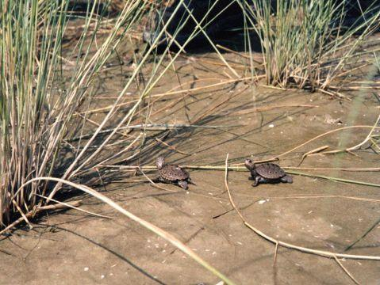
Salt Marsh
Hatchlings moving in a salt marsh
Notes:
These two hatchlings are moving in the saltmarsh. Notice the patches of cordgrass

Slide 6
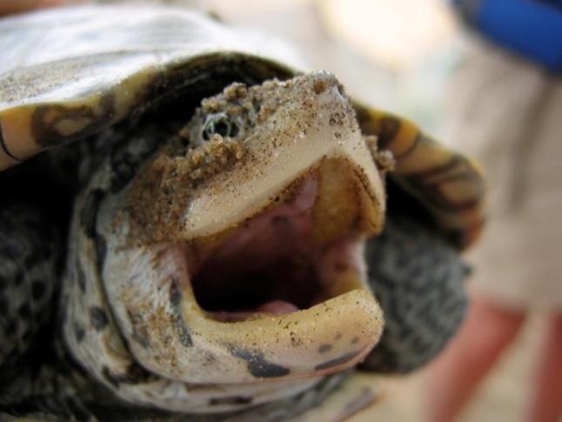
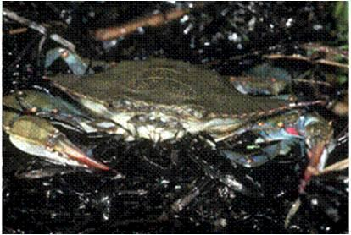
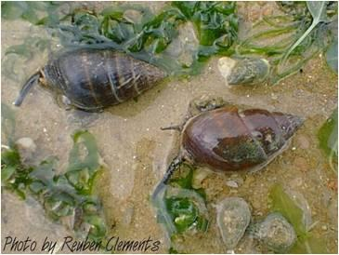
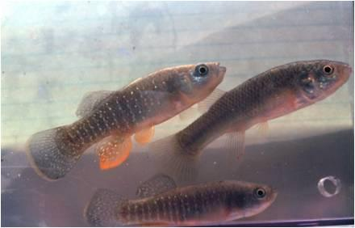
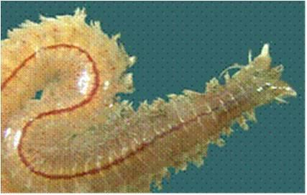
Terrapin Life
Live in brackish water
Sharp bony beak with NO TEETH!
We eat snails, fish, mussels, crabs, worms, algae and other plant material
Notes:
Only North American terrapin that strictly lives in brackish water. Brackish water is where salt enters freshwater and mixes.
They do not have teeth so food is crushed with the terrapins strong jaw.

Slide 7
TURTLE JOKES!!!!!!
Q: Why did the turtle cross the road?

Slide 8
A: To get to the Shell Station!

Slide 9
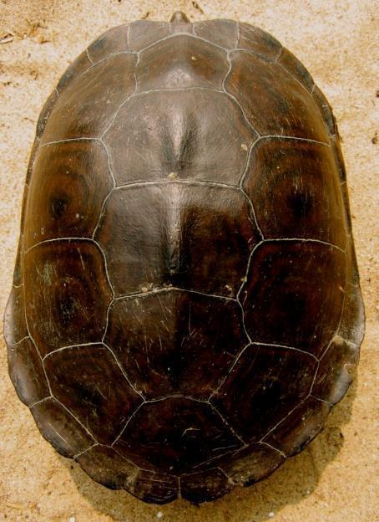
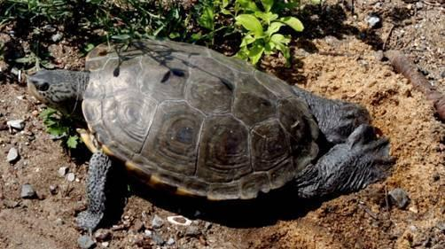
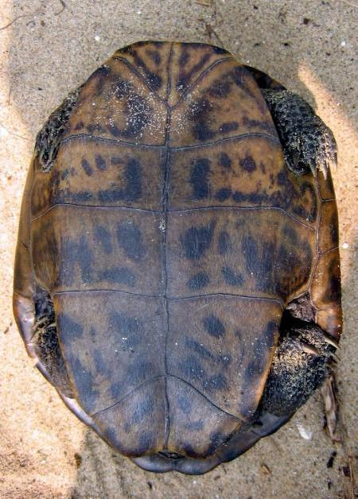
What do we look like?
Can live in water and on land:
  Streamlined shells!
  Webbed feet with nails!
Carapace
Plastron
Feet and Nails
Notes:
All terrapins have hingeless shells, therefore they can not retract into their shell like other turtles.
The carapace and plastron serve as a protective armor and structure like an external skeleton
The carapace is made up of scutes, or plates around the terrapins shell. Each scute grows outward in direction and can sometimes tell the age of the terrapin. By counting the rings in each scute, you can estimate how old a terrapin is. This is very similar to counting tree rings.

Slide 10
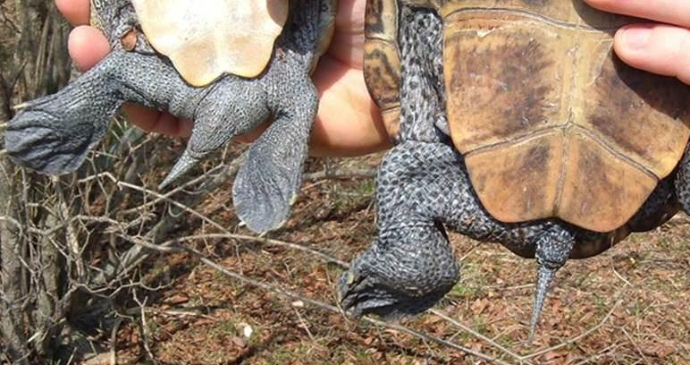
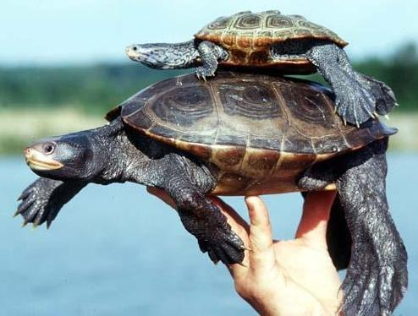
Do girls and boys look the same?
Average length: 6 inches
(15 cm)
Reach sexual maturity at
3 7 years old
Average length: 9 inches (23 cm)
Reach sexual maturity at
years old
Notes:
Male and female terrapins show sexual dimorphism. Sexual Dimorphism is when one sex (male or female) is extremely different looking for the other sex.
For terrapins, females are much larger, having larger heads and flat plastron. Males are smaller in size and have convex plastrons which fits with the females flat plastron during copulation.
yellowfin.dnr.sc.gov/.../Malaclemysterrapin.html

Slide 11
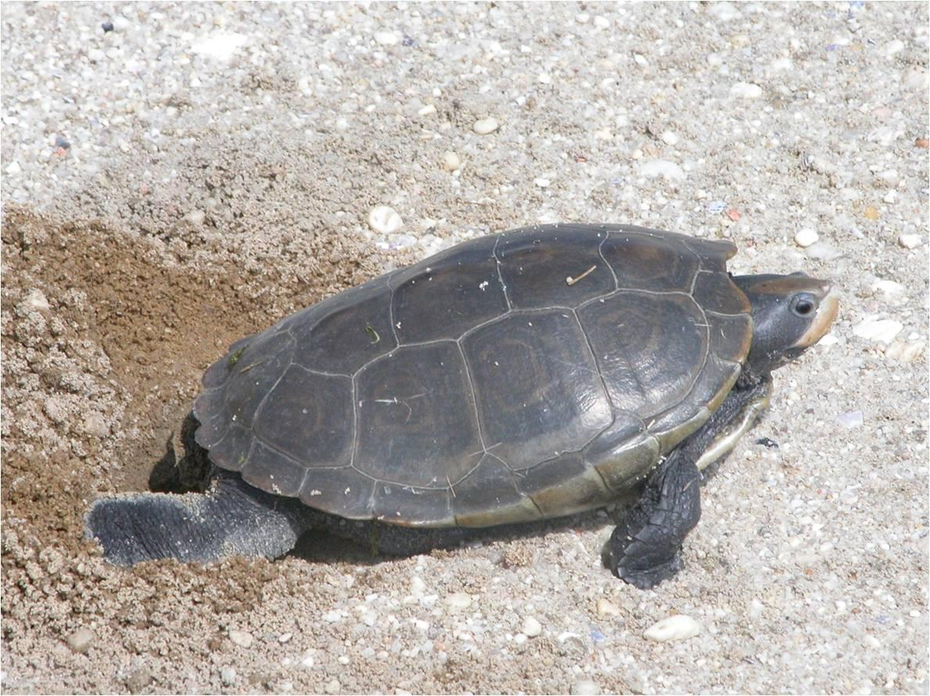
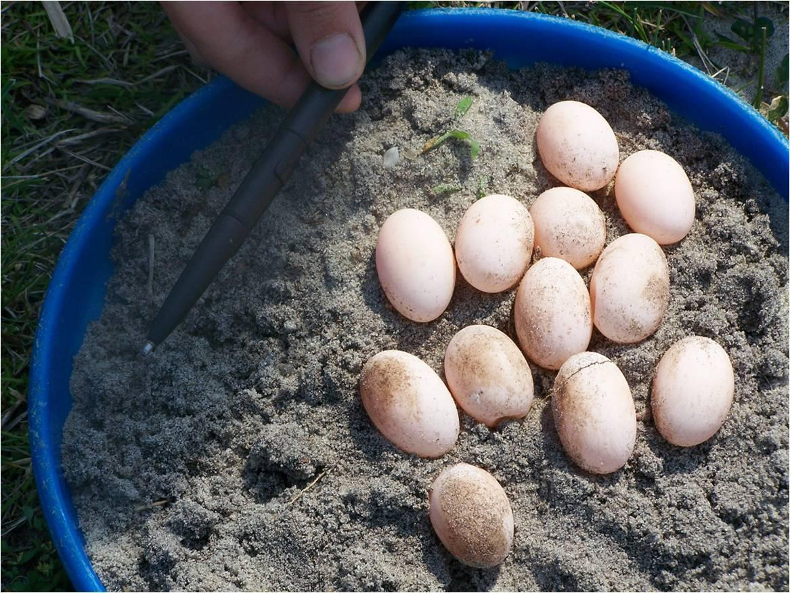
We lay eggs!
Nesting season: May – August
4 – 2-0 eggs per nest
Up to 3 nests per season
Notes:
The number off eggs a terrapin can lay in one single event is called a Clutch. Several clutches are possible per female in one nesting season with a 14 – 17 grace period of fertilization. Two or three clutches is common per nesting season.
http://www.nrdc.org/water/conservation/hbyear/hbjun.asp
Females can store sperm for the advantage of producing more than one clutch in one season with out multiple mating.
Terrapins are very particular about their nesting location. Several attempts on land can be made before a female will lay a clutch of eggs p 80- 100 etc…
Females can choose sandy or unrooted substrate when choosing a nest but other terrain could also be possible; dirt, rocks, or shells.
Females dig their nose into the sand before they lay their eggs to make sure they picked a good nesting location
http://www.wetlandsinstitute.org/education/teacher/Turtle_Talk.pdf

Slide 12
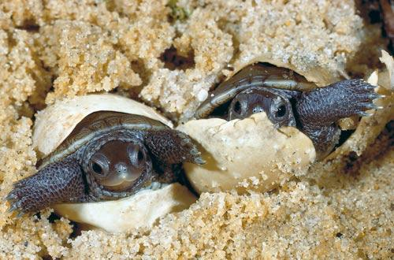
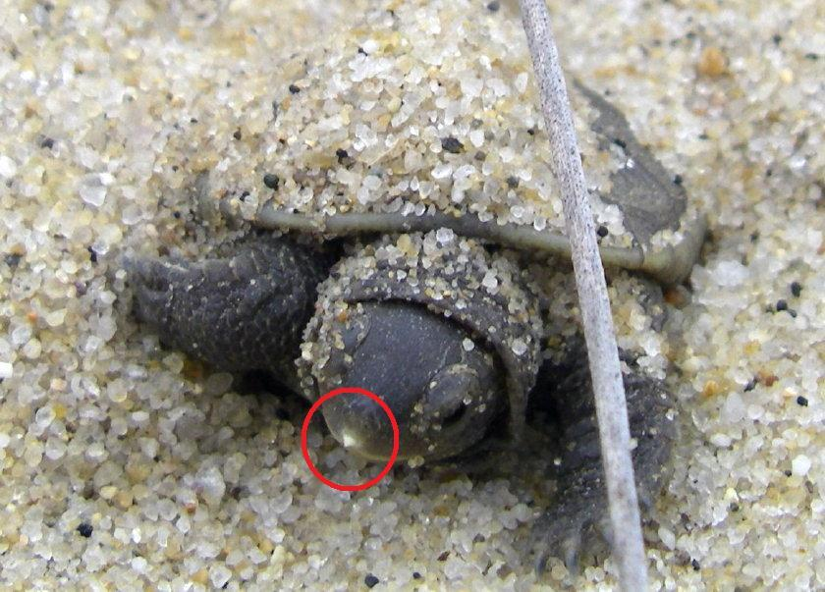
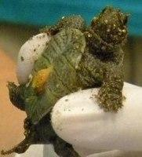
Hatchlings
Hatch in fall and spring
Egg tooth used to break out of shell
Egg sac for 2+ weeks
Notes:
It is impossible to determine the difference between a male and female hatchling. Because of their size and lack of unspecific features that are seen in the adults, all living hatchlings can not be sexed.
Egg yolk sacs serve as a the hatchlings food source providing important nutrients for the first two weeks of a hatchling life. This sac is located on the hatchlings plastron.
The egg tooth is made up of Keratin, a fibrous material just like your fingernails, that will eventually fall off

Slide 13
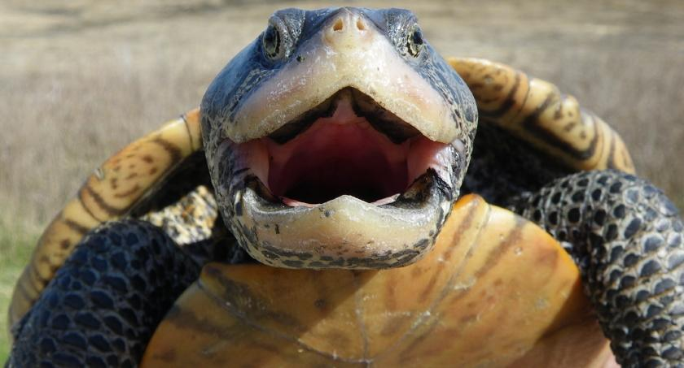
Conservation Efforts
Help! We are a “Species of Special Concern”!
Each state has its own laws for protecting us!

Slide 14
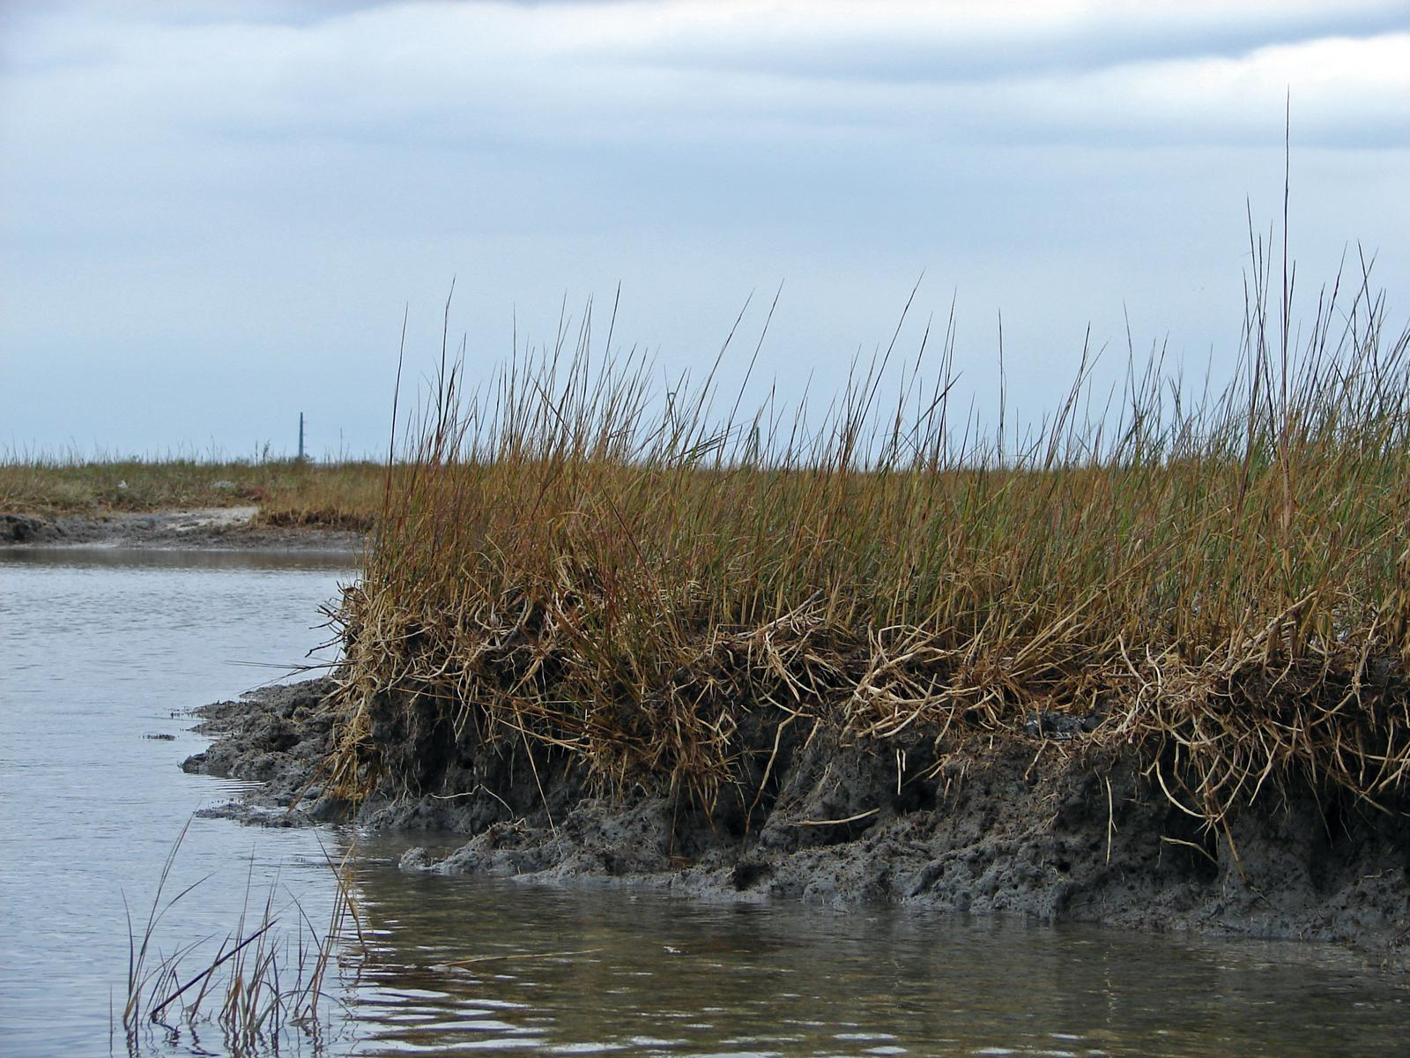
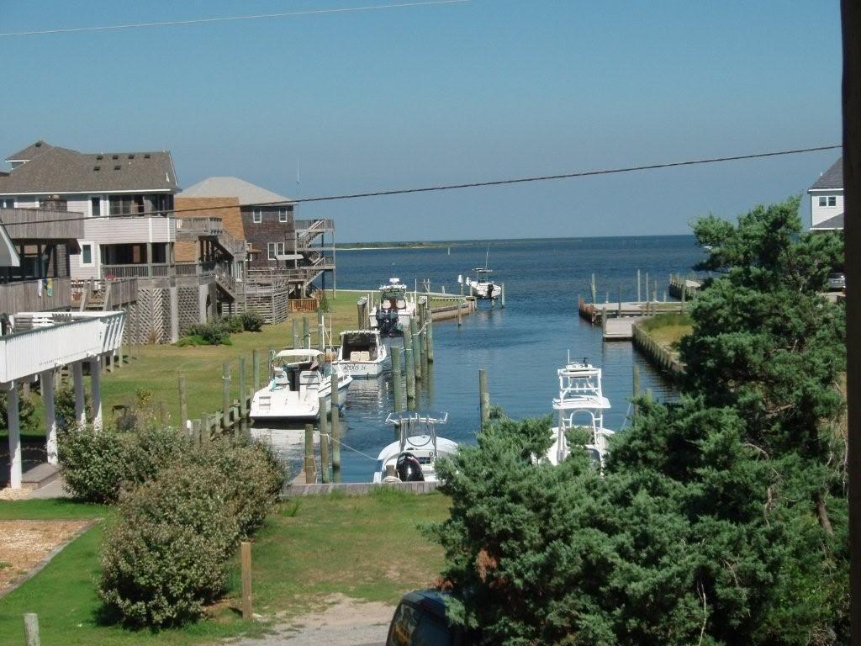
Terrapin Troubles!
Loss of salt marsh habitat from humans
Notes:
Erosion, development, and bulk heading can reduce, fragment, or eliminate nesting locations.
The loss in salt marsh habitat is the number one threat to terrapins. The loss can be directly related to the decline in terrapin populations. Because salt marshes serve as primary habitat source for terrapins, without their locale, the terrapin population could also diminish.
Another threat to terrapin populations is erosion. If a highly elevated slope is present, females will have a hard time climbing the slope which restricts them from laying their eggs in prime nesting locations. As a result poor habitat selection will be made which does not guarantee the best hatchling success. Females are often forced to lay their eggs in unfamiliar substrate.
Blue crabs and terrapins share a very similar home range
By catch in commercial and recreational Blue claw crab traps are a major threat to terrapins, bait used in crab traps also attract terrapins leading to entrapment
Traps that are abandoned or that become loose from their moorings are considered ghost traps and are responsible for terrapin deaths by drowning
Some states limit the number of traps fishermen use or the depth at which the trap is set.
Also some states require Turtle Excluder Devices, or By-Catch Reduction devices on crab traps. TED’s limit the size of the entrance funnel, crabs can still enter but larger turtles are restricted. Capture of older, larger females is reduced however, smaller males and juveniles are still at risk.
http://intraweb.stockton.edu/ccrp/description.html
http://www.terrapinconservation.org/articles.htm
When a females leaves the water in search of location of a nest, they often cross roads and become victims of car strikes.
http://www.jekyllislandauthority.org/turtlecenter/diamondbackterrapins.htm pictures website
http://nytts.org/proceedings/wood-rdk.htm roadkill pic
http://dnr.wi.gov/org/land/er/herps/turtles/turtle1.htm turtle crossing pic

Slide 15
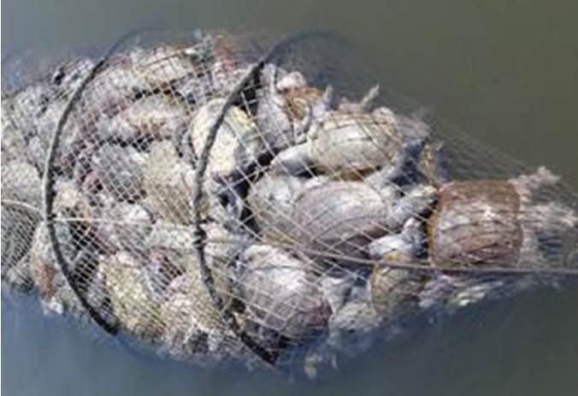
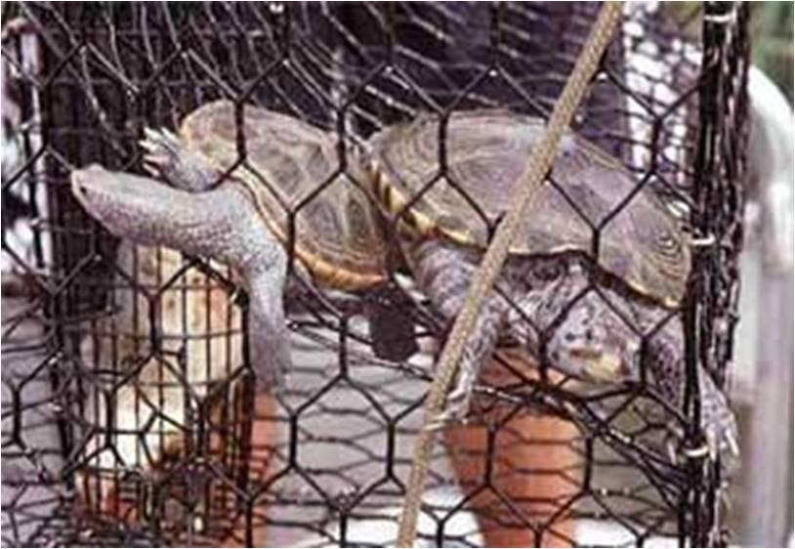
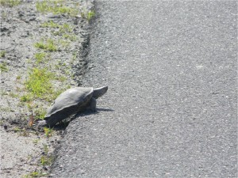
More Troubles!
Crab traps
Traffic

Slide 16
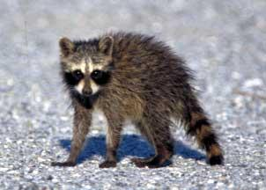
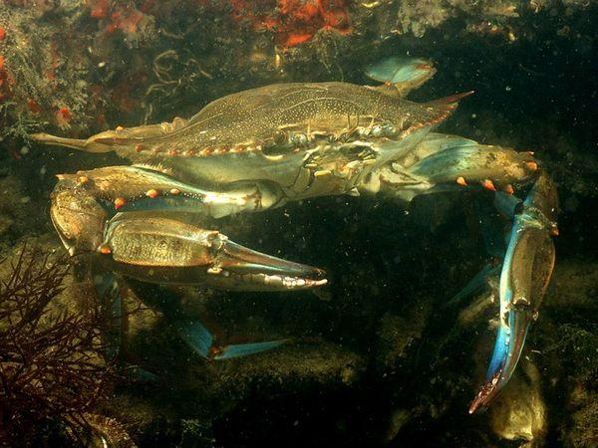
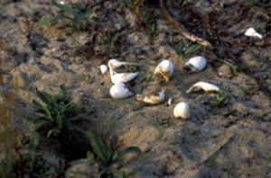
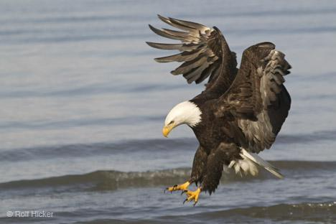
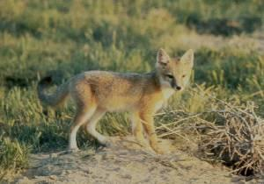
Natural Troubles!
Predators

Slide 17
TURTLE JOKES!!!!!!
Q: What kind of phone did the turtle buy?

Slide 18
A: A shellular phone!

Slide 19
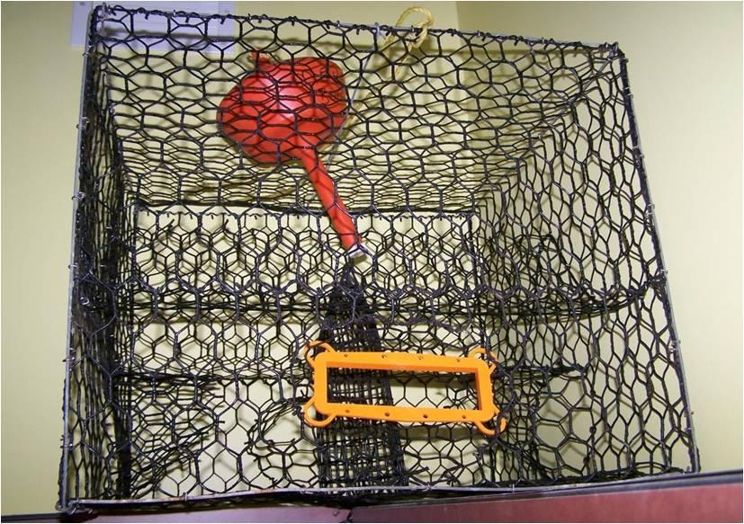
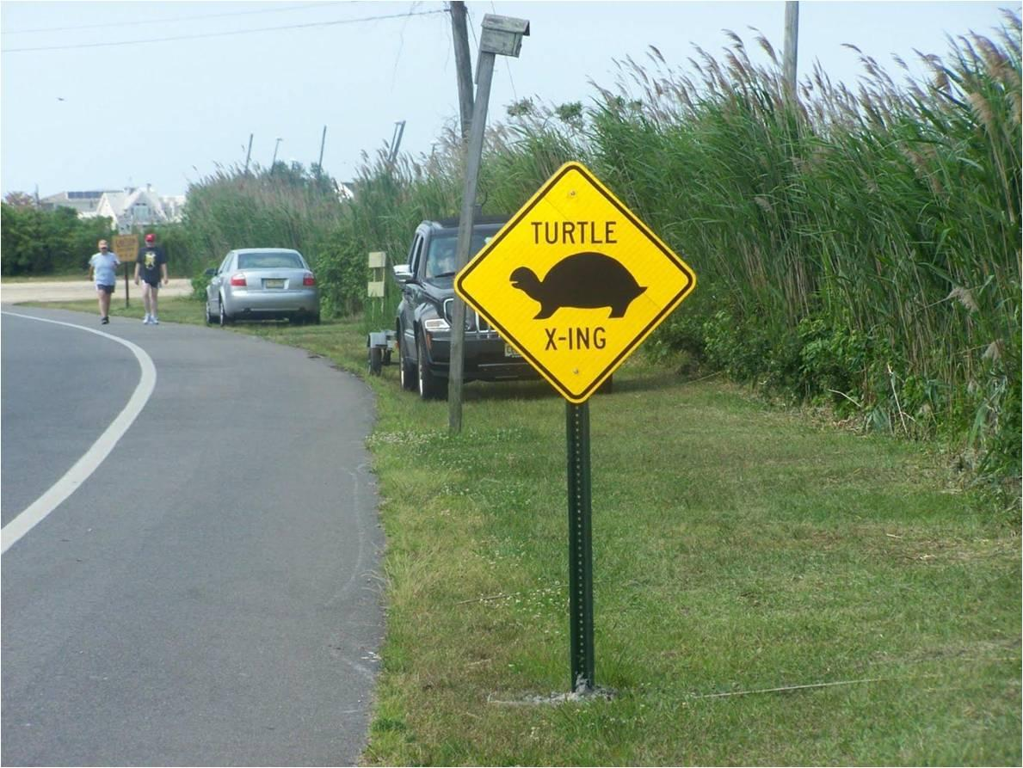
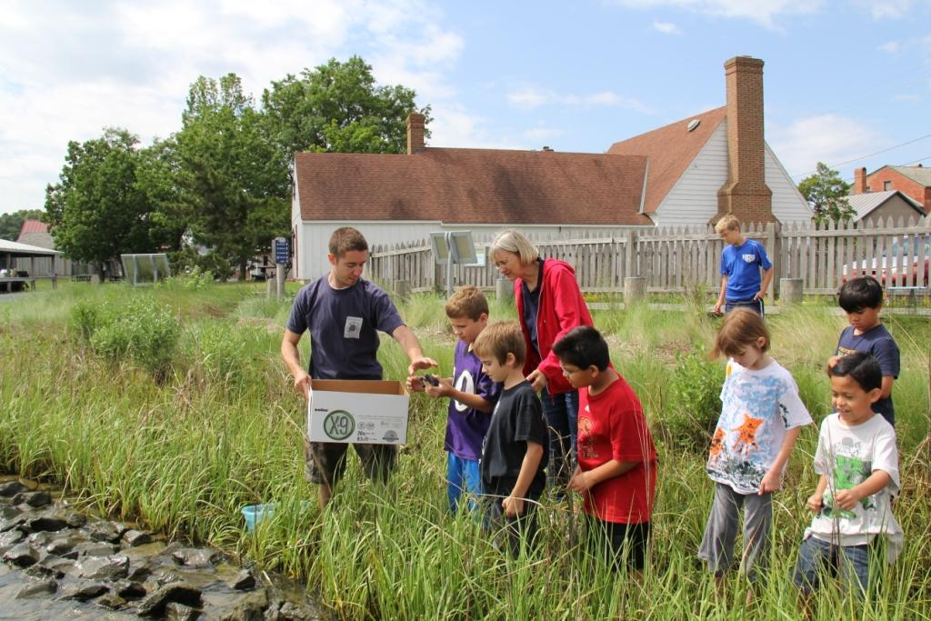
Helping Hands!
BRDs
Road crossing signs
Terrapin Head Start
Notes:
Conservation is the key element for helping to protect terrapins throughout their range. Habitat management is essential for maintaining a viable population.
Head starting programs eliminates egg predation. Eggs removed from their natural settings, placed in incubators, raised, and then released back into the wild.
Terrapins are used as marketing icons which promotes public awareness of the species.

Slide 20
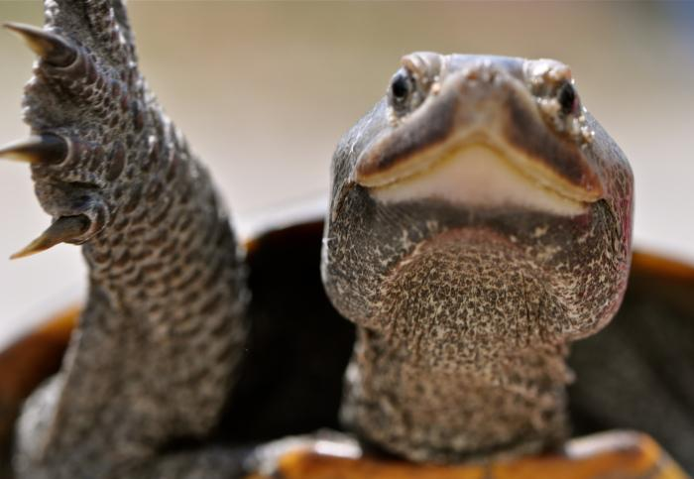
QUESTIONS???
Please visit DTWG.org

