Slide 1
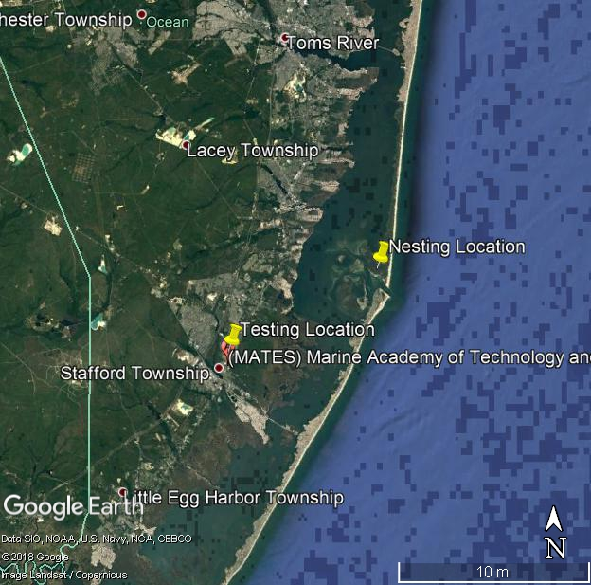
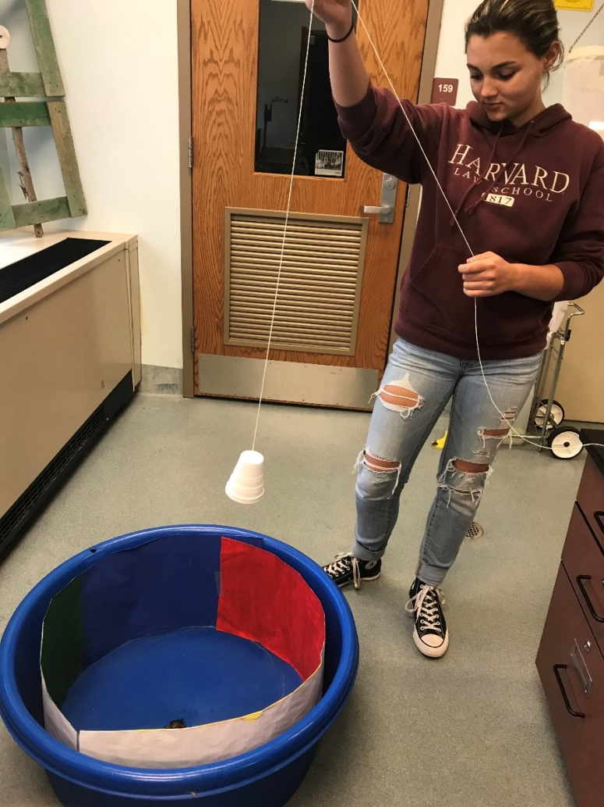
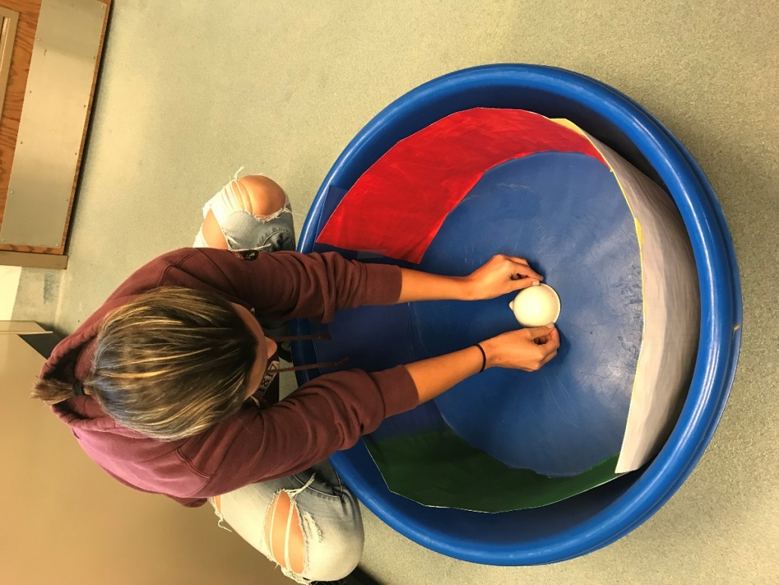
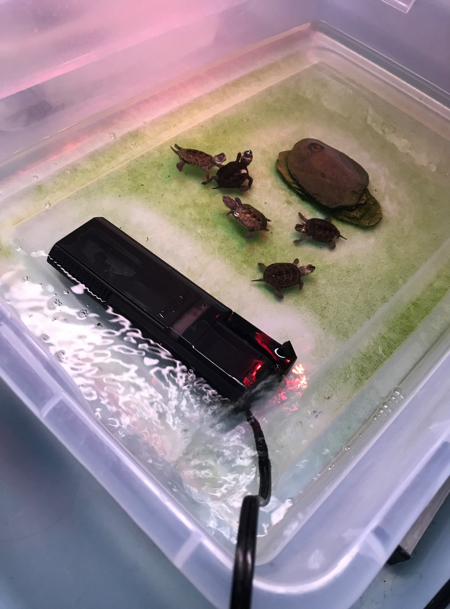
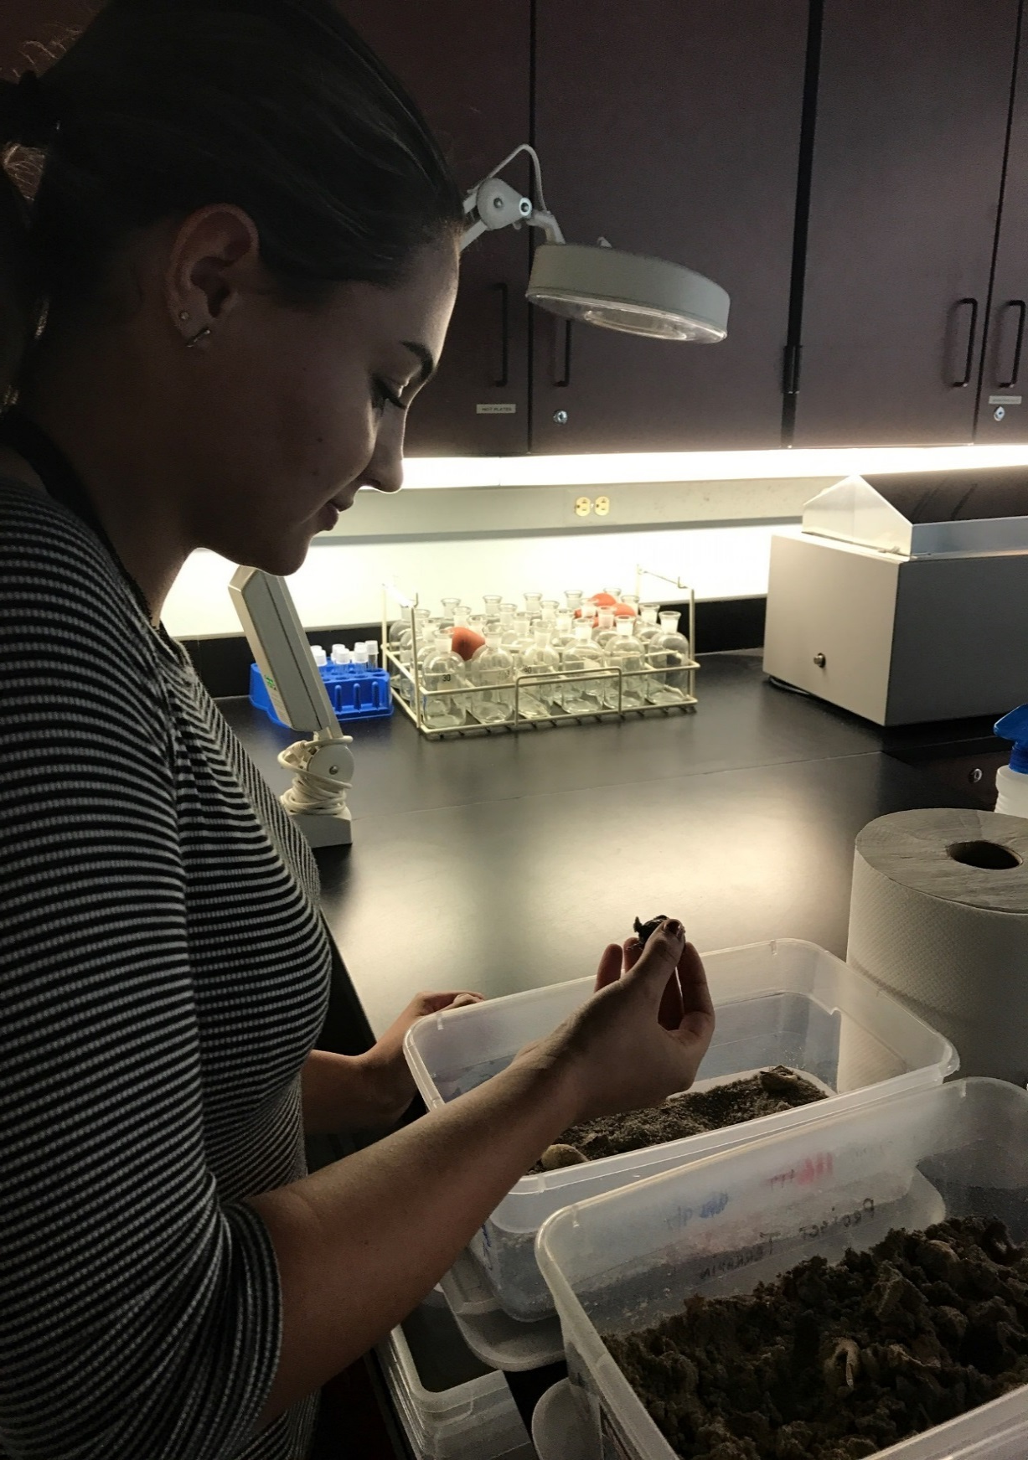
The Effects of Color Exposure on the Directional Preferences of Diamonback Terrapin, Malaclemys terrapin, Hatchlings Emma Riley Marine Academy of Technology and Environmental Science, Project Terrapin, Manahawkin, NJ
Abstract
Objective
Discussion
The Northern Diamondback Terrapin (Malaclemys terrapin terrapin) is a native turtle species to the east and Gulf coasts of the United States. In recent years, there have been many conservation efforts for the protection of this species as well as research done to better determine populations. Terrapins nest on shoreline areas along Barnegat Bay and hatchlings emerge from the nests, then make their way to salt marshes. In previous studies, hatchlings had a tendency to travel northwest because of their orientation where they hatch and location in relation to the water; however, there are other factors that may affect this, such as color. Do these factors have a significant effect on the directional preference of hatchling terrapins? To answer this question, I determined the orientation of 100 terrapin hatchlings from North Sedge Island. Hatchlings were placed in a large circular arena to determine their color preference as related to the initial nest site on the Island. Each terrapin was place in the center of the arena, under an opaque container, then released and monitored to see their first directional instinct. A majority of the hatchlings were observed to gravitate towards shades of green. The hatchlings used hatched at North Sedge Island as well as at MATES. It was concluded that the hatchlings do have a color preference but it can be swayed by their ability to use the magnetic field to navigate. This study indicates that terrapin hatchlings can be affected by man made structures and vegetation around nests.
To determine whether hatchlings have a color preference and to determine whether color exposure has a greater effect on directional preference than the magnetic field.
Based upon the statistical analysis done, it does seem that hatchlings have a general color preference. When an ANOVA was run using an alpha of 0.05, a P-value of 0.011 showed that there was a statistical difference in the preferred colors for the terrapins. However, when further statistical analysis was performed, it was seen that green was statistically different than both yellow and blue, but not statistically different from red. To ensure that this was not biased by a predisposed directional preference, a Tukey HSD test was run with a harmonic mean sample size of 4.000 and an alpha of 0.05. From these results, an ANOVA was run and yielded a P-value of 0.409, showing that color was in fact the driving force for movement and not the directional preference. In order to better see whether green and red are statistically different or not, larger sample sizes could be used in the future, which would also determine if green truly is their preferred color. I could also have tested outside and inside to see if this would have an effect on their color choices as well.
Procedure
Methodology:
Terrapin Usage, Quantity, and Specifics
a. Double previous hatchling and trial numbers, aim for 100+
b. Have hatchlings from multiple broods
c. Nesting locations on North Sedge Island
d. Each hatchling placed individually in the center of a circular arena and I will monitor which direction they turn in using a magnetic compass and protractor
2. Arena/Testing Setup
a. Arenas will be set up as circular plastic bins
b. Hatchlings will be covered for 30 seconds with a cup to disorient them
c. Make color swatches of basic colors to put on the edge of the bin
3. Monitoring and Testing
a. Hatchlings will be monitored from early September to mid February
b. Data will be collected and analyzed in order to come to a conclusion
Study Site:
A lab at the Marine Academy of Technology and Environmental Science in Manahawkin, N.J.
Statistical Analysis:
An ANOVA single factor was run on the data with an alpha of 0.05. A P-value of 0.011 was obtained, demonstrating a significant difference in the data and showing a preference of color in the hatchlings.
To determine whether color or directional preference was a greater driving factor, a Tukey HSD test was performed with a mean square of 49.125, a harmonic mean sample size of 4.00, and an alpha of 0.05.
An ANOVA then yielded a value of 0.409, thus showing that the color seemed to be the driving force for terrapin movement.
Introduction
Figure 3: Map of nesting location and test location.
The Malaclemys terrapin terrapin, also known as the Northern Diamondback terrapin, is a species native to the northeastern coast of the US. They are a keystone species for estuaries as they are often the first indicator of any water impurities (Brennessel 164).
They are also the only turtle that inhabits coastal marshes to spend their entire life in brackish water, and make a home in the Barnegat Bay (“Diamondback Terrapin” 1). They are a special concern species in New Jersey and tend to hatch in the late summer and early fall from their nests underneath the sand (Feinberg & Burke 1).
I have observed in my previous study that it appears as those these turtles have a directional preference based on their nesting location. It has been noted that in different species of turtles that also have this instinct, that artificial light has a large effect on where the hatchlings and migrating adults will go.
In this experiment, I plan to test to see if color affects their directional preferences as well as to see if they have a preferred color choice for their surroundings.
I will do this by giving them a choice of primary and secondary colors in another test to see which ones they gravitate towards. I will rotate these colors into different directions to compare my previous research to the color choices and locations and determine whether color or direction have greater influence.
This research is important because when building turtle gardens and safe areas for these turtles, preferences like this need to be thought of to create the best environment possible.
Conclusion
In conclusion, the hatchlings did in fact seem to have a color preference and generally gravitated towards green.
Color was also found to be a greater driving force than initial directional preference on terrapin movement.
When an ANOVA single factor was run using an alpha of 0.05, a P-value of 0.011 was obtained, showing a statistical difference in the color choice of these terrapins. However, when further analysis was done, although yellow and blue were statistically different than green, red was not.
In the future, more testing could be done with larger sample sizes and trials to determine whether red and green are statistically different, and to conclude with greater confidence that the preferred color is indeed green.
This research is important because in order to help conserve and raise the terrapin population, we need to be familiar with their behavior and instincts. Their color preference could be used in aiding those building turtle gardens or in case of man made structures being built near nesting sites. These turtle gardens can create an environment best suited for hatchling survival and structures can be made to deter terrapins from heading in the wrong direction after hatching.
Figure 4: Lifting the covering with a sting to minimize the shadows cast over arena
Figure 3: Covering a hatchling with an opaque covering
Results
Acknowledgements
I would like to thank my research advisors for all of their assistance in supplying me with the materials needed, a testing location, and aiding me in analyzing my data. I would also like to thank my parents for providing me with rides to and from the school as well as their support, and my friends for also assisting me with all of my trials.
Figure 5: The number of terrapins that gravitated towards each color and direction. It can be seen that terrapins overwhelmingly gravitated towards the color green.
Figure 6: Number of terrapins that gravitated towards color only. This shows that regardless of the direction the color was facing, hatchlings overwhelmingly chose green.
References
Diamondback Terrapin. (2015). Retrieved October 01, 2016, from http://www.aqua.org/explore/animals/diamondback-terrapin
Feinberg, J., & Burke, R. (2003). Nesting Ecology and Predation of Diamondback Terrapins, Malaclemys terrapin, at Gateway National Recreation Area, New York. Journal of Herpetology, 37(3), 517-526. Retrieved from http://www.jstor.org/stable/1566055
Irwin, W. P., & Lohmann, K. J. (2002, October 28). Magnet-induced disorientation in hatchling loggerhead sea turtles. The Journal of Experimental Biology 206, 497-501.
Figure 1: Malaclemys terrapin terrapins from Project Terrapin Hatchling Headstart Program.
Figure 2: Checking in on hatchlings to be used for research.
Figure 7: The color preference of hatchlings based on the Tukey’s HSD test. It shows that yellow, blue, and red are related and that green and red are related.
Figure 8: The directional preferences of the hatchlings used for this research. It can be seen that as the terrapins remain in captivity, they lose some directional sense.

