Slide 1
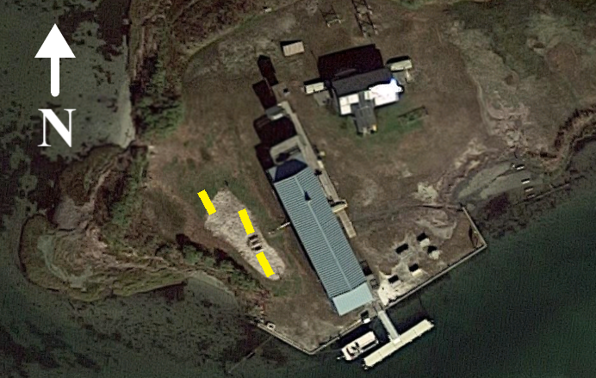
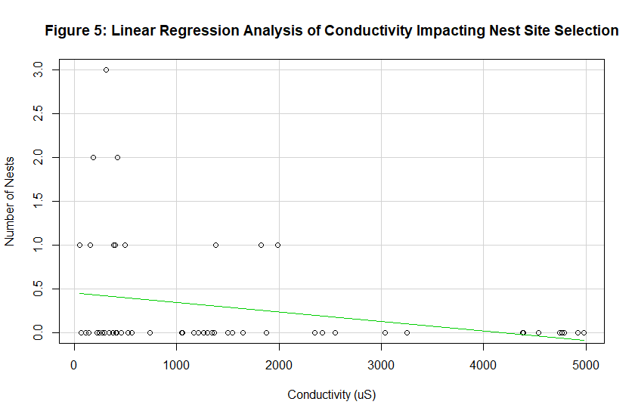
Conductivity has a significant negative impact on nest site selection of
Malaclemys terrapin terrapin
Emma Applegate^{1,2} and Dr. John Wnek¹
¹Project Terrapin, Marine Academy of Technology and Environmental Science, Manahawkin, NJ 08050
²University of Pittsburgh, 4200 Fifth Ave, Pittsburgh, PA 15260
Abstract
Methods
Discussion
The northern diamondback terrapin, Malaclemys terrapin terrapin, frequently accesses nesting sites in estuarine areas from late May into late July at Barnegat Bay, NJ. Terrapin nesting sites are affected by vegetation and microhabitat conditions, soil composition, elevation, and temperature. These factors have been shown to influence nest-site success. As areas along the east coast of the United States incur impacts resulting from Climate Change (i.e., sea level rise and storm surges) nesting sites are inundated with local brackish water. Through this study, the effect of conductivity on nest site selection of the northern diamondback terrapin was examined. This study was a continuation of a series of studies on North Sedge Island that began in 2015. Based on results of previous studies, was hypothesized that there will be no significant difference in nest site selection based on the conductivity of nest sites. Three tracts of land on North Sedge Island were split into three separate plots: one of high conductivity (conductivity ≥ 4000 µS), one of medium conductivity (1000 µS ≤ conductivity ≤ 2000 µS), and one control, creating a total of nine plots. Conductivity of each plot was measured, and terrapin nesting occurrences were recorded in each plot. Contrary to the hypothesis based on previous studies, it was determined that conductivity had a significant impact on nest site selection (p-value= 0.03973). This implies that terrapins can detect conductivity and select nests with lower conductivities, which is important in terms of possible egg survivorship.
Three separate tracts of land on North Sedge Island were split into three smaller plots: a control, medium conductivity, and high conductivity.
To obtain medium and high conductivity, brackish water from the surrounding Barnegat Bay was deposited on the corresponding plots.
Control conductivity ranged from 53.8 µS to 562 µS
Medium conductivity was considered between the range of 1000 to 2000 µS.
High conductivity was considered any conductivity above 4000 µS
Conductivity was measured by mixing 15 mL of soil with 45 mL of unionized water and obtaining values using a YSI 30 multimeter.
After rain events, conductivity was tested and adjusted accordingly.
Number of nests is negatively related to conductivity of nesting area, indicating that as conductivity increases, the number of nests decreases.
Conductivity has a significant effect on number of nests (Figure 4; p-value= 0.03973).
This does not correspond with previous studies (Gundermann and Wnek 2015, Anderson and Wnek 2017).
This implies that terrapins can sense soil conductivity and will not select sites with high conductivities.
However, sample size is low (11 nests) and more research needs to be done on this subject.
When compounded with previous years data, conductivity does not have a significant impact on nest site selection (Figure 5; ANOVA, p-value= 0.38211).
Conclusions and Future Direction
More studies on conductivity affecting nest site selection will need to be done at North Sedge Island and, potentially, other sites.
The data indicates that as storm surges inundate areas and sea level rise continues, terrapins will not only lose nesting area but will actively avoid areas that have high conductivity.
Though dredge islands can be created to add nesting habitat, they need to be aged (Wnek et al. 2013).
While it was believed that dredge island needed to age approximately one year, this data suggests that it will need to age longer, or until conductivity is low enough that it matches control plots.
Introduction
Figure 3: Study site- Aerial view of study site on North Sedge Island. Yellow marks indicate tracts used to create individual conductivity plots.
Figure 4: 2018 plot treatments, with H standing for high conductivity, M for medium conductivity, and C for control.
Northern Diamondback Terrapin
Malaclemys terrapin terrapin, known as the northern diamondback terrapin, is a subspecies of diamondback terrapin that ranges from Massachusetts to Cape Hatteras, North Carolina (Palmer and Cordes 1988).
Native to Barnegat Bay, terrapins are specific to brackish water environments.
Shoreline erosion, derelict crab traps, illegal harvesting, and vehicle collision threaten this species.
Like other turtles, terrapins exhibit nest-site philopatry and returns to the same sandy beaches each year (Roosenburg 1994).
Diamondback terrapins eat periwinkle snails, which feed on spartina found in estuaries and marsh ecosystems (Silliman and Bertness 2002).
Conductivity
As sea level rises and storm surges flood coastal areas, nesting habitat of the northern diamondback terrapin is altered. Diamondback terrapins have thin eggs which exchange water with the surrounding environment (Packard et al., 1987; Cagle et al., 1993; Wilson 1998; as cited by Wnek et al. 2013).
High soil conductivity leads to egg failure, with no embryonic development after the first stage of development (Wnek 2010).
Habitat fragmentation limits the availability of nesting sites; potential remedies are dredge made islands. These islands have high salinities and need to be aged approximately 1 year (Wnek et al., 2013).
Because eggs laid in dredge soil or areas affected by storm surges have a higher conductivity and thus a lower chance of survival, it is important to address whether or not the northern diamondback terrapin selects nesting area based on conductivity.
Previous studies suggest that conductivity does not impact nest site selection (Gundermann and Wnek 2015; Anderson and Wnek 2017).
Results
Of the total 27 nests on North Sedge Island, only 11 were in conductivity plots.
Of these 11 nests:
9 nests (81.81%) were in low conductivity/control plots
2 nests (18.18%) were in medium conductivity plots
0 nests (0%) were in high conductivity plots
The lowest recorded conductivity was 53.8 µS in a control plot
The highest recorded conductivity was 4382 µS in a high conductivity plot
Of the total 27 nests on North Sedge Island, only 11 were in conductivity plots.
Of these 11 nests:
9 nests (81.81%) were in low conductivity/control plots
2 nests (18.18%) were in medium conductivity plots
0 nests (0%) were in high conductivity plots
The lowest recorded conductivity was 53.8 µS in a control plot
The highest recorded conductivity was 4382 µS in a high conductivity plot
Figure 7: A terrapin nesting in a medium conductivity plot on North Sedge Island.
Figure 8: A tract of land used to form Plot 3, with stakes used to identify different conductivities.
Acknowledgements
I would like to thank Colby Capri, Nick DeGennaro, Darren Dorris, Mae Henry, Jim Merritt, Jackie and Tony Rainero, and the program interns of Sedge Island for assistance in the field. I would also like to thank New Jersey Fish and Wildlife for allowing usage of Sedge Island. And, most importantly, I would like to give a tremendous thanks to Dr. John Wnek, who assisted me throughout the project, and Karen Byrne, who put me on the path towards Project Terrapin, for moral support and help throughout my stay at Sedge Island.
Figure 5: Linear regression analysis of conductivity (µS) affecting the number of nests (p-value= 0.03973, R²= 0.06112). Statistics for linear regression were run through the program “R”.
References
Anderson, S. and Wnek, J. Reproductive output trends and effect of soil conductivity on nest site selection of Malaclemys terrapin in Barnegat Bay, NJ. College of the Atlantic. 2017.
Gundermann, K. The Effect of Soil Conductivity on Nest Site Selection in Northern Diamondback Terrapins. University of Delaware. 2015.
Palmer WM, Cordes CL (1988). Habitat suitability index models: diamondback terrapin (nesting)–Atlantic Coast. US Fish and Wildlife Service Biological Report 82, Washington, DC, pp. 1–18.
Roosenburg, W.M. 1994. Nesting habitat requirements of the diamondback terrapin: a geographic comparison. Wetlands Journal 6: 9–12.
Silliman, B. & Bertness, M. 2002. A trophic cascade regulates salt marsh primary production. PNAS. 99: 10501-10505.
Wnek, John P., 2010. Anthropogenic Impacts on the Reproductive Ecology of the Diamondback Terrapin, Malaclemys Terrapin. Thesis. Drexel University, N.p.: n.p., n.d. Print.
WNEK, J. P., BIEN, W. F. and AVERY, H. W. (2013), Artificial nesting habitats as a conservation strategy for turtle populations experiencing global change. Integrative Zoology, 8: 209-221. doi:10.1111/1749-4877.12042
Figure 1: Newly laid terrapin eggs contained before recording dimensions and moving to the hatchery on North Sedge Island.
Figure 2: Deceased hatchling found along the bulkhead of North Sedge Island. This hatchling was from the 2017 nesting season.
Figure 6: Compound bar graph displaying the past four years of nest site selection data (ANOVA, p-value= 0.38211) (Gundermann and Wnek 2015, Gundermann and Wnek 2016, Anderson and Wnek 2017). Statistics for ANOVA were run through Microsoft Excel.
Hypothesis
Based on previous studies, conductivity will not have a significant effect on nest site selection for the northern diamondback terrapin.

