Slide 1
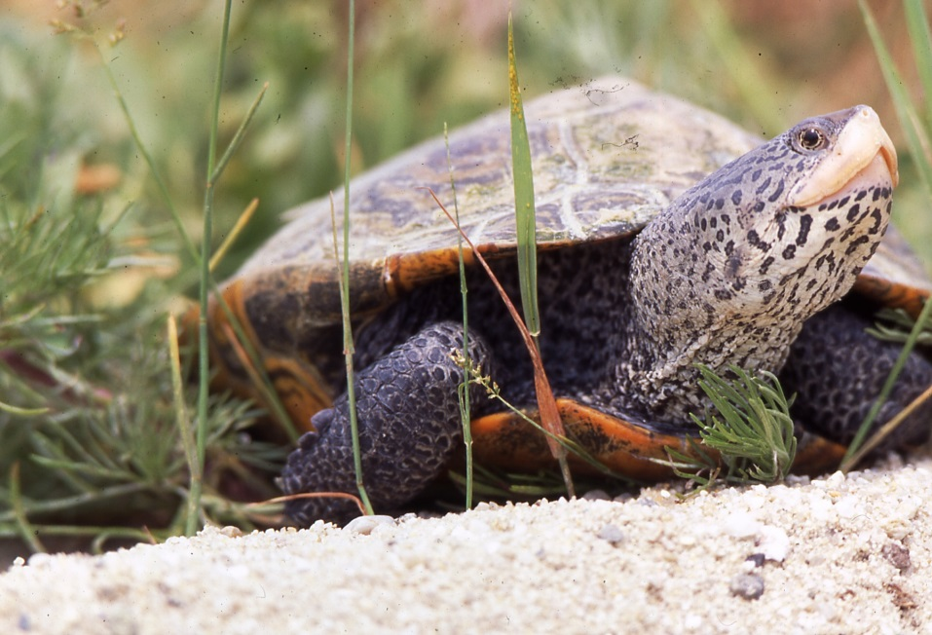
Project Terrapin
Marine Academy of Technology and Environmental Science, Manahawkin, New Jersey projectterrapin.org projectterrapin@gmail.com

Slide 2
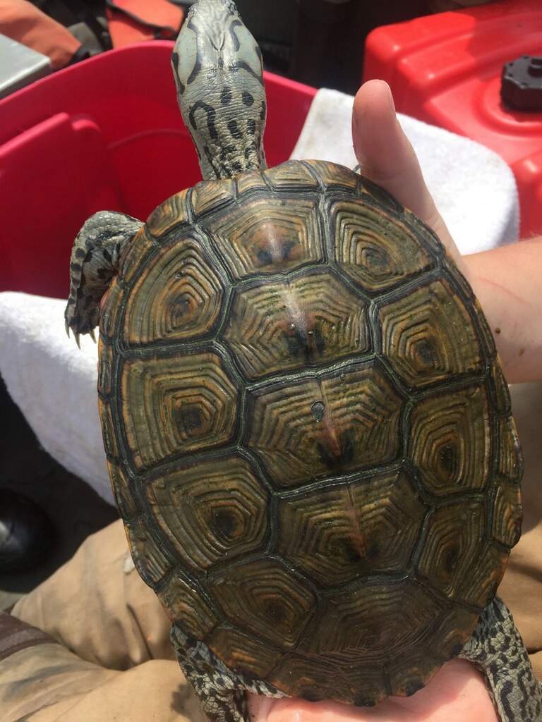
What Are Diamondback Terrapins?
Aquatic turtles adapted for water and land use.
Streamlined shells for swimming.
Webbed feet for swimming and digging nests.
Nails for digging through sand.
Name comes from diamond pattern on shell.
Can regulate the percentage of salt in their bodies.

Slide 3
Habitat
Live in brackish water, which is a mixture of freshwater and saltwater.
Found in salt marshes and mangrove swamps along the Eastern and Southern Coasts of the US, from Massachusetts to Texas.

Slide 4
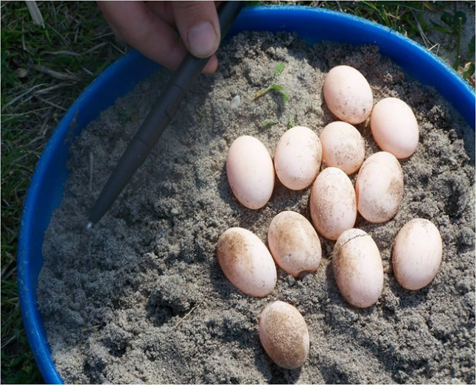
Nesting
Nesting season: April to August
Nesting habitat: Sandy beaches
Nests are dug 5 to 11 inches into the sand.
One female can lay 2 to 22 eggs at a time, up to 3 times per season!

Slide 5
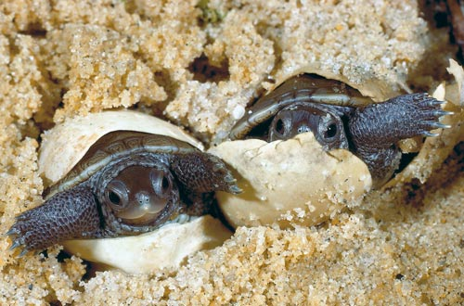
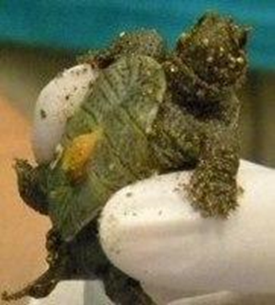
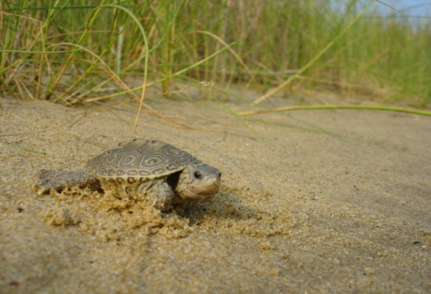
Hatchlings
Eggs hatch in Fall and Spring.
Break out of the shell with an “egg tooth” and survive on yolk sacks for the first few weeks.
Leave the sandy beaches to live in the salt marsh habitats.

Slide 6
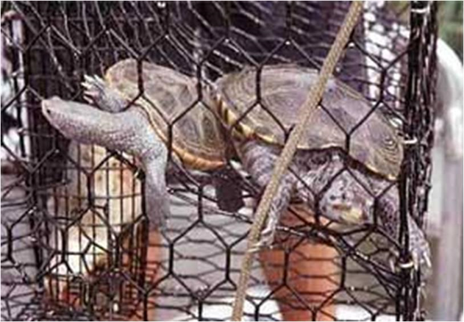
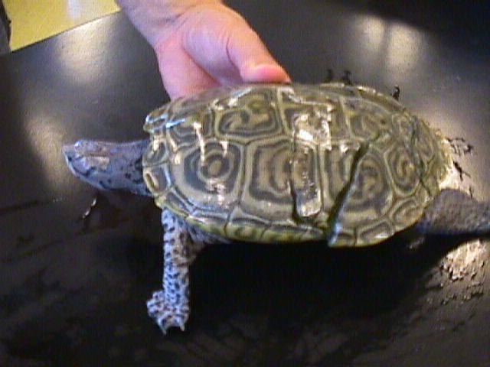
Human And Environmental Threats
Development along shorelines
Eliminates nesting habitats and causes erosion of salt marshes
Abandoned crab traps and other fishing gear
Crab traps without BRDs
Cars and Boats
Sea Level Rise

Slide 7
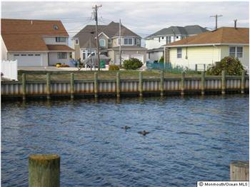
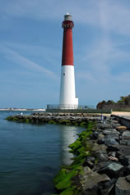
Habitat Loss
Over 25% of the original salt marshes in Barnegat Bay have been lost over the last 100 years.
Over 38% of the current Barnegat Bay shoreline is developed with structures, such as bulkheads or other barriers.

Slide 8
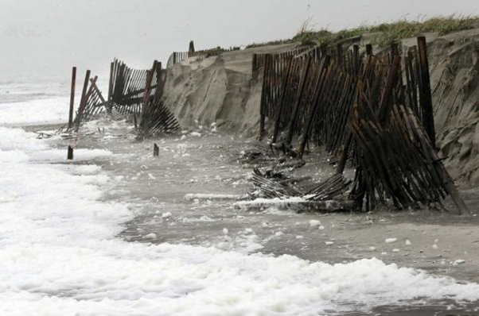
Sea Level Rise
Causes significant increase in sea level extremes, such as storm surge height and flood levels.
Causes erosion of habitat, especially during storms
Will affect over 95% of ocean areas

Slide 9
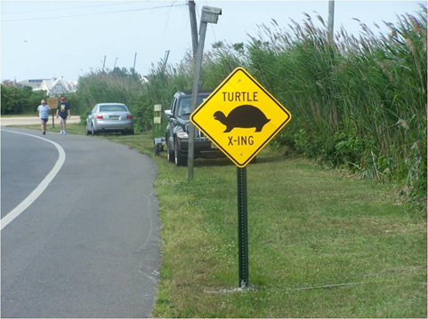
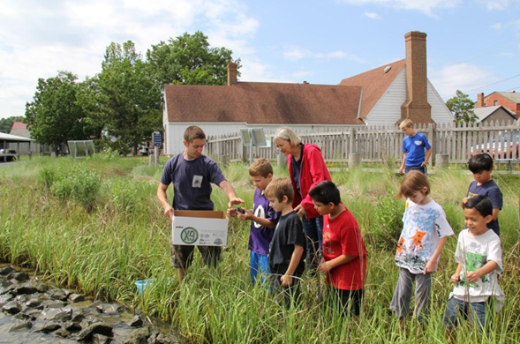
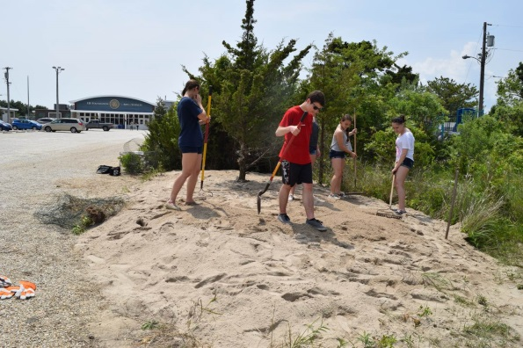
What Are We Doing To Help?
Install road signs
Promote the use of Bycatch Reduction Devices(BRDs) on crab traps
Studying terrapin activity on Sedge Island
Install Turtle Gardens for nesting habitat
Promoting Living Shorelines
Hatchling Head-Start Program
Terrapin Sighting Project for determining habitat use
Working with NOAA to remove abandoned fishing gear from Barnegat Bay
Education and Outreach through MATES

Slide 10
Learn More!

