Slide 1
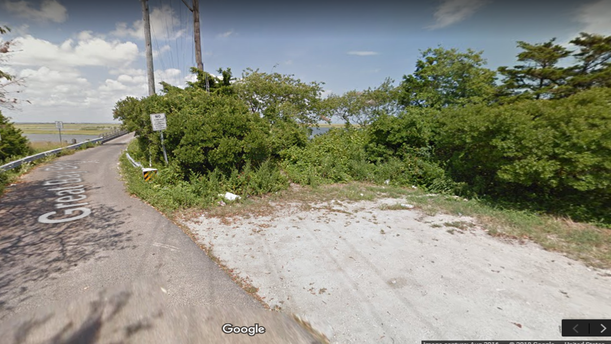
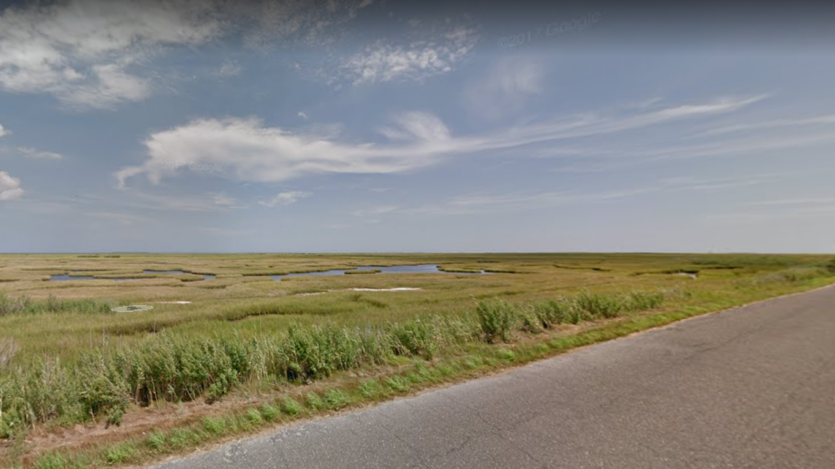
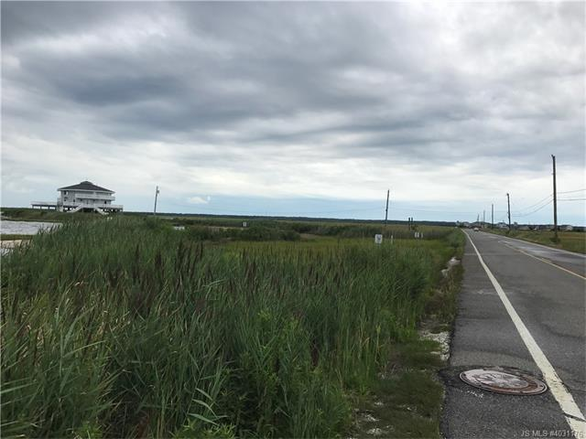
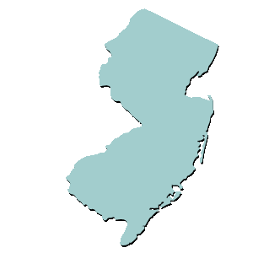
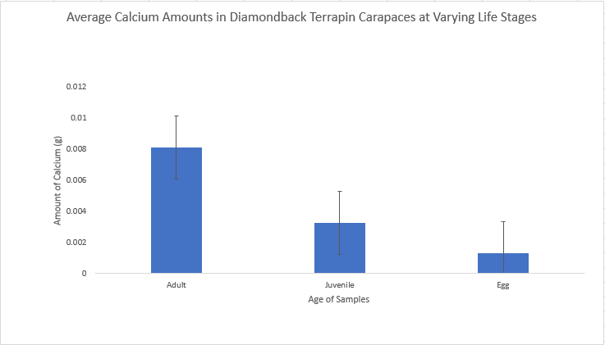
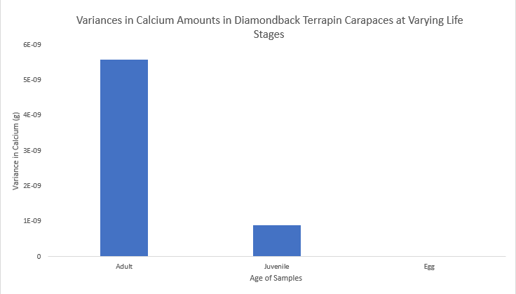
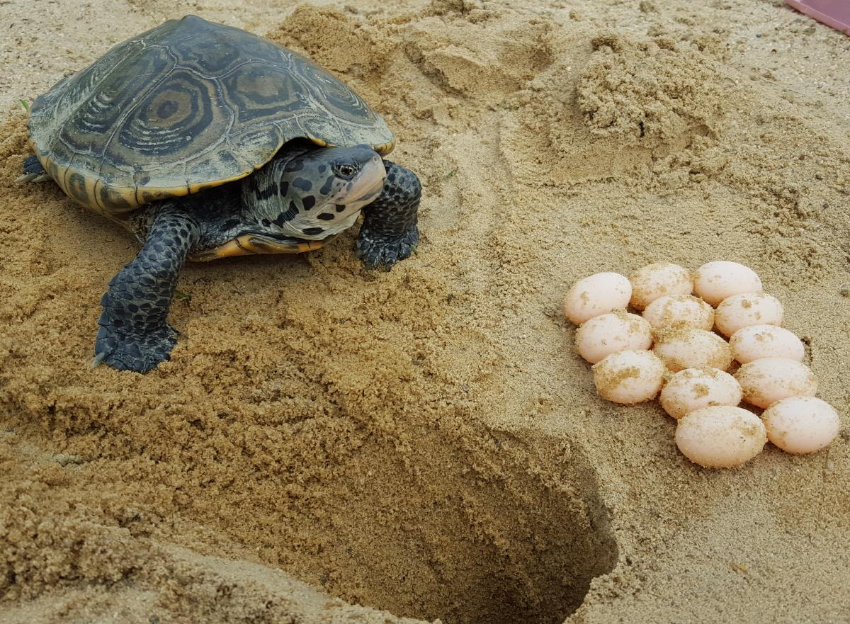
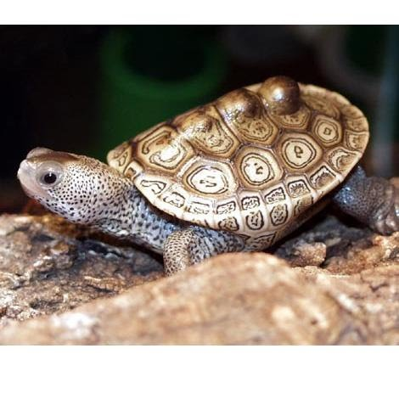
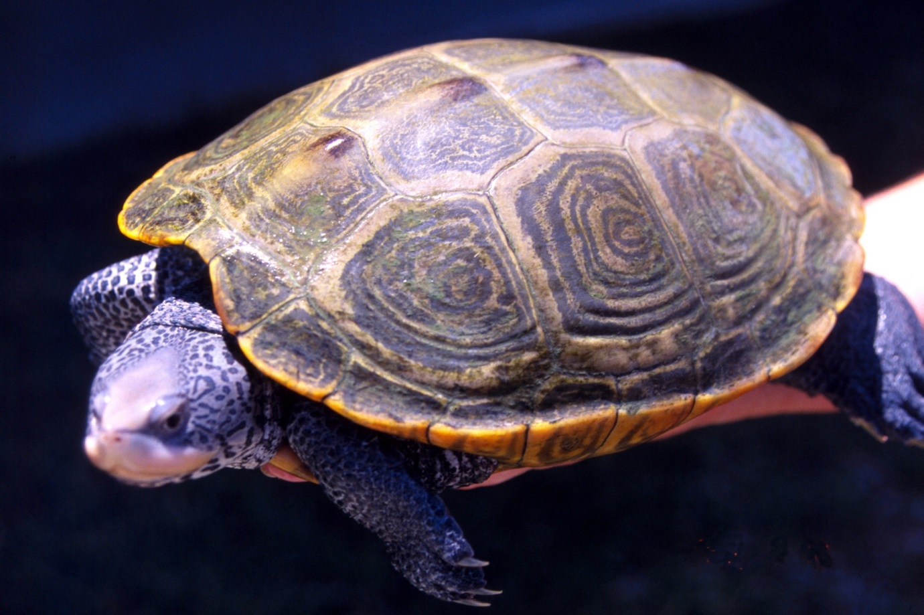
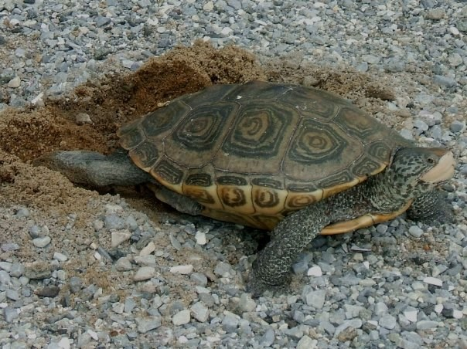
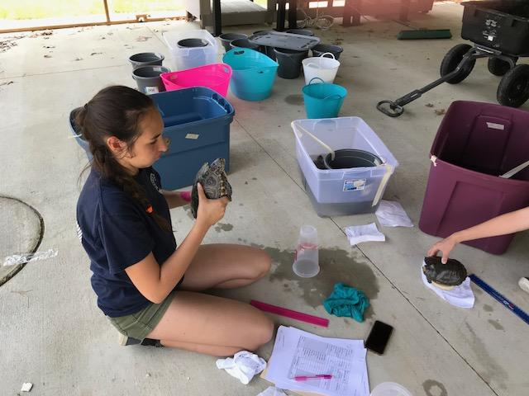
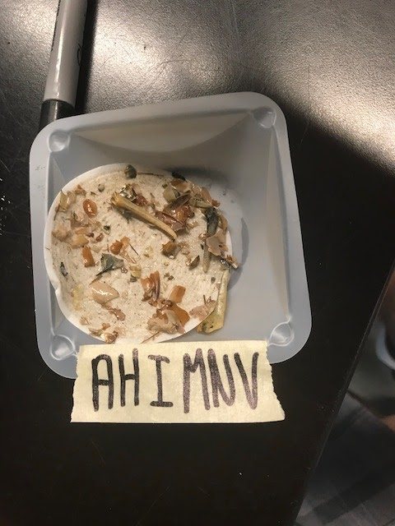
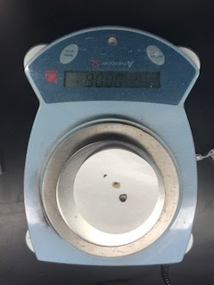
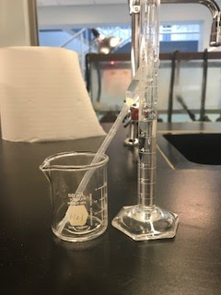
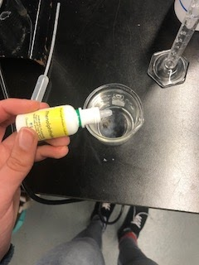
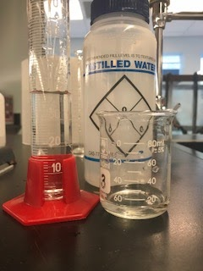
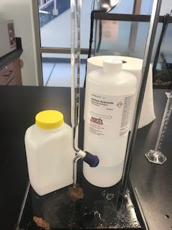
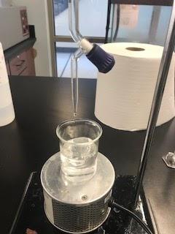
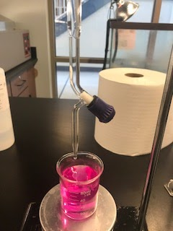
Calcium presence based on life stages and dietary habits of Malaclemys terrapin
Belle Weimer
Marine Academy of Technology and Environmental Science Manahawkin, NJ
Objective
Abstract
To determine dietary changes in Diamondback terrapins based on calcium presence at different life stages.
As the growth cycle of diamondback terrapins progress, the percent of calcium in a terrapin carapaces remain the same if not affected by other factors such as organ disease, growth defects, and varied diet. Due to this and the fact that terrapins are keystone species, it can be hypothesized that by comparing the percentage of calcium in the terrapin’s carapace, at multiple life stages, possible dietary changes can be discerned. In order to test this hypothesis, carapace samples were collected over summer and fall 2017 from terrapins captured along Great Bay Blvd in Tuckerton, NJ. As an addition to this study dietary samples were also collected summer 2018, from the same location as well as from Cedar Run Dock Road in Manahawkin, NJ, through a non-invasive purge of their systems using freshwater. ANOVA tests were used to determine the significance of calcium levels at different life stages. The results from the tests run showed that the adults and juvenile and the adult and egg sample groups were significantly different. Results from the testing displayed a significant difference between adult terrapins, and juveniles and eggs. It was also found that, once in the adult phase, diets of terrapins varied greatly across locations.
Discussion
Average amounts of calcium in adult and juvenile Terrapin carapaces and eggs ranged from 0.0080161g to 0.008366g, from 0.003209917g to 0.003350023g, and from 0.001286g to 0.001299g respectively (Figure 4).
Variances in the amount of calcium present in the adults, juveniles, and eggs were calculated and found to be 5.59053099432829E-09g, 1.12990296373887E-06g, and 2.20326746771922E-07 respectively (Figure 5 ).
ANOVA: single factor testing determined that there was no significant difference between calcium levels in the juvenile terrapins and eggs. It was also found that there was a significant difference between the adult and juvenile and the adult and egg sample groups (figure 4 ).
Calcium levels in the terrapins’ carapaces are fixed as juveniles and eggs and then slowly increase until maturity is reached around 2190 days (Park 2000).
Cedar Run dietary analysis showed mainly crustaceans, mollusks, and algae.
Great Bay Blvd dietary analysis showed mainly eggs, fish, crustaceans, mollusks, and algae.
Findings suggest a dietary change between the nutrients in the fetal and juvenile stages, and adulthood but not between fetal and juvenile stages.
A.
B.
C.
D.
Figure 3. A,B) Images of various sites where samples were collected on Great Bay Boulevard, Little Egg Harbor Township, New Jersey, during the summer of 2017. C,D) Various sample sites on Cedar Run Dock Rd, Manahawkin, NJ, during summer 2018.
Procedure
Study Site
Statistical Analysis
Real-World Application
20 adult and juvenile samples were collected as well as 8 egg samples.
Each sample was placed in a freezer to ensure they had not been altered or affected in any way that would induce error until testing.
Samples from juveniles were collected from deceased hatchlings as well as from notching process.
Samples from adult terrapins were collected by obtaining scute samples off of the carapace.
Dietary samples were collected through a noninvasive 24 hour freshwater purge and were analyzed using a vacuum filter and dissecting scope.
Samples were collected from Great Bay Boulevard in Little Egg Township, New Jersey and Cedar Run Doc Road in Manahawkin, NJ.
Testing was completed in school research lab in Manahawkin, NJ.
An ANOVA: single factor test was run on the data as a nonparametric test to determine significance.
Average amounts of grams of calcium present in the adult, juvenile, and egg sample groups were compared using a bar graph and 5% error.
Variances in grams of calcium present in the adult, juvenile, and egg sample groups were compared using a bar graph.
Diamondback Terrapins are an indicator species in the ecosystem meaning they can be monitored in order to determine if and when a pollutant enters the environment.
They can be used to detect P.O.Ps (persistent organic pollutants) if they are present.
These traits as well as the their role as keystone species makes the monitoring and care of these reptiles very important.
The data gained in this study could be used to monitor their population and to gain more information about them.
Dietary data can give a better understanding of how habits of terrapins of different locations can vary.
Table 1. Data collected for each of the varying age groups after calculations to determine amount of calcium present in carapace sample.
Figure 1. Samples were collected on Great Bay Boulevard and Cedar Run Dock Rd, summers of 2018 and 2019.
Adult | Juvenile | Egg
0.0080934 | 0.003240849 | 0.001298
0.0080782 | 0.003234784 | 0.001295
0.008101 | 0.003243882 | 0.001299
0.0080782 | 0.003234784 | 0.001295
0.0080934 | 0.003240849 | 0.001298
0.0080934 | 0.003240849 | 0.001298
0.0080192 | 0.003211129 | 0.001286
0.0080434 | 0.003220834 | 0.00129
0.0081085 | 0.003246914
0.0081085 | 0.003246914
0.0081918 | 0.003280273
0.008366 | 0.003350023
0.008154 | 0.00326511
0.0081555 | 0.003265716
0.0080782 | 0.003234784
0.0081085 | 0.003246914
0.0080934 | 0.003240849
0.0081767 | 0.003274208
0.0081206 | 0.003251767
0.0080161 | 0.003209917
C.
Figure 4. A comparison displaying the amounts of calcium present in the sample data collected. Error bars display standard error of 5%. A significant difference is shown here between the adult and juvenile and adult and egg samples. Juvenile and egg samples did not display a significant difference.
Figure 5. A Comparison between the variances determined for each sample group. Variance for egg sample group was shown to be 2.14E-11 although not visible on the chart. A sample size of 20 was used for the adult and juvenile groups and a sample size of 8 was used for the egg group.
Figure 2. Process through which persistent organic pollutants enter, remain, and biomagnify through the environment.
Figure 11. Top) Juvenile Diamondback Terrapin. Below) Adult Northern Diamondback Terrapin with eggs
Introduction
Conclusion
Malaclemys terrapin terrapin – Northern Diamondback Terrapin
Efficient indicator species of POPs (persistant organic pollutants) (figure 2) in their ecosystem (Basile et al. 2011).
Protected in some states.
Comsumes small crustaceans, fish, and other small invertebrates (Park 2000).
Calcium - responsible for shell strength and health
Calcium deficiencies can cause hatchling carapaces to be weak and cause them to be easier prey.
Calcium levels are mainly determined by dietary habits and nutritional intake.
Low calcium can also cause a terrapin to become lethargic or egg bound (Hopson 1999).
Titration – process by which indicators and used to complete a quantitative chemical analysis to determine the concentration of an unknown substance.
A base can be added to an acid in order reach a solution’s equivalence point where acid and base measurements are equal (Titration 2018) (figure 8).
This study is intended to analyze the change in calcium through a Diamondback terrapin’s life stages.
It hypothesized that the data collected will indicate dietary changes through a terrapins lifecycle.
Based on data collected the amount of calcium in a juvenile terrapin’s carapace remains approximately the same and then increases dramatically until adulthood when it evens out again.
In the future, a larger sample size could be benefited from.
It may also be of interest to compare calcium to age, size, and that of their food sources.
Figure 6 . Adult terrapin carapace and scutes.
Figure 7. Adult female terrapin nesting.
Figure 8 . Female being examined at Jaques Costeau.
Figure 9 . Example of purge sample after filtration..
Acknowledgements
I would like to express my thanks to my advisors for providing me with the materials needed to complete this study and for assisting me in the writing and creation of this poster. I would also like to acknowledge the many students of the 2018 MATES research class for assisting me in completing the necessary lab procedures. A third and final group I would like to thank are the Great Bay Blvd. volunteers who helped me to collect the samples I did.
A.
B.
C.
D.
E.
F.
G.
References
Figure 10. Back-titration procedure. A) A sample being massed on a scale. B) 6ml of 1 molar hydrochloric acid being measured to add to sample. C) 2 drops of phenophaelin being added to sample and HCl mixture. D) 40ml of distilled water is measured and added to sample, HCl, and phenophaelin. E) 25ml of .75molar sodium hydroxide added to titrator. F) Beginning of titration process. G) End of titration process.
Basile, E. R., Avery, H. W., Bien, W. F., & Keller, J. M. (2011). Diamondback terrapins as indicator species of persistent organic pollutants: Using Barnegat Bay, New Jersey as a case study. Chemosphere, 83(2), 208-209. Retrieved February 20, 2018.
Mary Hopson. (1999). Metabolic Bone Disease "Soft-shell syndrome". Retrieved February 20, 2018, from https://www.turtlepuddle.org/health/mbd.html
Park, I. 2000. "Malaclemys terrapin" (On-line), Animal Diversity Web. Accessed March 14, 2018
Titration. (2018). Retrieved February 20, 2018, from https://www.britannica.com/science/titration

